Slide 1
Queen Kong
Date:
LO: to understand the context of the poem Queen Kong
STARTER:
Look at the film stills (1933, 1976 & 2005). Describe what you see.
What are the connotations?
What do you think both characters represent?
What is the implicit message being given?
Notes:
These are on the next slide. Or you could print them out if you prefer.

Slide 2
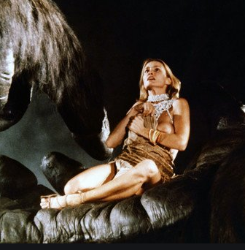
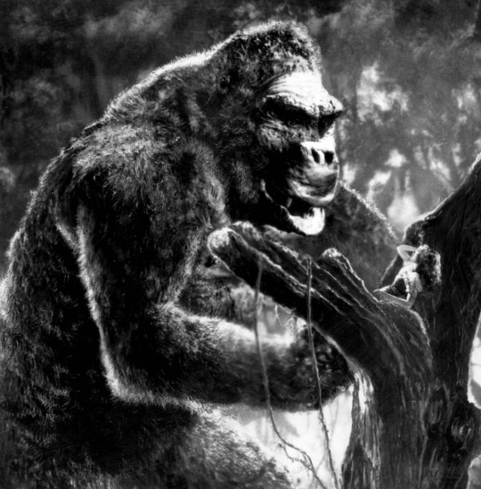
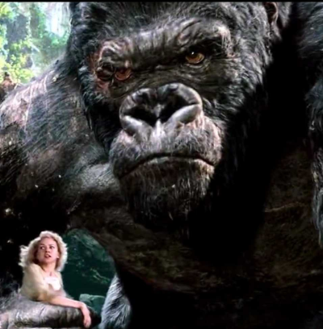
What do you see?
Can you comment on stereotypes and gender roles?
What role do movies play in society?
How does this link to what you know about Hollywood?
What are the connotations?
What do you think both characters represent?
What is the implicit message being given?
Symbolism?
Notes:
Movies = escapism & fantasy / reinforcing gender roles / socialises us on how to behave/act / we are able to see Ann Farrow through the male gaze
Object of desire
King Kong is destroying American society – link to Depression for 1930s version. Fear of it being destroyed combined with vicarious pleasure when it was.
Outdoors = masculine sphere
Racist overtones 1930s great migration – many black people migrating from the South to Northern cities
Masculinity
Femininity
Black masculinity
Jungle vs city
Strength & machismo
Traditional manliness is the base of romance - implied

Slide 3
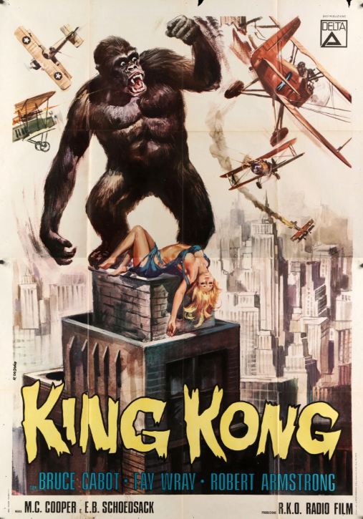
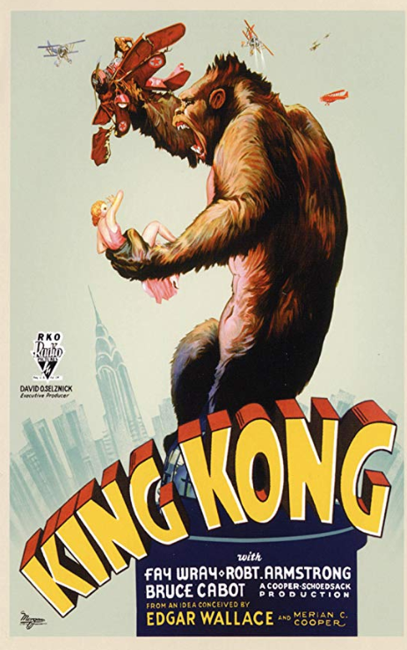
These are the 1933 film posters from different countries.
What do you see?
Can you comment on stereotypes and gender roles?

Slide 4
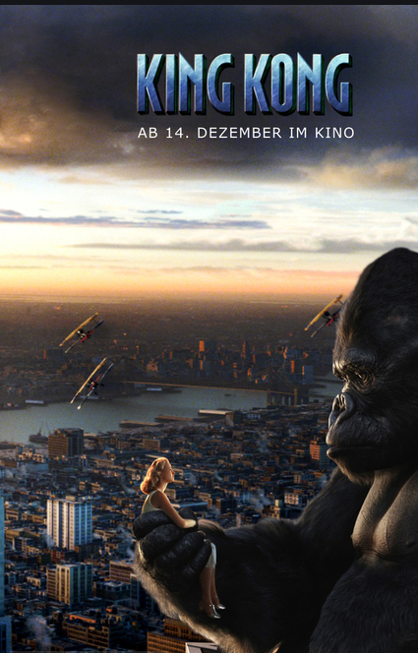
These are the 2005 film posters from different countries.
What do you see?
Can you comment on stereotypes and gender roles?
Are these different to the 1933 posters?

Slide 5
1. Watch in groups and discuss. Make notes as you do so.
Clip 1
Clip 2
Clip 3
Clip 4
Use the Cornell method!
2. Think about why Duffy reversed these roles in her poem.
Notes:
These are clips from the 1933 and 1976 versions of the film. They show the powerful role of King Kong and the submissive / victim role of Ann Darrow.
If pupils have access to laptops or phones you could share the links and let them go through the clips at their own pace.

Slide 6
How is each presented in the film versions? Make notes.
King Kong
Can you use the key terminology sheets to help you develop your interpretation?
7 minutes
Ann Darrow

Slide 7
Queen Kong
Date:
LO: to understand how to analyse the poem Queen Kong and interpret meaning
STARTER:
Finish the sentences –
My understanding of the character of King Kong is….
My understanding of the character of Ann Darrow is….
Even though King Kong is a gorilla….

Slide 8
In pairs, read the poem. Think about how ideas/roles have been subverted?
Individual task
How do you respond to this version? What is your opinion?
Why?
Task: write a 200 word response.
15 minutes
20 minutes

Slide 9
Go through the poem and highlight:
WHAT is shown?
Role reversals
Vulnerability
Physical contrasts
Possessiveness
Passivity
Love & sex
Primitive nature
Once you have done this, HOW is this shown?
Analyse techniques.
Use the guide sheets to help you.
Extension:
WHY is it shown this way?
20 minutes

Slide 10
Next lesson we will look at Mrs Beast. The original story is by Jeanne-Marie Leprince de Beaumont and was written in 1756
Homework
Due: ________
You can either read the story here or listen to it here.
Make notes on the key aspects of the story.

Slide 11
Thank you for downloading this resource. For the full scheme of work, please click here.
Please visit my website for more KS4 and KS5 resources.
You can also follow me on Instagram and find me on Facebook or twitter.

