Slide 1
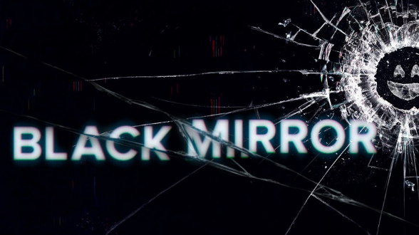
TV Series: Black Mirror
Date:
Focus for today:
To understand the themes and ideas expressed in the TV series.
To understand the show’s creator in more detail.

Slide 2
Overview
Black Mirror. Black Mirror is a British science fiction anthology television series created by Charlie Brooker. He and Annabel Jones serve as the programme's showrunners. It examines modern society, particularly with regard to the unanticipated consequences of new technologies.
An anthology series exploring a twisted, high-tech world where humanity's greatest innovations and darkest instincts collide.
The series was originally commissioned by Channel 4 in the United Kingdom and premiered in December 2011. A second series ran during February 2013. In September 2015, Netflix purchased the programme, commissioning a series of 12 episodes later divided into two series of six episodes.The first of these series was released on Netflix worldwide as the overall third series on 21 October 2016. The fourth series was released on 29 December 2017. A fifth series consisting of three episodes was released on 5 June 2019.

Slide 3
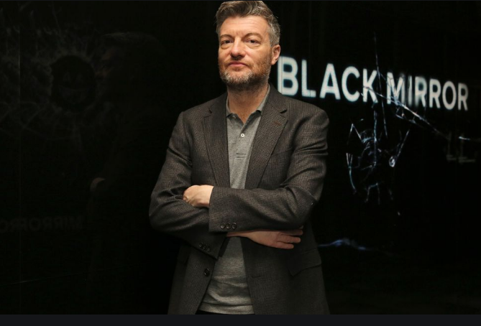
Research Charlie Brooker
25 minutes
Who is he?
Where does his inspiration for Black Mirror come from?
What has he said about his creation?
Which global issues can you already identify?
Notes:
Pupils need laptops or access to computers. You could also set this as a homework task so they come to lesson with this information already.

Slide 4
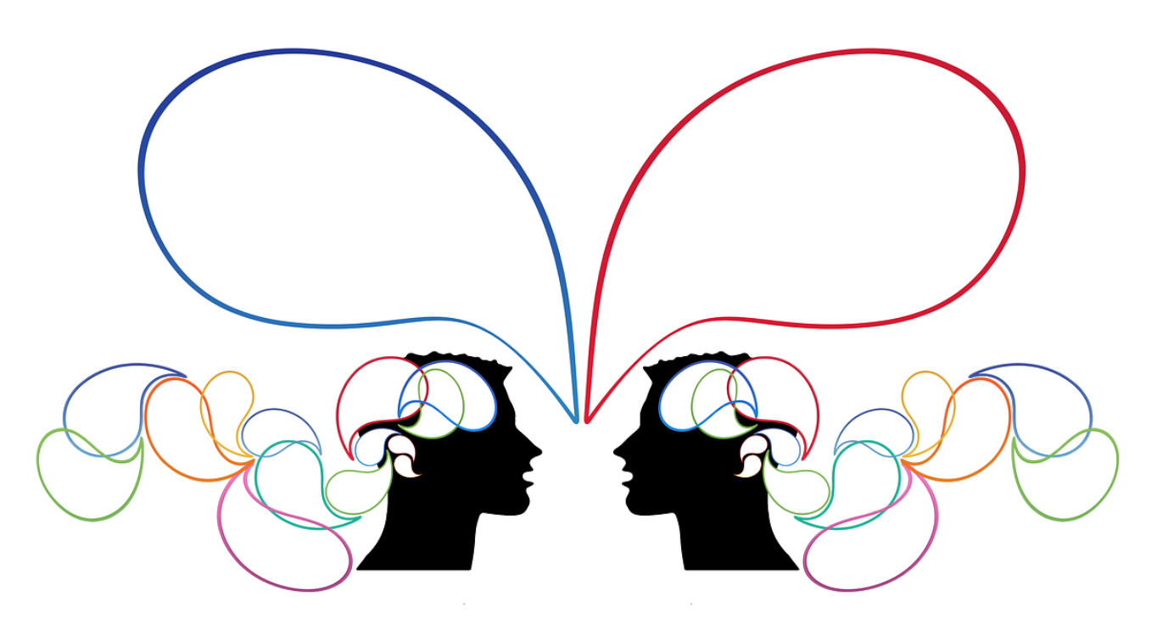
Class discussion
This will help you with writer intention, purpose and message later on.
Feedback on what you have found out.
Thinking question: Why do you think a TV show is a good way of expressing the ideas Brooker is interested in showing?
Are there any similarities between Brooker and Orwell?
Notes:
Pupils need laptops or access to computers. You could also set this as a homework task so they come to lesson with this information already.

Slide 5
TV Series: Black Mirror
Date:
Focus for today:
To understand how to analyse a multimodal media text.
Thinking question:
How much do we use social media today?
To what extent are we controlled by this?
Notes:
This will take 2-3 lessons. The TV show is available on Netflix.

Slide 6
For the purpose of this practice, one episode will constitute one BoW.
What must you consider as you watch the episode?
What are the ideas that the creators are trying to get across?
How do they do this?
How do you analyse a TV programme?

Slide 7
How to analyse a TV programme
How do all of these add/create meaning?
Genre
Plot
Characters / characterization
Point of view
Conflict: internal and external
Key themes
Setting
Key events
How the story is put together – sequencing (linear, non linear, flashbacks)
Multi strand (focused on several characters) or single strand narrative (focused on one main characters)
Realistic and non- realistic narrative
Tone
How does it make you feel?
Symbols/motifs
Cinematic effects:
Cinematography: Camera angles; framing etc
Mise en scene: The arrangement of everything that appears in the framing – actors, lighting, décor, props, costume – is called mise-en-scène, a French term that means “placing on stage.”
Music
Lighting
Sound effects
Dialogue
Pace
Editing
Costume
Special effects
Notes:
I printed this off for pupils so they could see it as they watched the show. I also paused the show at key moments and asked pupils to describe what was happening; what they saw etc.

Slide 8
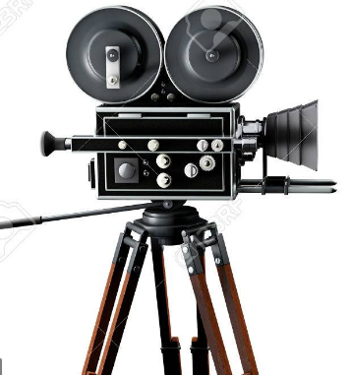
Camera angles and shots
The four basic shots used in films are:
a close-up – a very close shot where the camera lens focuses on some detail or the actor’s face.
medium shot – a shot where the camera lens picks up some background or upper half of the actor.
full shot – a shot where the camera lens has full view of the actor.
long shot – shot taken at a distance from an object.
What camera shots can you identify in the film? How are they used?
A camera angle is how the camera is tilted while filming.
straight-on angle – The camera is at the same height as the object.
high angle – The camera is filming from above the object.
low angle – The camera is looking up at the object.
oblique angle – The camera is tilted sideways.

Slide 9
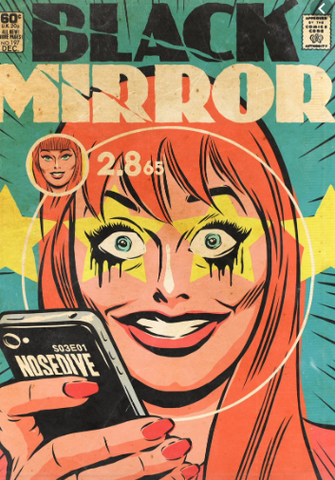
We will watch the episode once and then you will go back and decide on a key scene if you choose this as your non-literary BoW
Why is the episode called Nosedive?
Make notes on the sheet as you watch.

Slide 10
‘Black Mirror’ analysis sheet: Nosedive
Character/s | Themes | Conflict | Plot | Significant scenes- analysis | Links to 1984
Notes:
I printed this out on A3 paper but also gave it to pupils electronically so they could type straight into it.

Slide 11
Thank you for downloading this resource; I hope it is useful! You can find the full SoW on my website.
If you would like more free and paid resources, please visit my website: www.msduckworthsclassroom.com
You can also follow me on Instagram and find me on Facebook or twitter.

