Slide 1
The Handmaid’s tale

Slide 2
Analysing characters and their relationships
Date:
LO:
To understand how to track and analyse characters
Do now:
Write down 3 words to describe how you feel about the following characters…
Moira
Offred
Aunt Lydia
Serena Joy
Notes:
Pupils to feedback and explain their decisions

Slide 3
Whose voices do we hear in the novel?
Brainstorm ideas in pairs
How would you define their ‘voice’?
What do they add to the narrative? What role do they play?
How would you describe them?
How do we view these characters?
Challenge: consider Offred as an unreliable narrator. Does it matter that Offred is the vehicle through which we hear these voices?
Notes:
Pupils to feedback once they have discussed in detail

Slide 4
Character list
Offred – narrator / protagonist
Commander
Serena Joy
Moira
Luke
Nick
We will work on these today
Minor characters:
Offred’s mother
Offred’s daughter
Aunt Lydia
Ofglen
Janine
Professor Pieixoto

Slide 5
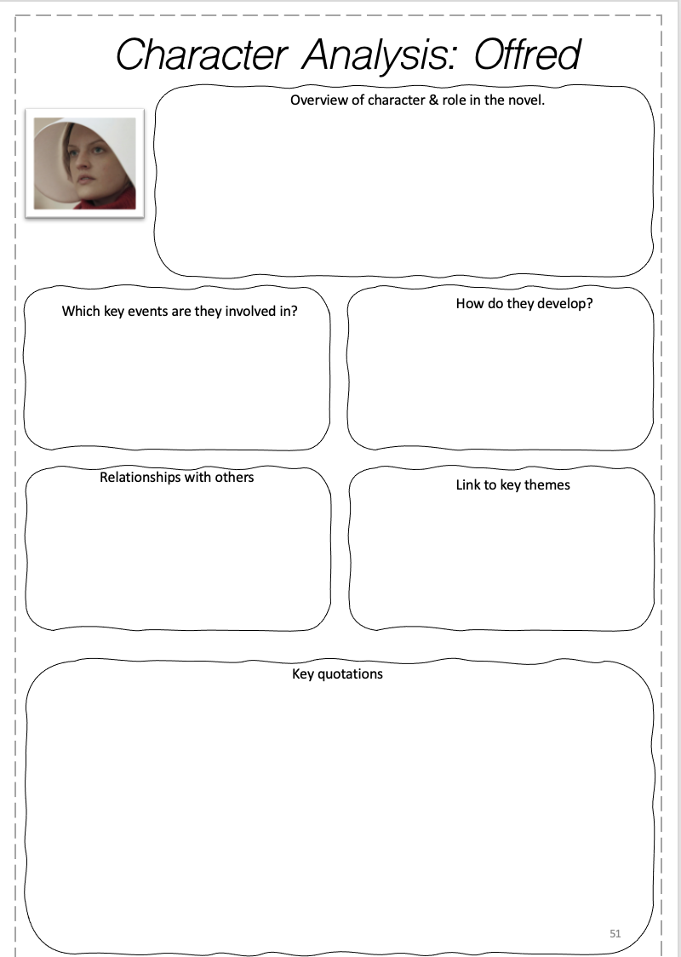
Each group will be responsible for analysing a character

Slide 6
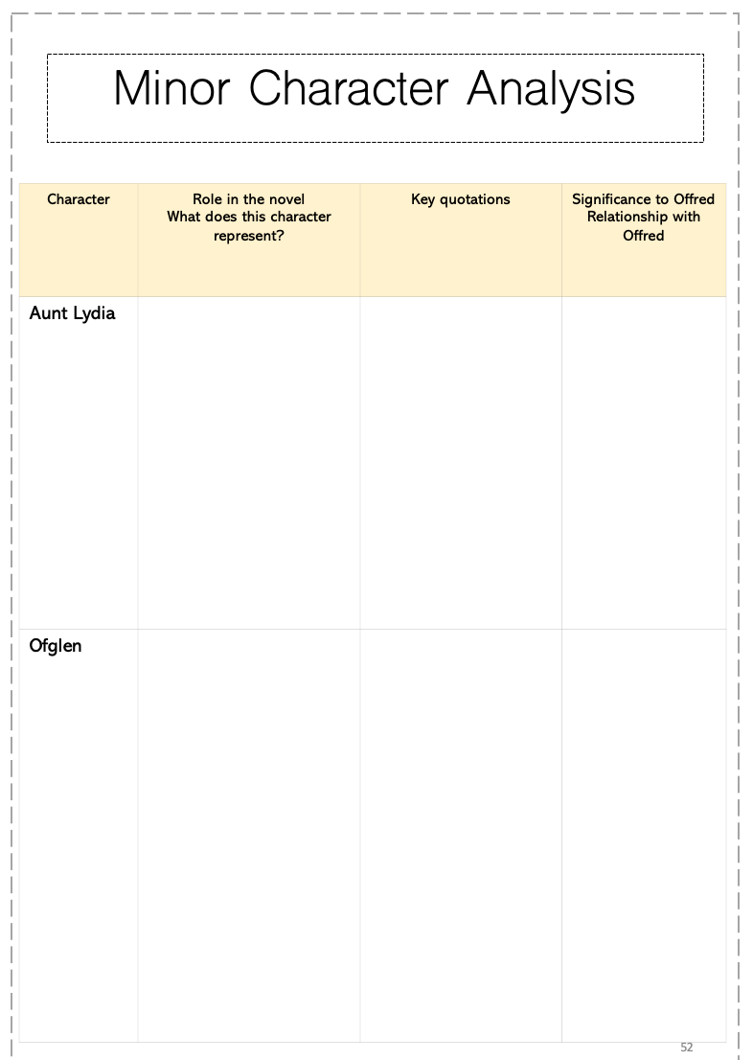
Homework – fill in the Minor characters pages
Minor characters:
Offred’s mother
Offred’s daughter
Aunt Lydia
Ofglen
Janine
Professor Pieixoto

Slide 7
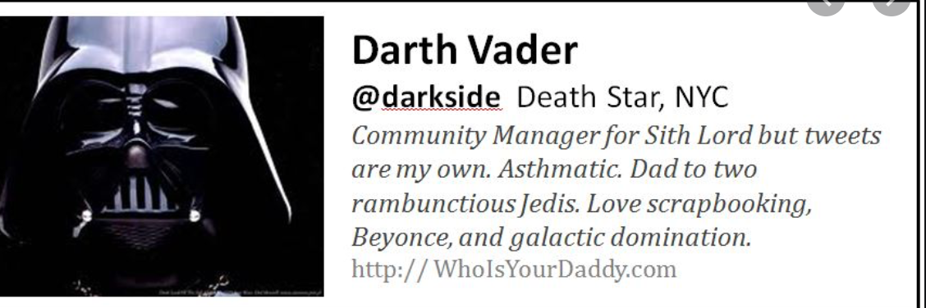
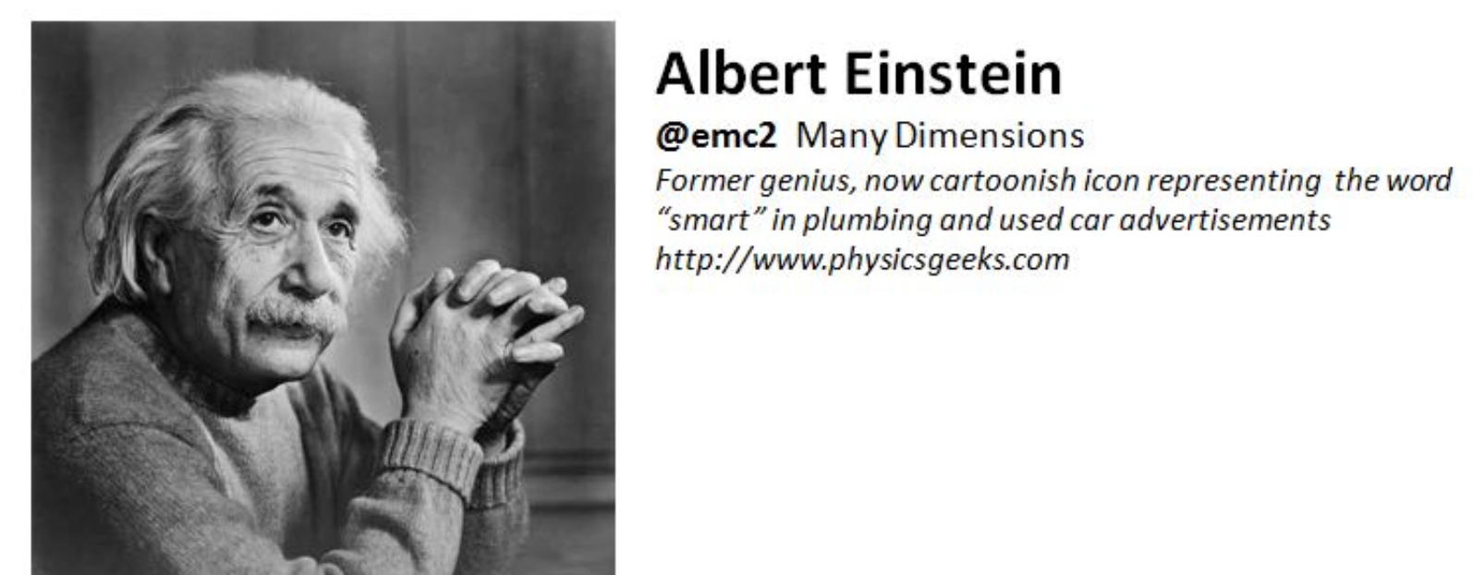
Drama performance
Date:
LO:
To understand how to plan a drama performance based on the characters in the novel
Do now:
Write a twitter bio for any of the following characters
Moira
Offred
Aunt Lydia
Serena Joy
The Commander
Janine
Notes:
Can cut this out due to time or use it as revision later on
Pupils to feedback on starter

Slide 8
We will do a drama activity on the characters….
Everyone will be given a different character.
Imagine that your character is talking about their relationships with the others as well as their lives in Gilead.
You can choose to present this as a monologue or pair up with someone else and produce a therapist/patient role play.
Make notes in your booklet.
You will present your piece on…..
You will all add to your character notes based on what you learn from others during their performances.
Offred
Commander
Serena Joy
Moira
Nick
Janine
Aunt Lydia
Notes:
Add the date for the performances
You can add more of the minor characters if you have a large class
Either let the pupils choose their character or assign them yourself.

Slide 9
You have the rest of the lesson to plan your piece
Use the character notes you made to help you plan.
What should our success criteria be for this task?

Slide 10
Analysing characters and their relationships: Performances
Date:
LO:
To understand how to track and analyse characters
Notes:
Pupils to feedback and explain their decisions

Slide 11
As we watch the different performances…
Make notes on your sheet if you learn anything new about the character.
Think of at least 1 question to ask each ‘character’.

Slide 12
I hope you enjoy the free resource! For more free KS4 and KS5 resources, visit my website here.
The full scheme of work for the CIE International A-Level can be found here.
The full scheme of work for the Edexcel A-Level can be found here.
The full scheme of work for IBDP English A: L&L can be found here.
You can also follow me on Instagram and find me on Facebook or twitter.

