Slide 1
AoE Cards

Slide 2
Readers, writers, texts
Time and space
Intertextuality: connecting texts

Slide 3
AoE Question Cards

Slide 4
Area of exploration—intertextuality: connecting texts (AOE3)
How do texts adhere to and deviate from conventions associated with literary forms or text types?
How do conventions and systems of reference evolve over time?
In what ways can diverse texts share points of similarity?
How valid is the notion of a classic text?
How can texts offer multiple perspectives of a single issue, topic or theme?
In what ways can comparison and interpretation be transformative?
Area of exploration—intertextuality: connecting texts (AOE3)
How do texts adhere to and deviate from conventions associated with literary forms or text types?
How do conventions and systems of reference evolve over time?
In what ways can diverse texts share points of similarity?
How valid is the notion of a classic text?
How can texts offer multiple perspectives of a single issue, topic or theme?
In what ways can comparison and interpretation be transformative?

Slide 5
Area of exploration—readers, writers and texts (AOE1)
Why and how do we study language and literature?
How are we affected by texts in various ways?
In what ways is meaning constructed, negotiated, expressed and interpreted?
How does language use vary amongst text types and amongst literary forms?
How does the structure or style of a text affect meaning?
How do texts offer insights and challenges?
Area of exploration—time and space (AOE2)
How important is cultural or historical context to the production and reception of a text?
How do we approach texts from different times and cultures to our own?
To what extent do texts offer insight into another culture?
How does the meaning and impact of a text change over time?
How do texts reflect, represent or form a part of cultural practices?
How does language represent social distinctions and identities?
Area of exploration—time and space (AOE2)
How important is cultural or historical context to the production and reception of a text?
How do we approach texts from different times and cultures to our own?
To what extent do texts offer insight into another culture?
How does the meaning and impact of a text change over time?
How do texts reflect, represent or form a part of cultural practices?
How does language represent social distinctions and identities?
Area of exploration—readers, writers and texts (AOE1)
Why and how do we study language and literature?
How are we affected by texts in various ways?
In what ways is meaning constructed, negotiated, expressed and interpreted?
How does language use vary amongst text types and amongst literary forms?
How does the structure or style of a text affect meaning?
How do texts offer insights and challenges?

Slide 6
Key Concepts Cards

Slide 7
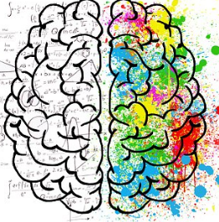
Identity
Culture
Creativity
Communication

Slide 8
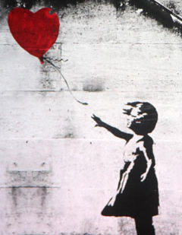
Perspective
Transformation
Representation

Slide 9
Global Issues Cards

Slide 10
Science, technology and the environment
Beliefs, values and education
Culture, identity and community
Art, creativity and the imagination

Slide 11
Politics, power and justice

