Slide 1
Social Class
Learning Question: How does Dickens present social class?
Date:
Do now: brain dump…
What do you know about Pip?
Notes:
This lesson may run across 2 – 3 periods.

Slide 2
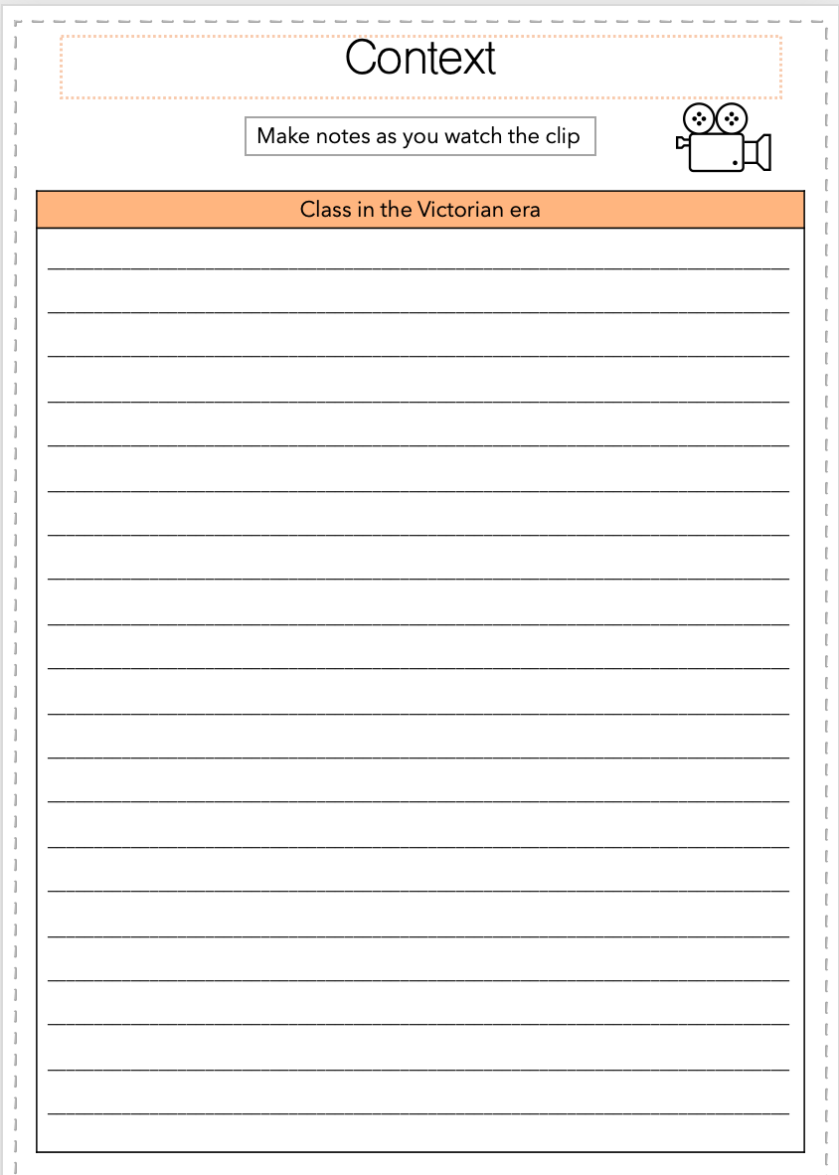
Watch the clip – what do you learn about class?
Page 19 in the booklet
Make notes
Notes:
https://www.youtube.com/watch?v=J9M2EAI0OsE

Slide 3
How is class referenced in Chapter 4?
What do you think Dickens’ intention is here? How do you think he feels about the Victorian class structure. Think back to what you know about Dickens’ background.
‘ “Take notice, guard,—he tried to murder me,” were his first words.
“Tried to murder him?” said my convict, disdainfully. “Try, and not do it? I took him, and giv’ him up; that’s what I done. I not only prevented him getting off the marshes, but I dragged him here,—dragged him this far on his way back. He’s a gentleman, if you please, this villain. Now, the Hulks has got its gentleman again, through me. Murder him? Worth my while, too, to murder him, when I could do worse and drag him back!” ’
What does it mean to be a gentleman?
Why does Magwitch focus on this? What does it imply about the treatment the other convict may have had or will have due to his status?
How is Magwitch’s class reflected in his speech?
Take it further: is anything foreshadowed here?
Thinking question:
Why does Pip refer to Magwitch as ‘my’ convict? What does this show about their relationship already?

Slide 4
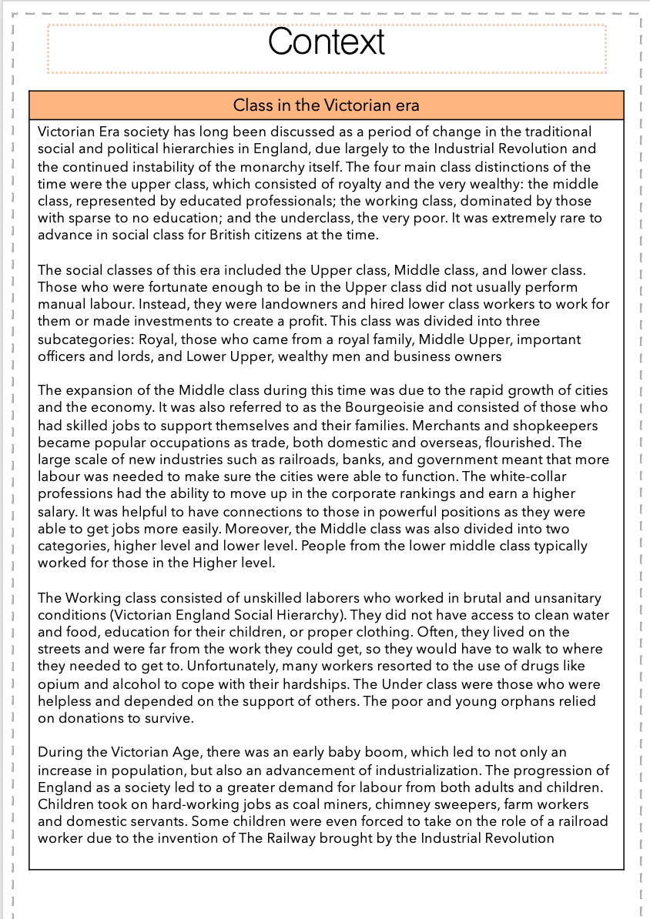
Context: the class system
‘families tended to be of the same classification that they were born into and kept their dedication to family owned businesses or trades’ Crossick
Task: read through the contextual notes and highlight anything important.
Join up with a partner once you have done this and condense the information into notes. This should be written in the notes section of the booklet.
New term
Social mobility – social mobility, movement of individuals, families, or groups through a system of social hierarchy.
As we read on, think about Dickens’ message about social mobility.
20 minutes

Slide 5
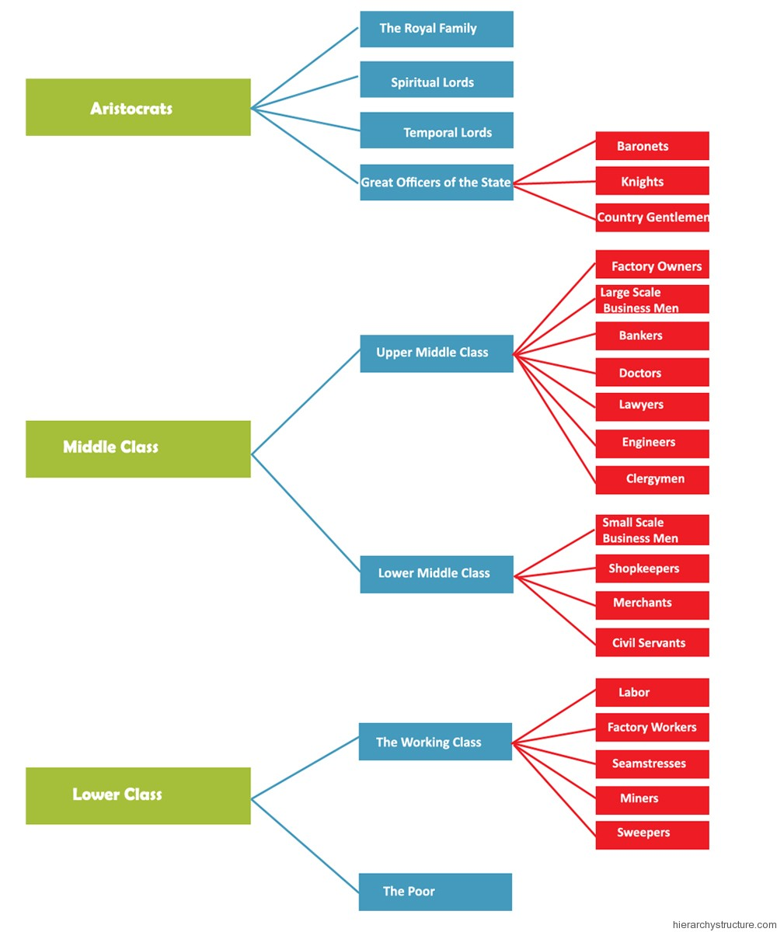
The Victorian Class System
Who goes where? Why?
The Gargerys
The convict
Mr Pumblechook
Miss Havisham
Thinking question:
Who do you think the reader responds to in a positive way? What class are they?

Slide 6
Social Class
Which classes have we seen so far? How are they presented? How is their class reflected in their actions, speech, appearance? Where do they live?
Lower Class | Poor working class | Middle Class | Upper Class
Convict | Joe Mrs. Joe Biddy Live in the village | Pumblechook Lives on the High Street | Miss Havisham Lives uptown
New term
Social mobility – social mobility, movement of individuals, families, or groups through a system of social hierarchy.
As we read on, think about Dickens’ message about social mobility.
Notes:
Class Discussion

Slide 7
As we read on, consider
Read Chapters 6-8
How can we see the two different versions of Pip?
How Pip views Joe.
How the educational system is presented.
What we learn about Biddy.
How Mr Pumblechook’s character is developed.
How the idea of Miss Havisham is introduced by the other characters.
How Satis House is described.
How Miss Havisham is presented.
The character of Estella and how she makes Pip feel.
How class is presented.
Information:
Pip, as a retrospective narrator, can control the telling of his story.
He has knowledge that his childhood self didn’t.
He can choose what to focus on.
There are two versions of Pip:
Adult Pip telling the story
Child Pip who is experiencing the events
Notes:
Reading to include chapter 8

Slide 8
Now we will spend some time analysing quotations
Do you remember how to analyse quotations?

Slide 9
Watch the video. What tips are you given for how to analyse techniques?
Notes:
The example given is a novel, however the process is the same regardless of the type of text. As you watch, ask pupils how they could apply this to ‘Othello’.
https://www.youtube.com/watch?v=D98_w9FUt2I

Slide 10
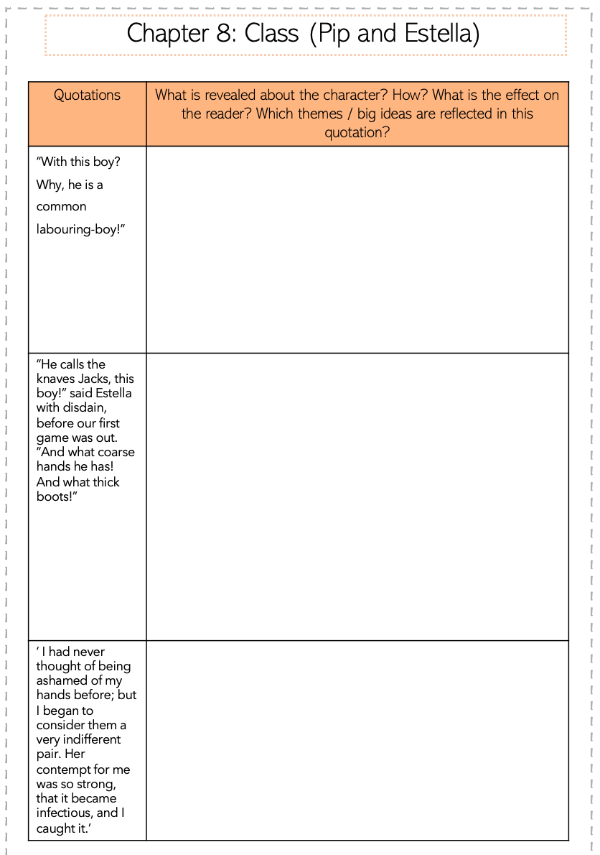
Social Class: Pip and Estella
How does Estella treat Pip? How does this reflect the Victorian Class system?
How does it affect the reader and how they view both characters?
Task: explain and analyse each quotation.
Think back to the learning questions and big ideas statements in your booklet – can these help you to develop your interpretation?
We will start by looking at my example on the next slide.
20 minutes
Notes:
There are 3 pages to complete. Teacher model on next slide

Slide 11
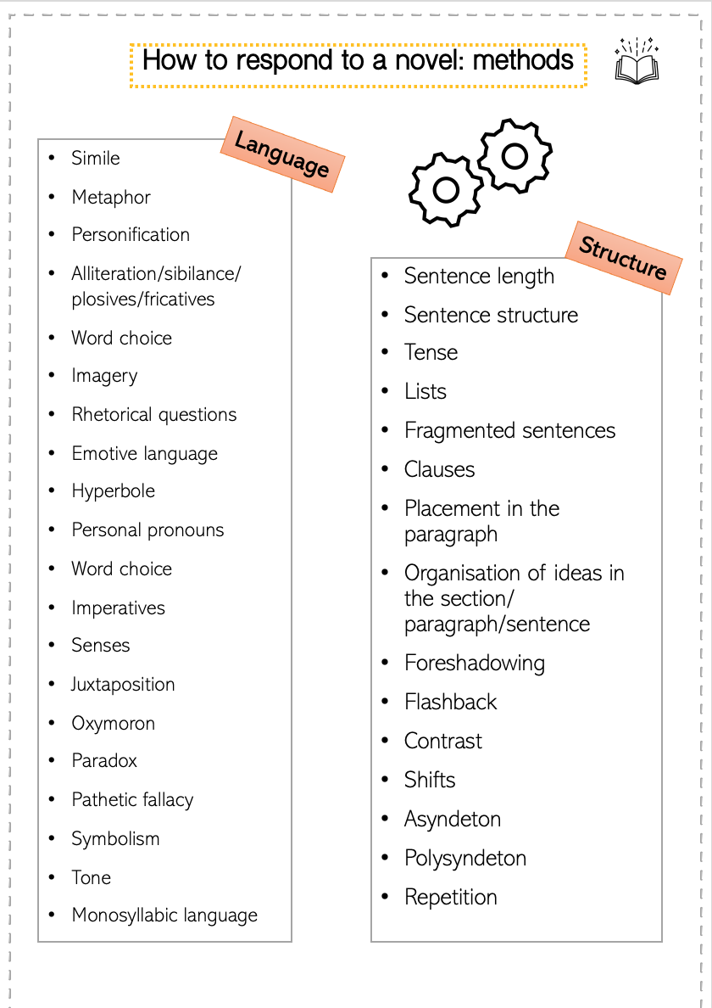
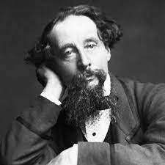
When analysing, we are looking at the choices made by the writer: AO3
I am the writer…why did I make the authorial choices I did?
Dive into the text and analyse the methods used!

Slide 12
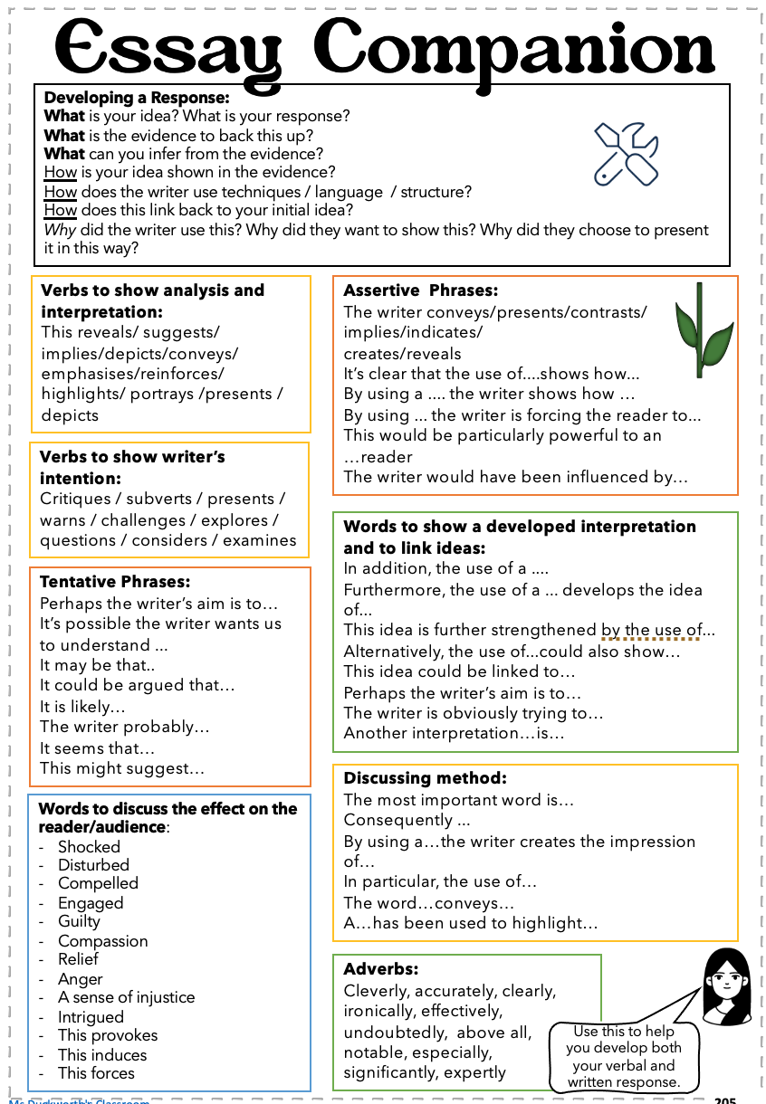
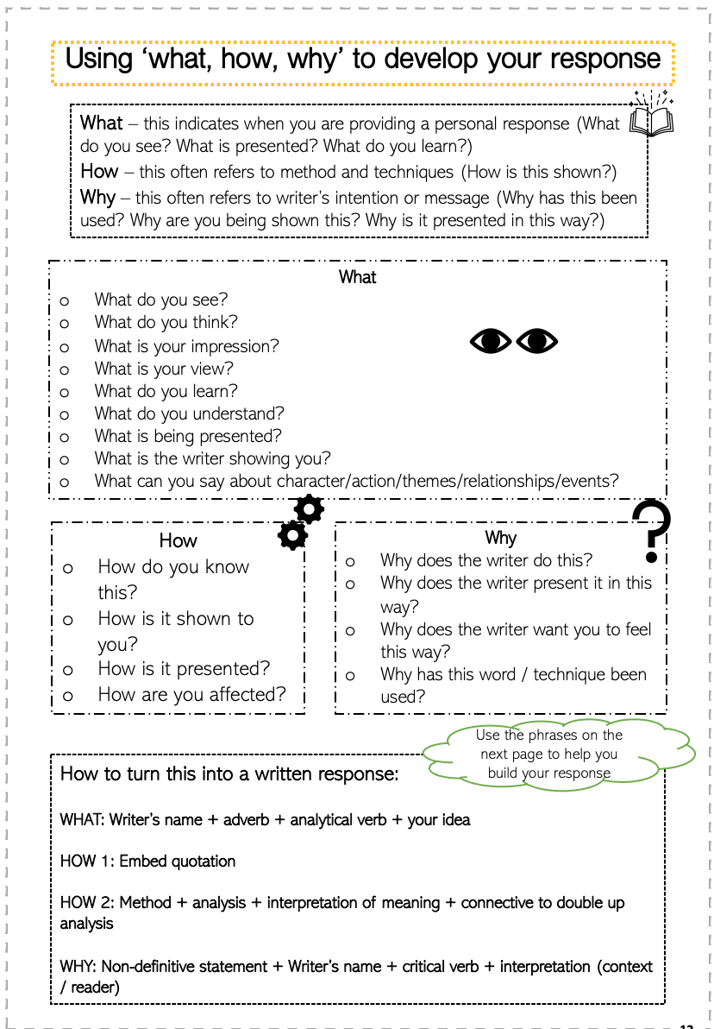
Use your booklet to help you

Slide 13
Social Class: Pip and Estella
Teacher model
Derogatory use of the word ‘boy’ rather than Pip’s name. Elevates her position.
Adverb shows her attitude towards Pip – she enjoys being cruel
‘ “Don’t be ridiculous, boy; I am not going in.” And scornfully walked away, and—what was worse—took the candle with her.’
Remember that we are looking for the layers of meaning. How is meaning built through the language and techniques?
She literally and metaphorically leaves him in the dark. Foreshadows her effect on his life – will she take something from him? Does he see her as the light due to his own low social status?

Slide 14
15 minutes
Write a summary of what you know about class in Victorian England
Success Criteria:
Full sentences
Facts
No opinion
Connectives to link ideas
Relevant information
Succinct and clear
Notes:
There is a page for this in the booklet

Slide 15
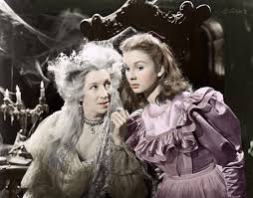
Final Task
What has the introduction of Miss Havisham and Estella added to the novel so far?

Slide 16
I hope you enjoy the resource! The full scheme of work can be found here.
You can also follow me on Instagram and find me on Facebook or twitter.
Notes:
https://www.msduckworthsclassroom.com/product-page/great-expectations-full-scheme-of-work-cie-igcse

