Slide 1
Analysing a Persuasive Speech
Date:
LO: To understand the success criteria for the assessment
To understand how to respond to the speech
STARTER: complete the rhetorical devices wordsearch!
Extension: can you remember what all of these are? If not, move around the room and find out from others.
Extension 2: choose one of the harder devices and write your own example.

Slide 2
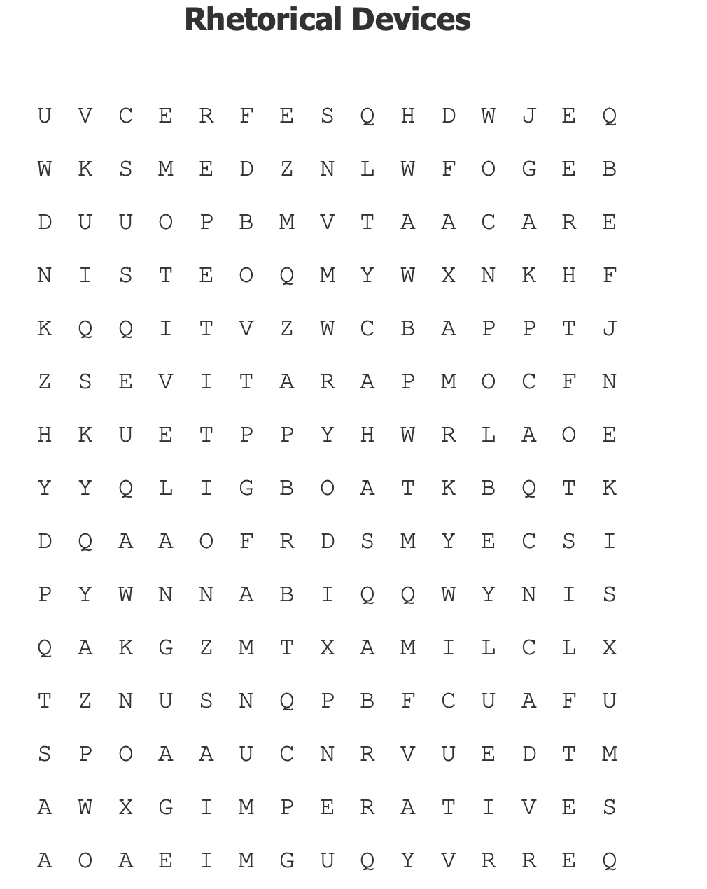

Slide 3
Your task
Over the past 3 weeks we have been looking at rhetoric and persuasive speeches.
You will now use all of your knowledge and skills to write an analysis of a new, unseen speech.
You will spend 3 lessons planning and one lesson to write up your essay.

Slide 4
What will you be assessed on? What do you think these mean?
AF4
Identify and comment on the structure and organisation of texts, including grammatical and presentational features at text level
AF5
Explain and comment on writers’ use of language, including grammatical and literary features at word and sentence level
AF7
Relate texts to their social, cultural and historical traditions

Slide 5
Essay question: how does Severn Cullis Suzuki use language to affect the audience?
You will be given a speech and you have 3 lessons to:
Read and listen to the speech and understand it. Identify the techniques
Explain the effect of the techniques.
Make a plan on the planning sheet
The following lesson you will write up your assessment. This will be on Monday and Tuesday.
Audio
Text
The girl who silenced the world for 5 minutes

Slide 6
First we will listen to the speech.
Audio
Make notes on:
What you notice about the speaker and why this is important.
Why she is speaking – what is the context.
The devices she uses in her speech and the effect.
How YOU feel.
How you think the intended audience felt.
Now share your ideas in groups of 3.
Can you fill in any gaps that you have?
Can you add any ideas to someone else’s notes?
Can you all work together to develop ideas or analyse techniques?

Slide 7
Plenary
Do you think that you could do something like Suzuki?
What do you think made her deliver this speech?
Extension: which part of her speech affected you the most? Why?

Slide 8
Writing an Effective Response
Date:
LO: To understand how to write an effective answer
Is this a good point for a PEEL about Emma Watson’s speech? Why? Why not?
In her speech on gender equality Emma Watson uses anaphora to show that her points are important.
Extension: improve it if you think it could be better.
Extension 2: continue the next few sentences. What should come next?

Slide 9
PEEL example
In groups, read the example and annotate for the following:
Evaluative words
Comment on technique
Different interpretations
Analysis of effect of technique
Quotes
Effect on audience
Link to purpose
Embedded quote
Specific point
In her speech on gender equality Emma Watson uses anaphora to emphasise how damaging gender expectations can be on young women. In order to reinforce the relationship she has already begun to build with her audience, Watson uses anaphora to elaborate on her own experience growing up. She repeats ‘When at’ to show how she experienced gender discrimination at different ages throughout her life and begins by saying, ‘When at 14 I started being sexualized by certain elements of the press.’ She then moves on to examples of how both her male and female friends were equally affected. This technique humanizes Watson and shows that even a film star can experience the same things as the rest of us. The anaphora moves her anecdote through the ages 14, 15 and 18 and this further reinforces how gender inequality is an ongoing issue for many. She skillfully ends the clauses that begin with ‘when’, by concluding ‘I decided I was a feminist’. Here Watson is implying that the only solution to such examples of inequality and discrimination is to become a feminist, it is almost a natural response. This assertive statement is a message to those watching her speech and could be considered advice to us all on how to accurately respond to gender inequality, discrimination and stereotypes, especially at a time when the word feminism (according to Watson) has ‘become an unpopular word’.

Slide 10
Practice PEEL: do this on a speech of your choice. It has to be one we have studied in this unit.
P – point which names a technique
E – quote
E – explanation of effect
L – link to: your point/the audience/context / purpose. Think about why they chose the technique and why it would be successful for that particular audience. Who are they? Does this effect how the speech is received?
Extension: link to historical significance. Why is this speech important?
Make your point as specific as possible. Pankhurst / Watson uses a ….to…
Watson uses this because she is addressing…
Pankhurst is speaking at a time when…

Slide 11
Make your own checklist for this assessment
What will you have to do in order to be successful?
What tips do you want to remember?
AF5
Explain and comment on writers’ use of language, including grammatical and literary features at word and sentence level
AF4
Identify and comment on the structure and organisation of texts, including grammatical and presentational features at text level
AF7
Relate texts to their social, cultural and historical traditions

Slide 12
Success Criteria
Must | Should | Could
Include a relevant point about the speech. Say something specific. Do not use the banned phrase! Identify a technique. Explain the effect of the technique by linking to TAP. Include a quote. | Analyse the language/word choice Analyse the effect of the technique – why was it used? Link to who the speaker is, does this affect the meaning of the technique or why it was used? Embed the quote. | Evaluate how successful the technique was in terms of audience and purpose. Discuss how a technique is built up. Comment on where in the speech the technique appears and why Link to the different audiences Use more than one quote per point.

Slide 13
Fill in the planning sheet
You can use this in the assessment.
Your ideas must be in note form; you cannot write up your essay in full.

Slide 14
Thank you for visiting Ms Duckworth’s Classroom! I hope you enjoy the free resource. Please feel free to let me know how you used them and if they were helpful. Also, you can find the full SoW in my website store.
You can also follow me on Instagram and find me on Facebook or twitter.

