Slide 1
Act 1 Scene 1
Date:
Learning question:
Why is Othello absent from Act 1 Scene 1?
Do now
Fill in the gaps
Roderigo is _______ Desdemona.
Roderigo ____ Iago so that he will help him win Desdemona.
Iago is _______Roderigo.
Iago seeks _____ for being overlooked in favour of _____.
Iago is __________ Cassio.
Notes:
Answers on the following slide. Pupils do not have to use the exact words as shown next – elicit ideas from them.

Slide 2
Where are we?
Last lesson we learned that:
Roderigo is in love with Desdemona.
Roderigo pays Iago so that he will help him win Desdemona.
Iago is exploiting Roderigo.
Iago seeks vengeance for being overlooked in favour of Cassio.
Iago is jealous of Cassio.

Slide 3
Big Ideas
We began to discuss these last lesson.
Now you have read the opening to Act 1 Scene 1, can you make any more guesses about the big ideas?
Have a quick discussion in pairs and be prepared to feedback.
Big ideas so far:
Othello as ‘other’ and outsider.
Jealousy can be powerful and damaging.
Notes:
We will add to this as more is read.
Ask pupils to discuss before you show them the 2nd box.

Slide 4
Prose and blank verse
Blank Verse refers to unrhymed iambic pentameter. Blank verse resembles prose in that the final words of the lines do not rhyme in any regular pattern (although an occasional rhyming couplet may be found). Unlike prose, there is a recognizable meter: most lines are in iambic pentameter, i.e. they consist of ten syllables alternating unstressed and stressed syllables (there may be some irregularities, such an occasional troche mixed in with the iambs or an extra unstressed syllable at the end of a line).
Blank verse can be used to:
Show the status of a character
Signify the importance or significance of speech
Reflect themes
Create connections/relationships between characters or to show difference
WHAT, HOW, WHY
Try and identify what kind of speech is used.
How is speech used to reveal something about a character, relationships or action?
Why is it used here? Why for this character?
OTHELLO: Was this fair paper, this most goodly book
Notes:
Talk through with pupils and ensure understanding

Slide 5
Prose and blank verse
Prose has characteristics that make it distinctly different from verse. They include:
Run-on lines
No rhyme or metric scheme (i.e. iambic pentameter)
The qualities of everyday language
On paper, you can easily spot dialogue written in prose because it appears as a block of text, unlike the strict line breaks that are a result of the rhythmic patterns of verse. When performed, prose sounds more like typical language—there are none of the musical qualities that come with verse.
Shakespeare may switch to prose for many different reasons:
Comedic effect
To show the status of a character
To reveal something about a character
To show the mental state of a character
To make the dialogue seem more realistic
To deviate from convention
To make a speech more poignant
WHAT, HOW, WHY
Try and identify what kind of speech is used.
How is speech used to reveal something about a character, relationships or action?
Why is it used here? Why for this character?

Slide 6
Prose and blank verse
WHAT, HOW, WHY
Try and identify what kind of speech is used.
How is speech used to reveal something about a character, relationships or action?
Why is it used here? Why for this character?
Shakespeare may alternate between these two in order to:
Change the mood or tone
Show a difference between characters
Show a change in one character
Highlight the mental or emotional state of a character
Change the levels of formality.

Slide 7
You will read the rest of Scene 1 in groups of 3
Read from:
RODERIGO
What a full fortune does the thick-lips owe, If he can carry't thus!
To the end of Scene 1
What are we expecting when Brabantio enters? Why?
How will each character act/speak?
Can you identify if it is prose or blank verse? How does this affect how you deliver the line?
Read this scene aloud and try your best to channel the emotions and status of each character!
Notes:
Walk around and listen to pupils’ interpretations. Pick some that can be performed in front of the rest of the class. This prompts a nice discussion on stagecraft, interpretation, characterisation and the audience.

Slide 8
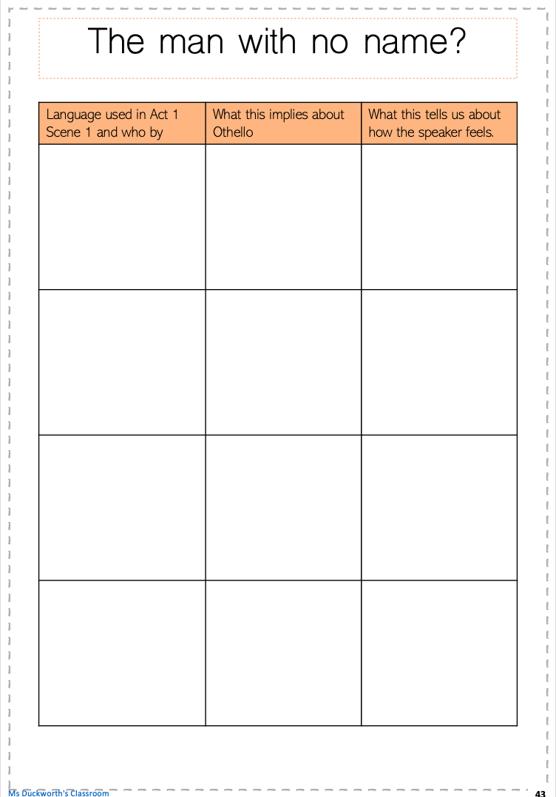
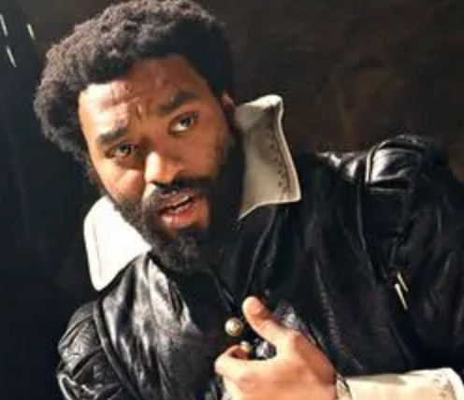
The man with no name?
Throughout Scene 1, no one has referred to Othello by his name.
In pairs, go back through Scene 1 and make a note of how each character has referred to Othello.
Think about the effect on the audience…
15 minutes
Notes:
You may wish to go through one example with pupils first e.g moor or barbary horse
Print out the worksheet

Slide 9
End of lesson review
Can you write a response to today’s learning question?
Or you can discuss with a partner.
Learning question:
Why is Othello absent from Act 1 Scene 1?
Notes:
Elicit responses from pupils. Remind pupils to think about stagecraft, methods and an audience.

Slide 10
Act 1 Scene 1: language analysis
Date:
Learning question:
How revealing is the language used in Act 1 Scene 1?
Do now
Explain in your own words, how each image is linked to what you know about the context of the play or what you have read so far.
1.
2.
3.
Notes:
Pupils to feedback – there may be various different interpretations.

Slide 11
Themes
Themes:
Prejudice
Jealousy
Honour
Love and hate
Relationships
Identity
Appearance vs reality
Deception & manipulation
Gender
Race
Which themes have we seen so far?
When?
Which characters reflect these themes?
5 minutes
Notes:
Quick pair or group discussion then feedback

Slide 12
Language analysis
We will be looking at the following:
Binary opposition: paired opposites and the understanding of something in relation to something else. e.g black and white
Religious imagery: using religious terminology to describe a character or action. The audience is forced to consider the connotations of the imagery.
Animal imagery: using imagery to imply or show a relationship between animals and humans. To suggest a human has animal-like qualities.
Try and use the key terms for today:
Other
Othering
Otherness
Notes:
Ensure pupils understand these terms and perhaps elicit some examples from them to ensure they can find relevant examples.

Slide 13
How can we analyse a quotation in depth?
1. Demeaning view of their relationship. Unequal power.
What is being described/presented?
How? Which techniques/devices have been used?
Why have these techniques/devices been used? Think about what you have said for number 1. What is the effect? How would an audience react? What is Shakespeare trying to show us? Can you link to context?
‘…an old black ram
Is tupping your white ewe’
2 – animal imagery
3 – Degrading. Reduces their relationship to something base. Makes Othello seem mindless.
2 – binary opposition (black/white)
3 – implies that Desdemona is passive. This use of black and white also positions Desdemona as pure and innocent and Othello as someone who has despoiled her.
The audience link blackness to barbarism - stereotypes.
2 – language – ‘your’
3 – Suggests ownership. Links to patriarchy. This is also skilful manipulation from Iago as it will be emotive for Brabantio.
Notes:
Go through this example with pupils so they can see how to layer analysis and double up. Encourage them to try and say as much as possible about a quotation. This example is also included

Slide 14
Your task
In groups of 3, you will select and analyse several quotations from Act 1 Scene 1.
You must select quotations that:
Describe Othello
Show how others feel about Othello
Describe Desdemona
Show how others feel about Desdemona
20 minutes
Notes:
Go through the following slide before they begin and discuss the requirements and expectations for this task.
Pupils can feedback as a whole class.

Slide 15
Language, structure and form
What, how, why
Page 13 in the booklet
Language, Structure & Form
Animal imagery | Religious imagery | Juxtaposition | Simile
Metaphor | Alliteration | Blank verse | Prose
Rhyming verse | Binary opposition | Oxymoron | Syntax
Monosyllabic | Repetition | Contrasts | Allusions
Paradox | Rhetorical question | Pun | Consonance
Black and white imagery | Symbolism | Foreshadowing | Assonance
How to analyse technique/device:
What technique or device is used?
Why is it used?
What is the effect?
How does it reinforce the message?
How does it reinforce or reflect the themes?
Can you double up on the techniques used?
Dramatic Devices
Long pauses and silences | Stage directions | Sound and music | Props
Entrances and exits | Monologue | The introduction of characters | Foreshadowing
Interruptions | Soliloquy | Lighting | Dialogue vs stage directions
Length of sentences and speech | Beginning and ending of acts and scenes | Time | Dramatic irony & verbal irony
Asides | Symbols | Chorus | Dialogue
How to analyse language:
What word stands out?
Why has it been used?
What is the effect?
How does it reinforce the message?
How does it reinforce or reflect the themes?
How does it reinforce the effect of the overall technique?
Notes:
These lists are not exhaustive.
Double up means to discuss more than one aspect of a quotation e.g. juxtaposition and religious imagery
This information is also one page in the booklet

Slide 16
End of lesson review
Can you write a response to today’s learning question?
Or you can discuss with a partner.
Learning question:
How revealing is the language used in Act 1 Scene 1?
Notes:
Elicit responses from pupils. Remind pupils to think about stagecraft, methods and the audience.

Slide 17
Thank you for visiting Ms Duckworth’s Classroom! I hope you enjoy the resource. You can find the full scheme of work here.
You can also follow me on Instagram and find me on Facebook or twitter.

