Slide 1
Areas of exploration
Area of exploration—readers, writers and texts (AOE1)
Why and how do we study language and literature?
How are we affected by texts in various ways?
In what ways is meaning constructed, negotiated, expressed and interpreted?
How does language use vary amongst text types and amongst literary forms?
How does the structure or style of a text affect meaning?
How do texts offer insights and challenges?
How can we use these questions to wider and deepen your reading of texts?
Which questions do you not understand?
Area of exploration—intertextuality: connecting texts (AOE3)
How do texts adhere to and deviate from conventions associated with literary forms or text types?
How do conventions and systems of reference evolve over time?
In what ways can diverse texts share points of similarity?
How valid is the notion of a classic text?
How can texts offer multiple perspectives of a single issue, topic or theme?
In what ways can comparison and interpretation be transformative?
Area of exploration—time and space (AOE2)
How important is cultural or historical context to the production and reception of a text?
How do we approach texts from different times and cultures to our own?
To what extent do texts offer insight into another culture?
How does the meaning and impact of a text change over time?
How do texts reflect, represent or form a part of cultural practices?
How does language represent social distinctions and identities?

Slide 2
Online essays
Areas of Exploration covered:
Readers, writers and texts
Time and space
Read and respond task:
What do we associate with the term masculinity?
What do we associate with the term femininity?
Today we will: consider different interpretations of gender
Look at how meaning is expressed in a non-literary text

Slide 3

New terms:
Heteronormative - denoting or relating to a world view that promotes heterosexuality as the normal or preferred sexual orientation
Binary – relating to two distinct things
Patriarchy - a system of society or government in which men hold the power and women are largely excluded from it.
Toxic masculinity – after reading the article, what do you think this means?
What does it mean to be a man?

Slide 4
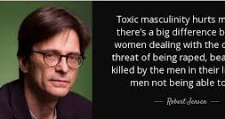
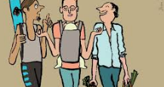




Who are the victims of toxic masculinity?

Slide 5
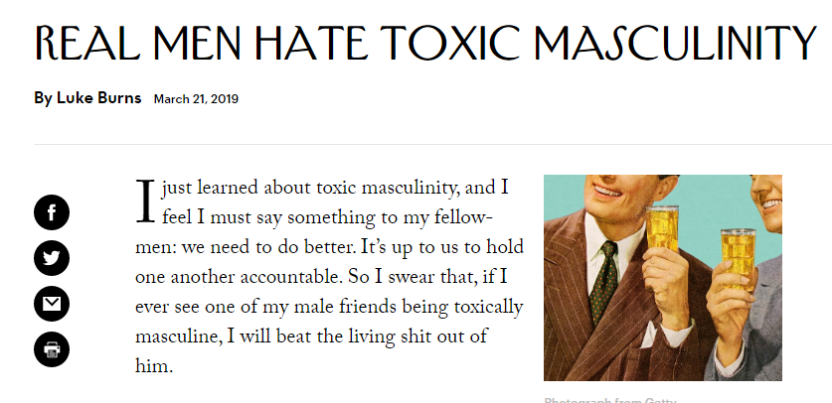
What are your first impressions of the article? Discuss in groups.
Notes:
https://www.newyorker.com/humor/daily-shouts/real-men-hate-toxic-masculinity

Slide 6
Questions to ask yourself
Course link: Paper 1 Non-Literary (unseen)
What is the purpose? What does the writer want you to understand/do/think/feel?
Who is the audience? How do you know? Why have they been targeted?
What is it about? What are the main ideas that are being conveyed.
What is the tone/mood?
How are ideas conveyed:
Language / stylistic devices
Structure
What is the context? Does this help us to interpret meaning?
Which techniques have been used? Why?
What is the effect?
How do they reinforce the purpose?

Slide 8
How does Burns use stereotypes in his article?
Make a list of the stereotypes he mentions.
How does he use them?
What is the effect of each?
In what context does he mention these?
What is he trying to do?
How do you feel/react?

Slide 9


Let’s look at the stylistic features of his article
What do you notice about his language and style?
Select examples – can you name the device used?
What is the effect?

Slide 10
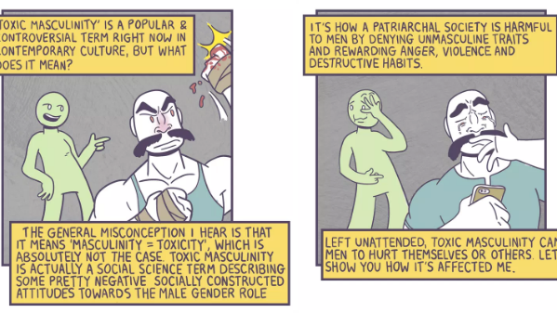
How does this comic help you to further understand the issues raised by Burns in his article? Follow the same steps as we did for the Burns article and do your own analysis.
Notes:
https://thenib.com/toxic-masculinity

Slide 11
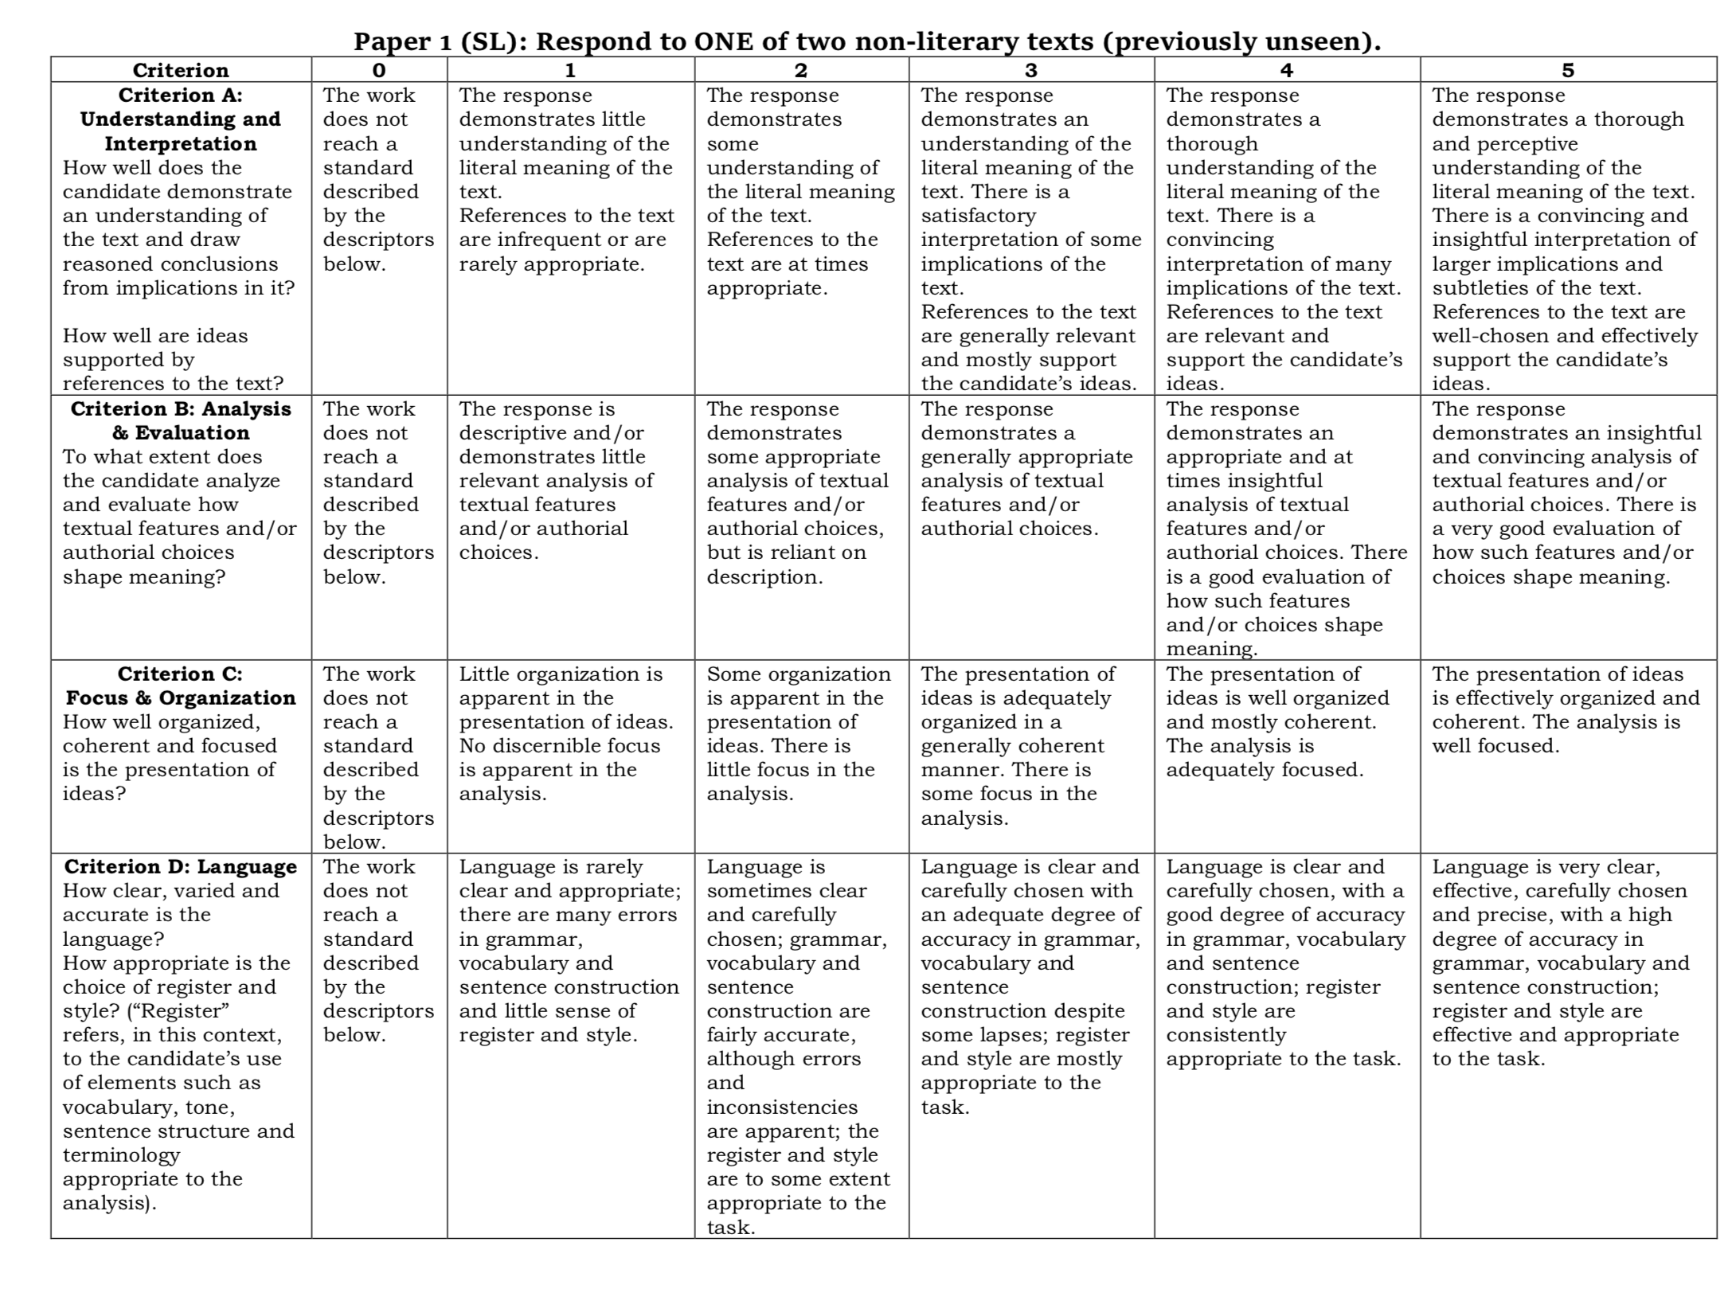
Looking at the criteria
With a partner, have a look at the different strands.
What do you have to do for each?
What have you already done so far, either verbally or in writing.
Do you have any questions?
Course link: Paper 1 Non-Literary (unseen)

Slide 12

Your task
Choose a text that you would like to write about in response to this question:
How do you understand the purpose and provocative nature of this text?
This is a guiding question, it is there to help you.

Slide 13
Things to consider for a Paper 1 response
Ensure you understand: purpose; audience; main ideas; tone; form.
Everything you decide to comment on should be linked back to these key areas.
Ask your self questions:
  What is your initial response? Does this change as you read the text again?
  Why is the text structured in this way?
  Why did the writer choose this form?
  Why are certain linguistic and stylistic devices used?
  Are there images? If so what are they and why are they used?
How do all of these affect the meaning?
How do they reinforce the purpose?

Slide 14
Plan your answer
Introduction:
  Engage with the text –show that you understand the meaning, main ideas, context, form.
  Overview of the text and its effects.
  Purposeful comments on audience; purpose; tone etc
Main body:
  Develop your response here by making several points about the text. Refer to the text throughout as this is your evidence. Analyse. Effect.
Conclusion:
  overall how effective is the text? Why? How do you respond?
What do you want to comment on?
Which ideas stand out for you?
How do you respond?
How do you understand the purpose and provocative nature of this text?

Slide 15

Thank you for downloading this resource; I hope it is useful! Please feel free to browse the range of KS3 & KS4 resources. You can also check out my blog for tips and ideas.
You can also follow me on Instagram and find me on Facebook or twitter.

