Slide 1
Note to teachers
This is a stand alone introductory unit and was planned as a fun way to engage pupils before they begin work on their 1st text. The aim is to make pupils feel confident when using the new IB terminology and also to help them build up skills of analysis before they begin to look at their 1st text/body of work.

Slide 2
Identifying meaning within a text
Thursday 22nd August 2019
Today we will be looking at:
How meaning is constructed, negotiated, expressed and interpreted

Slide 3
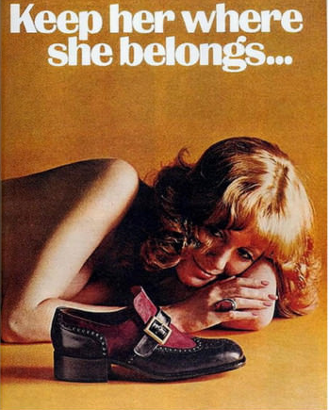

Slide 4
You each have key concept cards…
What do you think they mean? How can you interpret them? What do they refer to?
How can you link them to literature? How can you link them to the wider world and society?
Identity
Culture
Creativity
Communication
Perspective
Transformation
Representation

Slide 5
Areas of exploration
Area of exploration—readers, writers and texts (AOE1)
Why and how do we study language and literature?
How are we affected by texts in various ways?
In what ways is meaning constructed, negotiated, expressed and interpreted?
How does language use vary amongst text types and amongst literary forms?
How does the structure or style of a text affect meaning?
How do texts offer insights and challenges?
How can we use these questions to wider and deepen your reading of texts?
Which questions do you not understand?
Area of exploration—intertextuality: connecting texts (AOE3)
How do texts adhere to and deviate from conventions associated with literary forms or text types?
How do conventions and systems of reference evolve over time?
In what ways can diverse texts share points of similarity?
How valid is the notion of a classic text?
How can texts offer multiple perspectives of a single issue, topic or theme?
In what ways can comparison and interpretation be transformative?
Area of exploration—time and space (AOE2)
How important is cultural or historical context to the production and reception of a text?
How do we approach texts from different times and cultures to our own?
To what extent do texts offer insight into another culture?
How does the meaning and impact of a text change over time?
How do texts reflect, represent or form a part of cultural practices?
How does language represent social distinctions and identities?

Slide 6
Global Issues
Culture, identity and community
Art, creativity and the imagination
Science, technology and the environment
Beliefs, values and education
Politics, power and justice
Thinking questions:
Which of these have you seen or experienced? Describe it to a partner.
How important are global issues when studying this course? Why?

Slide 7
Mini task text
On your desks you have:
Key concepts cards
AOE cards
Global Issues cards
Link to paper 1
Glue the text into the middle of the A3 paper and brainstorm ideas.
Say as much as you can about this text…
Use the cards on your table to help you.
Remember to deconstruct it!
Keywords:
Audience
Purpose
Context
Meaning
What does this word mean?

Slide 8
How does this information help you to interpret the text?
This shoe ad was created by Weyenberg Massagic Footwear in 1972 and was published in the December issue of Playboy magazine in 1974

Slide 9
Guiding questions
Mini task
Which of these also link to ToK?
What do you see? How do you know what it means?
Which ideas are presented?
How does the text link to the image?
What is the meaning of the text? How is the meaning conveyed? How is the text constructed?
How do you feel? Why?
How are the intended audience supposed to feel?
What is the broader meaning? Look beyond the text.
How important is representation?
Which global issues can you comment on?
What is the text type? How does this aid your interpretation?

Slide 10
How does the advert link to the AoE?
Readers, writers and texts (AOE1) | Time and space (AOE2)

Slide 11
Which global issues are presented in the advert?
How do you know?

Slide 12
How does the advert link to the key concepts?
Identity
Culture
Creativity
Communication
Perspective
Transformation
Representation

Slide 13
How is gender presented in the advert?
Class discussion.
Share ideas – be as detailed as possible and back up your comments with evidence from the text.

Slide 14
Task: find your own advert that presents a global issue of your choice.
Thursday 29th August
Deconstruct and analyse using the key concepts and areas of exploration.
Remember to analyse image, colour, placement and structure and language.
Link your ideas to: context; audience; form and purpose
This should be in the form of a PPT and should last no more than 3 minutes.

Slide 15
In order to assess the presentations, we will use the IO criteria.
Each group must make notes on how well the group who is presenting meets the criteria.
You must also formulate one question that you can ask them. This could be linked to key concepts or ideas. Use the question cards to help you.
Area of exploration—readers, writers and texts (AOE1)
Why and how do we study language and literature?
How are we affected by texts in various ways?
In what ways is meaning constructed, negotiated, expressed and interpreted?
How does language use vary amongst text types and amongst literary forms?
How does the structure or style of a text affect meaning?
How do texts offer insights and challenges?
Area of exploration—intertextuality: connecting texts (AOE3)
How do texts adhere to and deviate from conventions associated with literary forms or text types?
How do conventions and systems of reference evolve over time?
In what ways can diverse texts share points of similarity?
How valid is the notion of a classic text?
How can texts offer multiple perspectives of a single issue, topic or theme?
In what ways can comparison and interpretation be transformative?
Area of exploration—time and space (AOE2)
How important is cultural or historical context to the production and reception of a text?
How do we approach texts from different times and cultures to our own?
To what extent do texts offer insight into another culture?
How does the meaning and impact of a text change over time?
How do texts reflect, represent or form a part of cultural practices?
How does language represent social distinctions and identities?

Slide 16
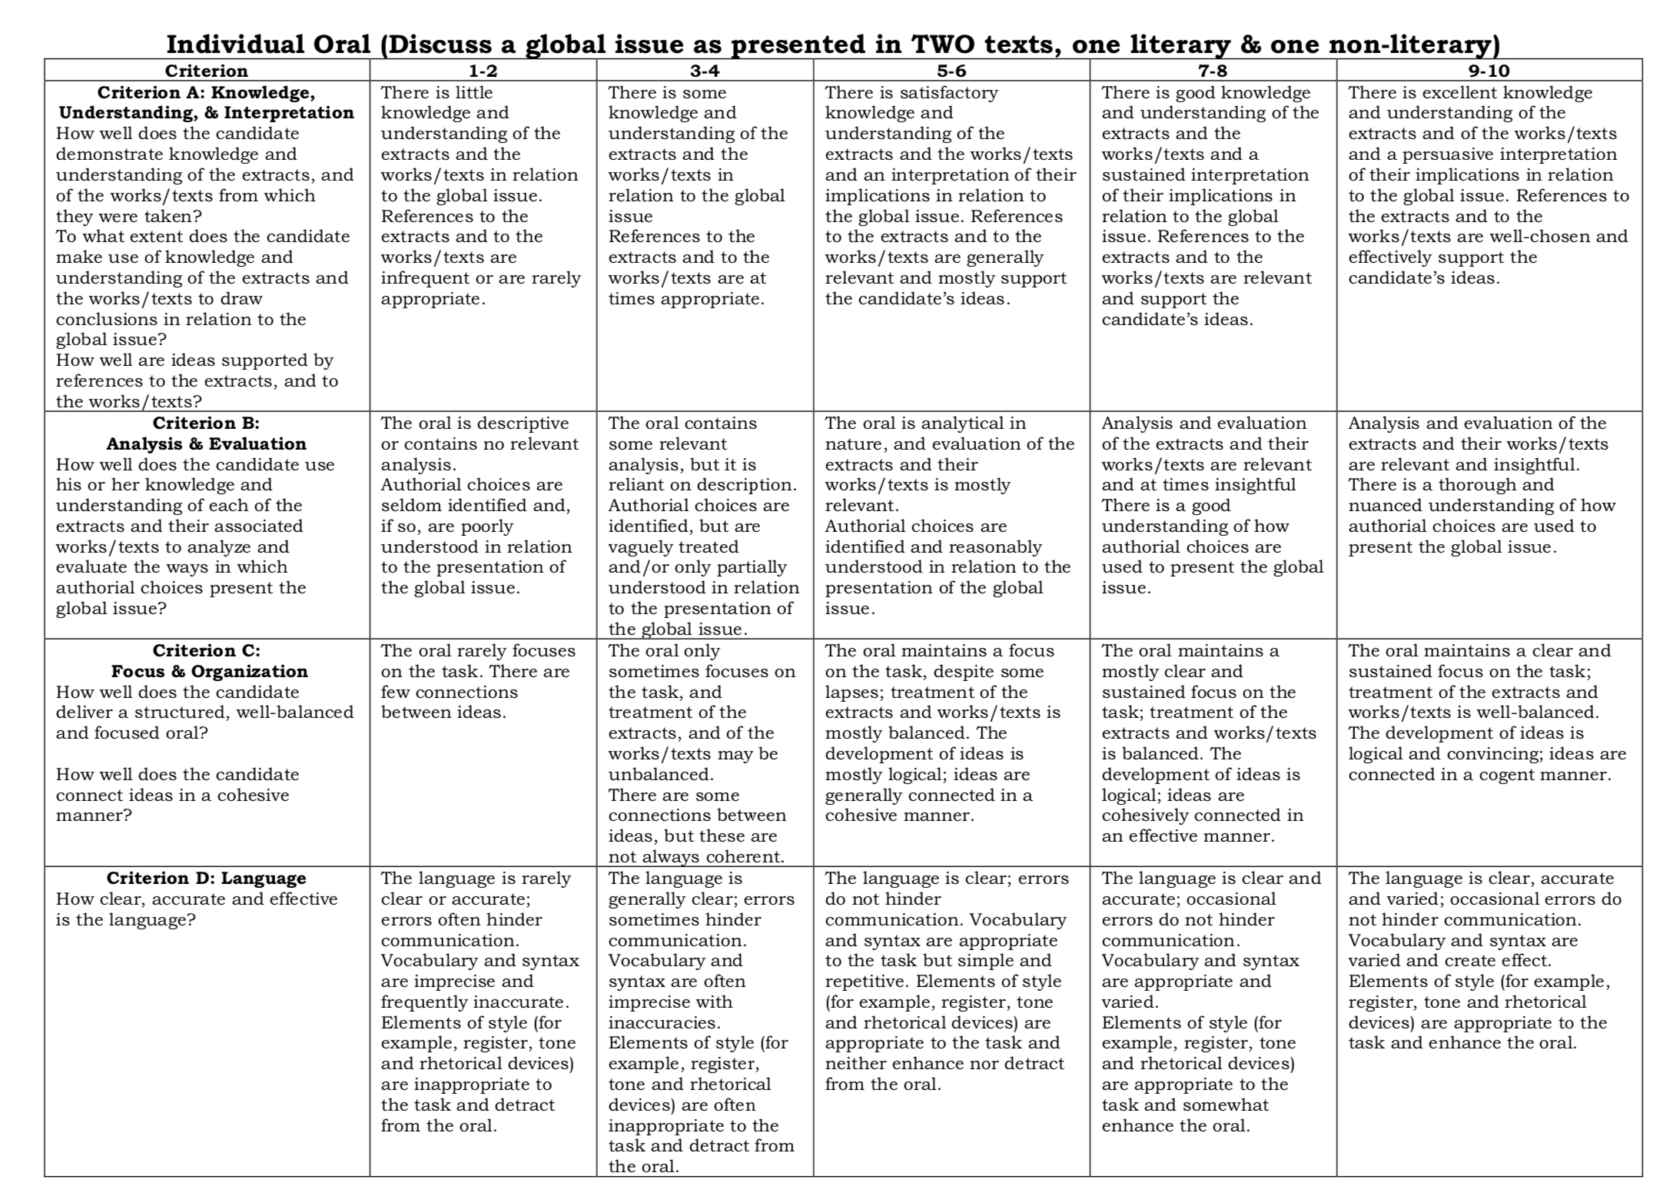

Slide 17
Homework – write up the findings from your advert analysis
You should answer the question: How is ______ explored within the advert.
Insert the global issue you focused on.
This will be your 1st written task for your LP

Slide 18
Looking at multimodal texts
Monday 26th August 2019
STARTER: what is the purpose of a song?
Why are they written?
Why do we listen to them?
How important are the music videos that accompany the song?
Today we will be looking at:
How meaning is constructed, negotiated, expressed and interpreted by doing an in depth analysis of a multimodal text
Making connections between texts
Notes:
This section of lessons is aimed at engaging pupils in a fun way with multimodal texts and getting them to engage with texts on an analytical level. As song lyrics are considered literary this ‘introduction’ cannot be used as part of a non-literary body of work. It is merely an interesting task to begin the course with as it lends itself to both analysis and the use of new concepts and terminology.

Slide 19
In pairs, add a qualifying statement to the following:
Try and think of as many as you can. They don’t have to be similar.
This is America;__________

Slide 20
Listen to the song…
As you take part in this activity, think about how the fact that this is a multimodal text is affecting how you interpret and react to it.
Now you will watch the video.
Does this enhance or change your understanding of the song?
Is anything shocking?
What is the tone?
Can you make any intertextual references (this could be to anything outside the song)?
Write down anything that comes into your head.
Focus on the lyrics and the music. What sounds do you hear?
Once the song has finished, discuss in groups and link it to the different global issues and concepts we have been looking at.

Slide 21
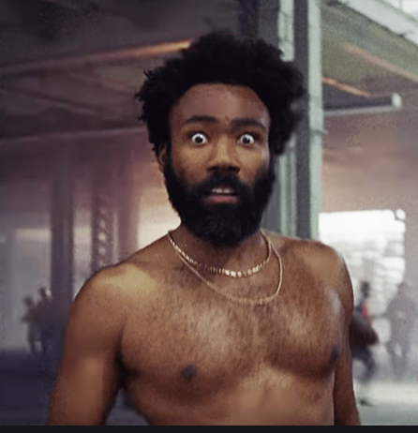
Now let’s ignore Childish Gambino!
X
What do you notice in the background?
Which other characters can you see? What do they represent? Think about how you can comment on intertextuality here.

Slide 22
Analysing multimodal texts
Wednesday 28th August 2019
STARTER:
What would you like to explore further in terms of the song? What would you like to know more about?
Today we will be looking at:
How meaning is constructed, negotiated, expressed and interpreted by doing an in depth analysis of a multimodal text
How context can help us to understand meaning
Notes:
Aural, linguistic, visual,

Slide 23
X
What did you notice when you stopped focusing on Childish Gambino? Why did he do this?
What is his message here?

Slide 24
Spend 4 minutes writing down your initial reaction to the video.
Who is the audience?
How do you feel when you watch the video?
What is the purpose?
How is culture being represented?
Which global issues are being presented?

Slide 25
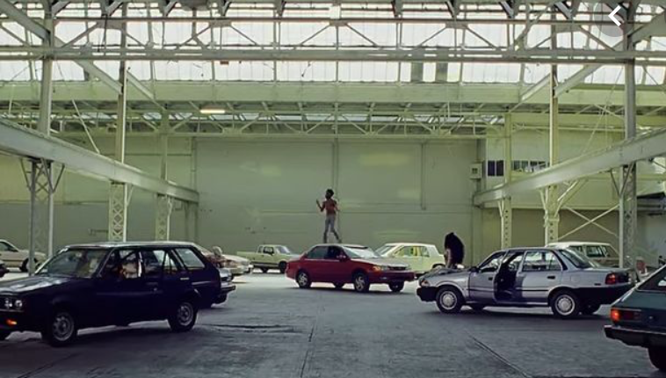
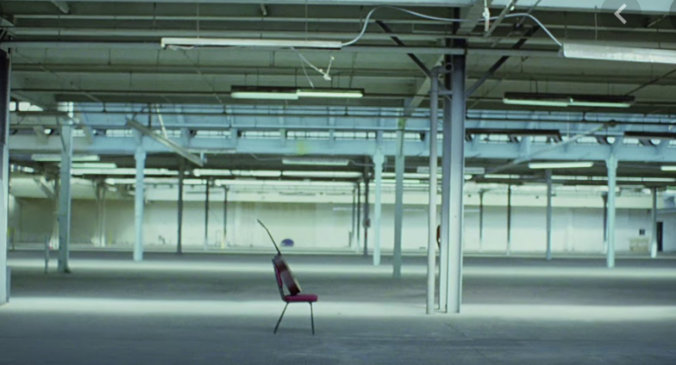
What is the significance of the setting?

Slide 26
You will now do an analysis of only the lyrics. Treat this as a literary analysis
What do you think you should be looking out for? Make a list of devices and techniques.
Think about what you already know about songs….

Slide 27
Repetition…
What is repeated throughout the song?
Let’s watch the song again. What is happening each time the song title is repeated? Make a note on your lyrics.

Slide 28
Background to the song – the history of America
Before we watch the video again, lets look at some of the events in American history that have inspired Childish Gambino. This will also help you to understand the meaning/message.

Slide 29
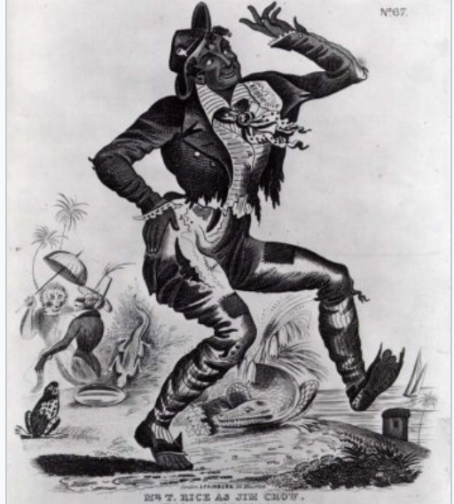
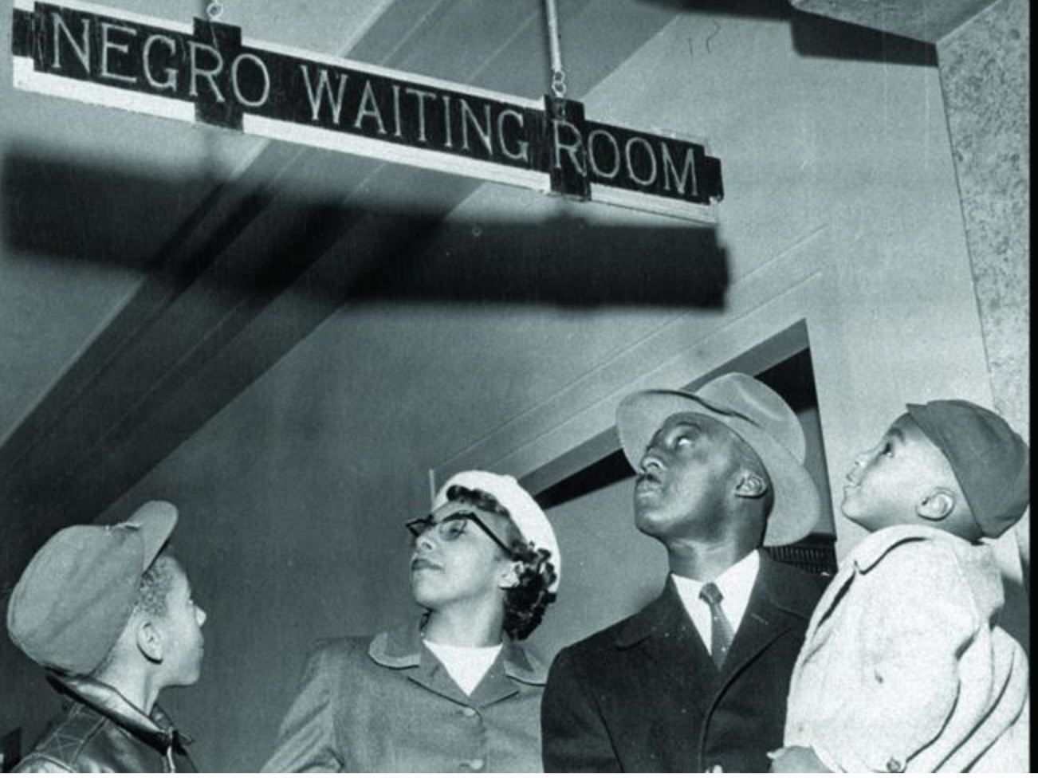
Jim Crow
Racist images in the Jim Crow era were used as propaganda to send messages that demeaned African Americans and legitimized violence against them.
Thomas Dartmouth Rice, a white man, was born in New York City in 1808. He devoted himself to the theater in his twenties, and in the early 1830s, he began performing the act that would make him famous: he painted his face black and did a song and dance he claimed were inspired by a slave he saw. The act was called “Jump, Jim Crow” (or “Jumping Jim Crow”).
To call someone “Jim Crow” wasn’t just to point out his or her skin color: it was to reduce that person to the kind of caricature that Rice performed on stage.
After the Civil War, southern states passed laws that discriminated against newly freed African Americans; and as early as the 1890s, these laws had gained a nickname: The Jim Crow Laws.
Under Jim Crow, African Americans were relegated to the status of second class citizens. Jim Crow represented the legitimization of anti-black racism.

Slide 31
Black stereotypes
Stereotypes of African Americans grew as a natural consequence of both scientific racism and legal challenges to both their personhood and citizenship. In the 1857 Supreme Court case, Dred Scott v. John F.A. Sandford, Chief Justice Roger B. Taney dismissed the humanness of those of African descent. This legal precedent permitted the image of African Americans to be reduced to caricatures in popular culture.

Slide 32
Emanuel African Methodist Episcopal Church shooting
The Charleston church shooting (also known as the Charleston church massacre) was a mass shooting in which Dylann Roof, a 21-year-old white supremacist, murdered nine African Americans (including the senior pastor, state senator Clementa C. Pinckney) during a prayer service at the Emanuel African Methodist Episcopal Church in downtown Charleston, South Carolina, on the evening of June 17, 2015. Three other victims survived. The morning after the attack, police arrested Roof in Shelby, North Carolina. The shooting targeted one of the United States' oldest black churches, which has long been a site for community organization around civil rights

Slide 33
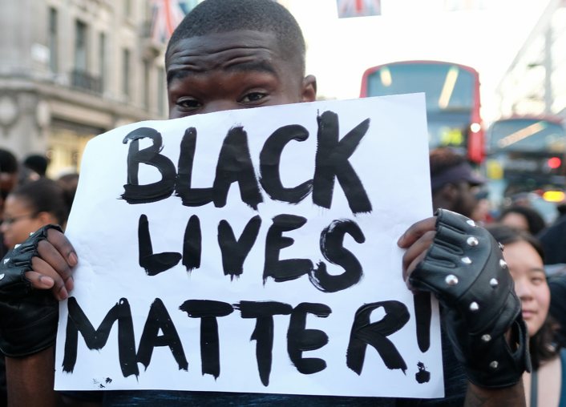
Black lives matter
“The Black Lives Matter Global Network is a chapter-based, member-led organization whose mission is to build local power and to intervene in violence inflicted on Black communities by the state and vigilantes.
We are working for a world where Black lives are no longer systematically targeted for demise.
We affirm our humanity, our contributions to this society, and our resilience in the face of deadly oppression.
The call for Black lives to matter is a rallying cry for ALL Black lives striving for liberation.”
In 2013, the movement began with the use of the hashtag #BlackLivesMatter on social media after the acquittal of George Zimmerman in the shooting death of African-American teen Trayvon Martin in February 2012. Black Lives Matter became nationally recognized for its street demonstrations following the 2014 deaths of two African Americans: Michael Brown—resulting in protests and unrest in Ferguson, a city near St. Louis—and Eric Garner in New York City.

Slide 34
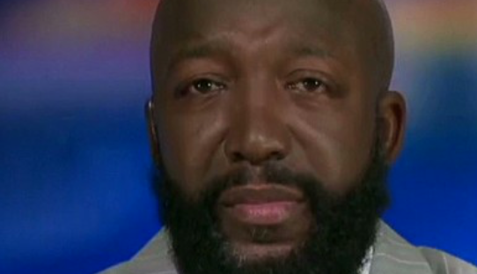
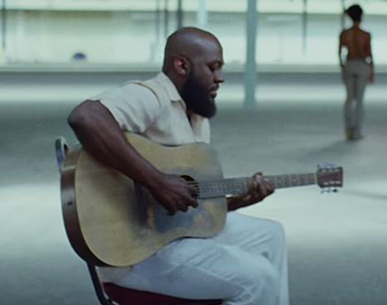
#BLM
Trayvon Martin’s father – Tracy Martin looks a lot like the character that we first see in the video.
What is the significance of this?

Slide 35
Gun Crime and Police Brutality Guns matter vs lives matter?
The Second Amendment of the United States Constitution reads:
"A well regulated Militia, being necessary to the security of a free State, the right of the people to keep and bear Arms, shall not be infringed."
In the U.S., African Americans are 2.5 times more likely to be killed by police than white people.

Slide 36
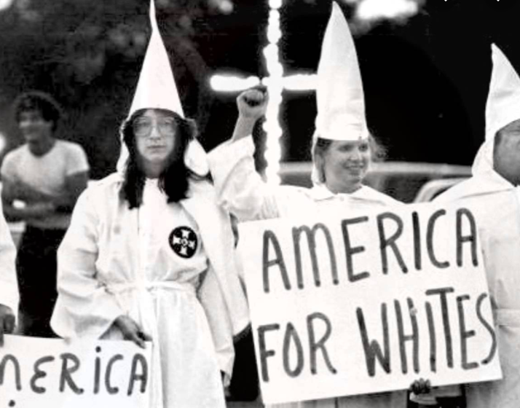
White supremacy & Racism White supremacists believe that almost any action is justified if it will help “save” the white race.
The white supremacist “Unite the Right” rally in Charlottesville, Virginia, on August 11-12, 2017, attracted some 600 extremists from around the country and ended in deadly violence. These shocking events served as a wake-up call for many Americans about a resurgent white supremacist movement in the United States.
Klu Klux Klan
Lynching
Segregation
Though aspects of the alt right date back to 2008, it was Donald Trump’s entry in 2015 into the 2016 presidential race that really energized the alt right and caused it to become highly active in support of Trump.

Slide 37
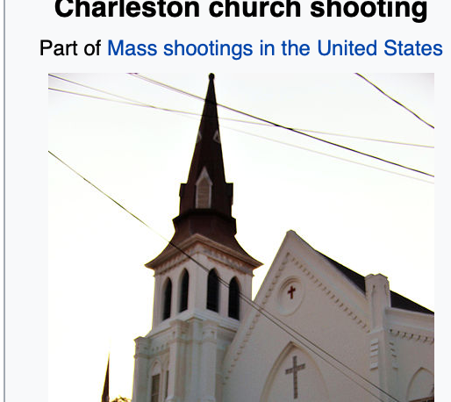
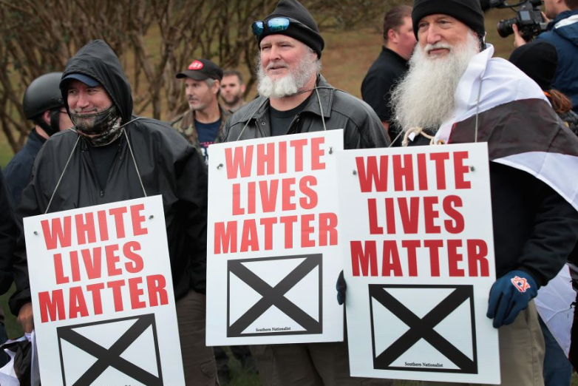
Now watch the video again – do you notice anything new this time? Think about the issues we have just discussed.
Think about the cultural and historical significance of the song. Which symbols can you pick out? What do they represent?
Add to the notes you already have.

Slide 38
Linking the lyrics to the symbols in the video
Today we will be looking at:
How meaning is constructed, negotiated, expressed and interpreted by doing an in depth analysis of a multimodal text
Initial task: respond to each of the questions on the next slide.

Slide 39
What do you think Childish Gambino’s impression of America is?
Why did he write the song?
Who is the audience?
This is America
Is the form an effective way of conveying meaning?
What does he want you to understand?

Slide 40
How can we talk about the key concepts? Make notes next to each.
Identity
Culture
Creativity
Communication
Perspective
Transformation
Representation

Slide 41
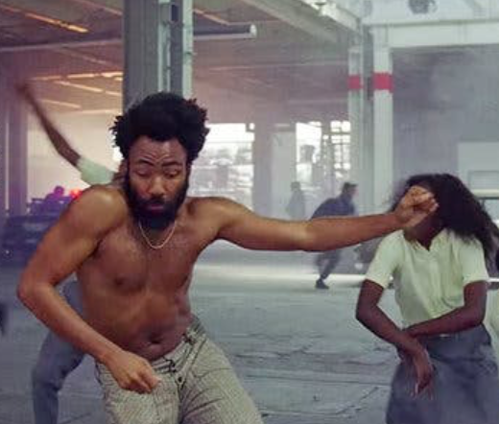
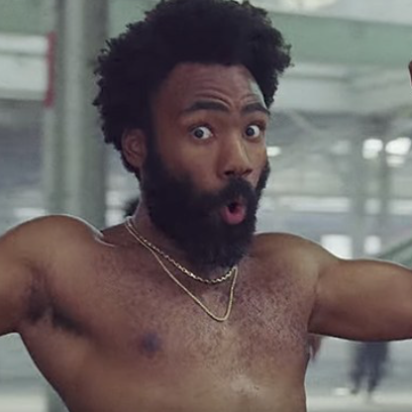
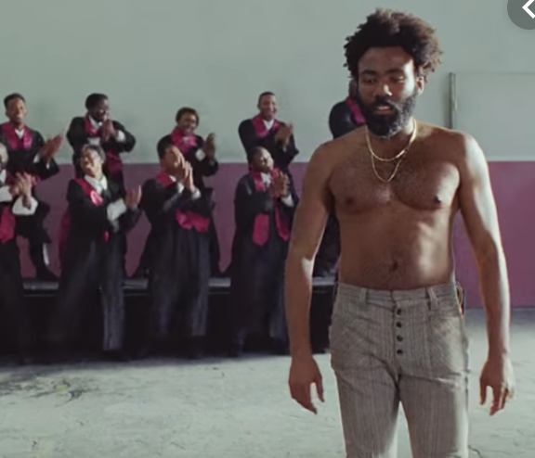
Lets look back at the lyrics and link them to the video. What happens in the video? How important are the lyrics? What do they add? Get your analysis of the lyrics out and be ready to make notes!
Think about how important the different scenes are – how do they represent what he is saying.
Think about the global issues or concepts that are being presented.

Slide 42
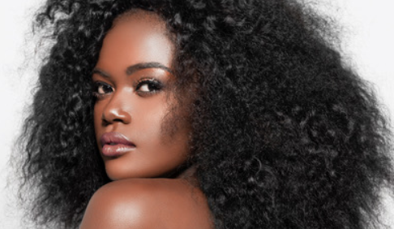
The significance of dance moves - Rwandan-born Sherrie Silver constructed the dance sequence
Silver was specifically instructed to include the South African dance the gwara gwara, which went from viral hit to Grammy stage thanks to Rihanna. Silver, who left Rwanda as a toddler in 1999 and travels there often, also brought in influences from around Africa.
There are gyrations from Angola, Ghana’s alkayida and an exaggerated walk in which you “imagine you’re walking into a party,” which she borrowed from Côte d’Ivoire. When you see Glover’s hips twist from side, his hands grasping wide, it’s the Azonto, also from Ghana. When his legs twist over each other as he steps forward, and his upper body seems to be falling around the screen, that’s the Shoki from Nigeria.
She also created her own dance, the “nziza” (meaning good in Kinyarwanda) in which you shake your shoulders and pause to pick something up. There are also nods to urban America with the nae nae and BlocBoy JB’s “shoot” dance.

Slide 43
Dancing and cultural appropriation
Homework Research:
The different dances in the video
The history of minstrel shows
Black entertainment on stage and film - stereotypes

Slide 44
Analytical write up
Today we will be looking at:
How meaning is constructed, negotiated, expressed and interpreted by doing an in depth analysis of a multimodal text
Look at how can texts offer multiple perspectives of a single issue, topic or theme

Slide 45
Which of these questions are relevant to ‘This is America’?
Area of exploration—time and space (AOE2)
How important is cultural or historical context to the production and reception of a text?
How do we approach texts from different times and cultures to our own?
To what extent do texts offer insight into another culture?
How does the meaning and impact of a text change over time?
How do texts reflect, represent or form a part of cultural practices?
How does language represent social distinctions and identities?
Area of exploration—readers, writers and texts (AOE1)
Why and how do we study language and literature?
How are we affected by texts in various ways?
In what ways is meaning constructed, negotiated, expressed and interpreted?
How does language use vary amongst text types and amongst literary forms?
How does the structure or style of a text affect meaning?
How do texts offer insights and challenges?

Slide 46
In groups, answer the questions in as much detail as you can.
Area of exploration—time and space (AOE2)
How important is cultural or historical context to the production and reception of a text?
How do we approach texts from different times and cultures to our own?
To what extent do texts offer insight into another culture?
How does the meaning and impact of a text change over time?
How do texts reflect, represent or form a part of cultural practices?
How does language represent social distinctions and identities?
Area of exploration—readers, writers and texts (AOE1)
Why and how do we study language and literature?
How are we affected by texts in various ways?
In what ways is meaning constructed, negotiated, expressed and interpreted?
How does language use vary amongst text types and amongst literary forms?
How does the structure or style of a text affect meaning?
How do texts offer insights and challenges?

Slide 47
How do you respond to these quotes about the song?
Guthrie Ramsey, a professor of music history, says “Even though we think of popular culture as a space where we escape, [Childish Gambino]’s forcing us to understand that there’s actually nowhere to run. We have to deal with the cultural violence that we have created and continue to sustain.”
CNN analyst Bakari Sellers, in a reaction to the video, said “Being black in America is constantly living in a state of PTSD.”
Videographer Taylor Hickman said of the video, “My ultimate takeaway is that it’s easy for an audience to consume black entertainment while simultaneously ignoring black social issues.”
Rodney Carmichael – Hip Hop Journalist: "I think in a lot of ways what Glover is trying to do is really bring our focus and our attention to black violence, black entertainment [and] the way they're juxtaposed in society. They seem to cancel each other out in the greater public consciousness,"
Move around the room and make notes on each one. Deconstruct what you think they are trying to say and then add your own opinions. Add evidence.

Slide 48
Task: each group will take a scene and do an in depth analysis. This will form the basis of your individual written reflections on the song.
Pair up with someone else and share your ideas.
Listen to their interpretation – can this help you to develop yours?
Remember that this is a multi-modal text.
You must analyse all aspects of the song: dancing; lyrics, metaphor; symbolism; imagery; repetition
Use the different course cards to help you.
Think about: purpose, audience, form, writer.

Slide 49
In groups, write down 3 statements for the song. For example….
This is America looks at what it means to be African American
This is America is a political song
Childish Gambino distracts us with dance while…
Brainstorm evidence to back up your statement – remember that your evidence can be both the lyrics and the music video.

Slide 50
Individual Task for the Learner Portfolio
You will prove your statement using one section of the song.
You can use stills from the video and include them in your response.
You should be linking different ideas together, such as music, lyrics, actions.
This should be between 500-700 words only.

Slide 51
Being successful on the task
This is your own personal response in written form.
It will form part of your LP
As you are also using stills as your evidence, it doesn’t have to look like a traditional essay but should still begin with an introduction/overview.
Decide on your viewpoint; then gather evidence to support your view.
Consider the 4 criteria when constructing your answer.
Success criteria:
Link everything back to: context; audience; purpose; form; style
Analyse all aspects of the text: if it is multimodal, how do all of these aspects work together to create meaning.
Analyse and interpret meaning in as many ways as you can: layer meaning.
MEANING! How does everything you mention link back to or reinforce the MEANING?

Slide 52
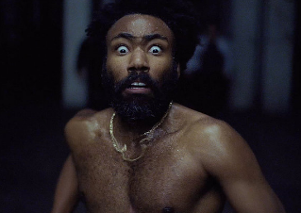
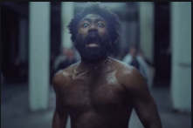
Let’s do an example together…
What can we say about this part of the song? What can we analyse?
Success criteria:
Link everything back to: context; audience; purpose; form; style
Analyse all aspects of the text: if it is multimodal, how do all of these aspects work together to create meaning.
Analyse and interpret meaning in as many ways as you can: layer meaning.
MEANING! How does everything you mention link back to or reinforce the MEANING?
You just a Black man in this world You just a barcode, ayy You just a Black man in this world Drivin’ expensive foreigns, ayy You just a big dawg, yeah I kenneled him in the backyard No probably ain’t life to a dog For a big dog

Slide 53
Thank you for downloading this resource; I hope it is useful!
You can also follow me on Instagram and find me on Facebook or twitter.

