Slide 1
Purple Hibiscus
Lesson 1
0475 / 0992

Slide 2
What does this section of your exam look like?
Paper 1 Poetry & Prose
1 hour 30 minutes
50 marks
Section A: Poetry (25 marks)
Section B: Prose (25 marks)
Assessment Objectives:
AO1: show detailed knowledge of the content of literary texts, supported by reference to the text
AO2: understand the meanings of literary texts and their contexts, and explore texts beyond surface meanings to show deeper awareness of ideas and attitudes AO3: recognise and appreciate ways in which writers use language, structure and form to create and shape meanings and effects AO4: communicate a sensitive and informed personal response to literary texts.

Slide 3
Watch this video for an overview of the exam
Notes:
Link: https://www.youtube.com/watch?v=WnFiNJefSMk&list=PLw8WoAh2Xt9VYn6u_3J19mZwvT9pw4Rii&index=1

Slide 4
When looking at a novel, we must consider the following:
Now move around the room and join up with 2 people from different groups. Share your ideas and add to your notes.
What are these?
In groups of 3, make notes under each heading.
e.g. Setting = different places in a novel
Setting
Plot
Narrative perspective
Characterisation
Genre
Style and language
10 minutes
Notes:
Pupils must write down anything they know already about these different aspects of the novel.
Elicit ideas from pupils at the end of the sharing activity. You could write ideas on a white board so pupils have a clear idea of what to look out for when discussing and anlayisng the different aspects of the text.

Slide 5
When looking at a novel, we must consider the following:
Setting
Plot
Narrative perspective
Characterisation
Genre
Style and language
AO1: show detailed knowledge of the content of literary texts, supported by reference to the text
AO2: understand the meanings of literary texts and their contexts, and explore texts beyond surface meanings to show deeper awareness of ideas and attitudes
AO3: recognise and appreciate ways in which writers use language, structure and form to create and shape meanings and effects
AO4: communicate a sensitive and informed personal response to literary texts.
How do these link to the AOs?
Notes:
Elicit discussion from pupils on how these different aspects of the novel link to what the pupils must understand/demonstrate when writing about the novel.

Slide 6
Assessment Objectives
Page 4-6 in
the booklet
Assessment Objective | What this means
AO1 Show detailed knowledge of the content of literary texts, supported by reference to the text | Demonstrate a good knowledge of the what the novel is about; the tone; the characters; the ideas expressed; and the themes. Select and use a range of relevant and well-chosen references from the novel. These must not only support your point but must also be the best quotations you can find to support your ideas.
AO2 Understand the meanings of literary texts and their contexts, and explore texts beyond surface meanings to show deeper awareness of ideas and attitudes | You must have a detailed knowledge of the novel and the meaning or message behind it. Good understanding of any contextual references that are relevant. Think about how they help you to develop your own interpretation and analysis of the novel. Think beyond the literal meaning of the novel. What are the ‘big ideas’ that are being explored? What is being represented in the novel? What does the novel reflect on a wider level? Think about why the writer wrote the novel. What was their intention? What do they want the reader to understand? What are they trying to present or express?
Notes:
Pupils can add notes in the booklet

Slide 7
Assessment Objectives
Assessment Objective | What this means
AO3 recognise and appreciate ways in which writers use language, structure and form to create and shape meanings and effects | Good understanding of different aspects of form, language and structure. You should be able to identify a range of different techniques/devices and discuss them in your answer. Ensure you are able to analyse all of these in your response. How does the writer utilise these as a way of presenting their ideas? What is the effect of these different elements of the novel? How do they add meaning? How can you analyse them as a way of developing your own personal response? Can you link ideas back to context or the writer’s intention? Why have these choices been made? How do they work within the text? How do they create meaning?
AO4 Communicate a sensitive and informed personal response to literary texts. | You must be able to develop a personal response to the question. Your response should aim to be perceptive, sophisticated and insightful. Interpret the question in your own, personal way. Make clear points that show how you are responding to the question. You need a range of points that show you are answering the question. Each point must be supported by relevant and well-chosen references. You must refer back to your point and the question. This will ensure you remain focused. Express your ideas in a clear and coherent way. Group similar ideas together and explore these logically.

Slide 8
Setting
This refers to geographical location as well as time.
The significance of ‘where’ a certain action/event takes place.
We can often link characters to a particular setting and they reveal more about that character. They may belong to this location or not. They may react positively or negatively to it.
Plot
Major and minor events.
The structure and organisation of action/events.
Chronology.
Linear/non-linear.
How the story progresses.
The beginning of a novel gives us a lot of information.
Narrative perspective
Who is the narrator?
Voice.
How is the story told?
Are they involved in the story?
1st person?
3rd person omniscient narrator?
Dual narrative?
Characterisation
How do we feel about the characters? Why?
How do the characters change/develop?
Protagonist / antagonist.
Dynamic or static characters.
Can we see the consciousness of the characters? Which ones? Why? What do we learn?
Genre
What type of story is it?
Romance? Sci-fi? Mystery? etc
How do you know?
Which features of the genre can you identify?
Style and language
Literary devices.
Choices made by the author e.g linear or non-linear.
Language used.
The way in which characters speak / are described.
Detailed style / minimalist style.
Notes:
Talk pupils through these so they understand each in detail. Encourage them to add to their notes.

Slide 9
What do you think the novel will be about based on these reviews?
‘An intoxicating story that is at once distinctly feminine, African and universal.’
Observer
‘A beautifully judged account of the private intimate stirrings of a young girl…Adichie is a fresh new voice out of Africa.’
Telegraph
‘This debut novel, in the best tradition of coming of age novel, serves as a reminder of what serious committed storytelling can do… Adiche draws us into Kambili’s world through her rich descriptions of physical and domestic environments...’ New Statesman
‘With writing marked by infinite wisdom and heart breaking generosity, Adiche draws the African struggle for a modern identity into the heart of family life.’
Glasgow Herald
Notes:
Class discussion

Slide 10
Final Task
The novel is divided into 4 sections with these titles:
Breaking Gods: Palm Sunday
Speaking With Our Spirits: Before Palm Sunday
The Pieces of Gods: After Palm Sunday
A Different Silence: The Present
What do these titles reveal about the novel; the themes; chronology etc?
What predictions can you make about the novel?

Slide 11
Reading the novel
Lesson 2
Learning question: how do we effectively read and understand a novel?
Date:
Do now:
The title of Section 1 is ‘Breaking Gods: Palm Sunday’
What clues does this give you about what this section will be about?
What are thee connotations of the words used?

Slide 12
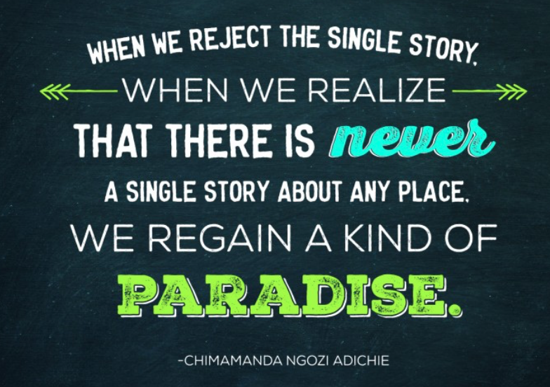
Why is it important for us to be exposed to literature from different authors?
Discuss with a partner

Slide 13
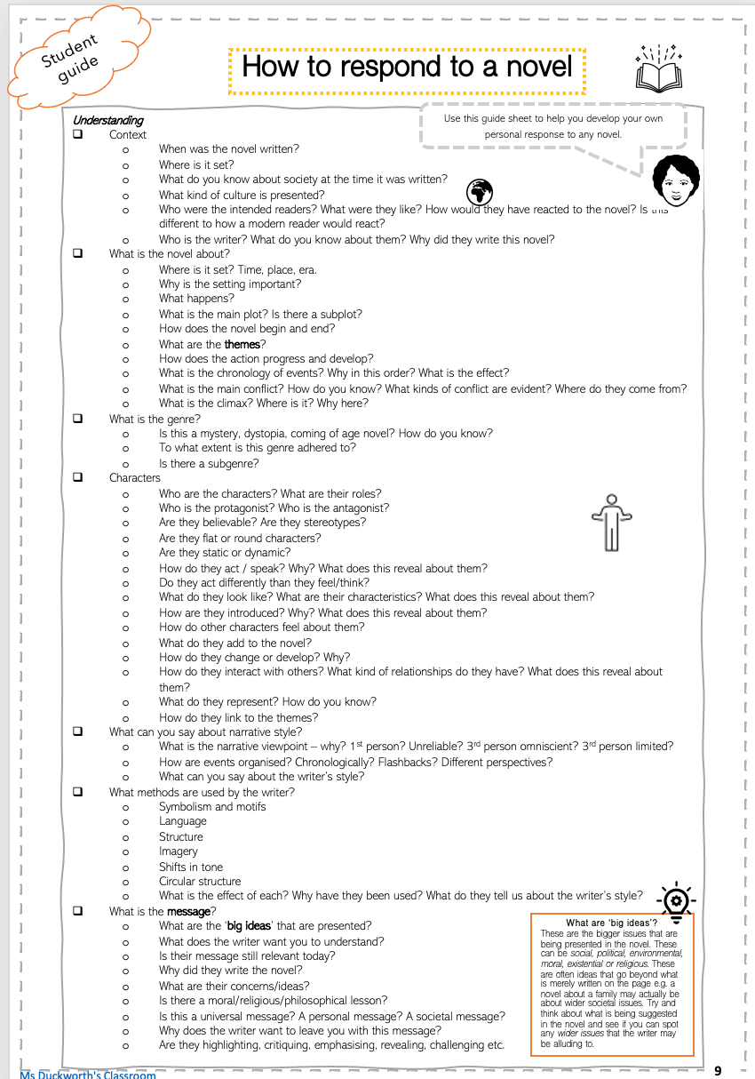
How should we read a novel?
How will you know what the novel is about?
What should you be looking for?
Guiding questions:
What is the novel about?
What is the writer’s message?
What are the themes?
How is all of this expressed and why?
Notes:
Elicit responses from pupils then look at this guide in the booklet

Slide 14
What should we know before we read?
The narrator’s name is Kambili – she is 15.
This novel can be classified as a coming-of-age novel.
The novel was written in 2003.
It is set in Enugu, Nigeria.
Context:
Palm Sunday - Palm Sunday is a Christian moveable feast that falls on the Sunday before Easter. The feast commemorates Jesus' triumphal entry into Jerusalem, an event mentioned in each of the four canonical Gospels. Palm Sunday marks the first day of Holy Week.
Ash Wednesday - Ash Wednesday is a Christian holy day of prayer and fasting. It is preceded by Shrove Tuesday and falls on the first day of Lent.
Notes:
More context will be introduced later on. For today, the focus is on how to read, understand and interpret.

Slide 15
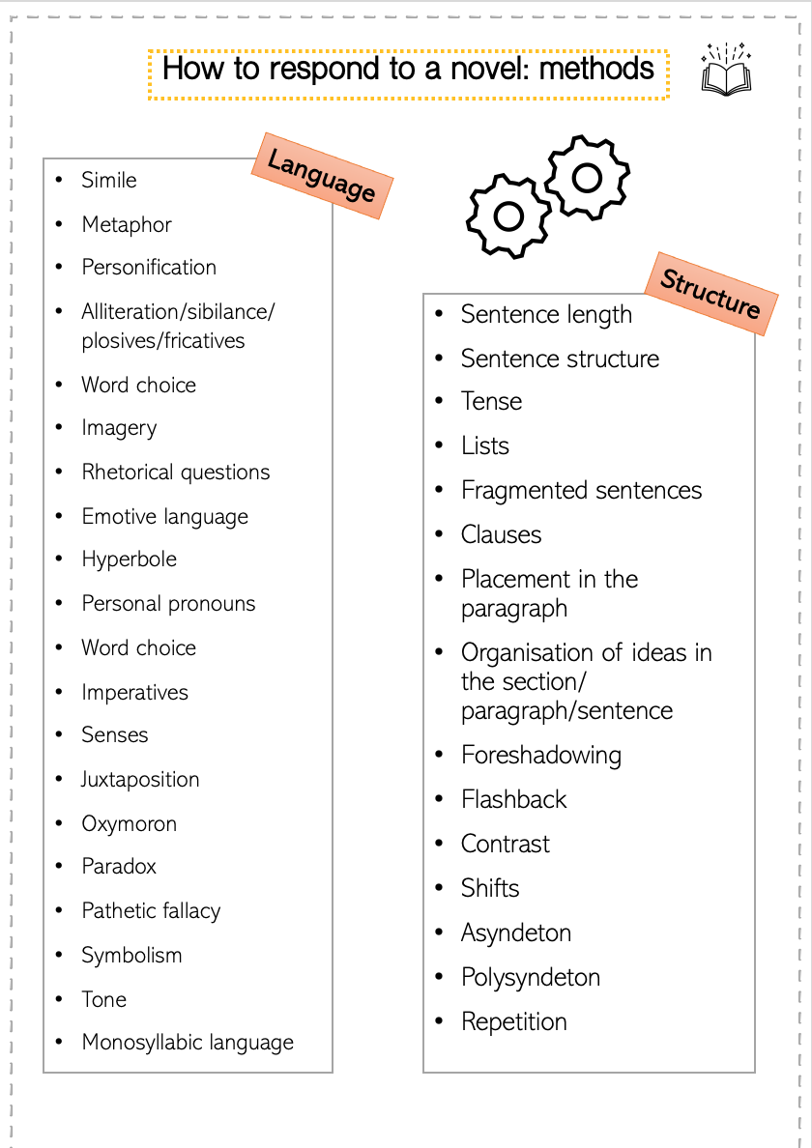
When analysing, we are looking at the choices made by the writer: AO3
I am the writer…why did I make the authorial choices I did?

Slide 16
Read the first paragraph – what can you say about narrative style?
Tense
Perspective
Narrative voice
Things started to fall apart at home when my brother, Jaja, did not go to communion and Papa flung his heavy missal across the room and broke the figurines on the étagère. We had just returned from church. Mama placed the fresh palm fronds, which were wet with holy water, on the dining table and then went upstairs to change. Later, she would knot the palm fronds into sagging cross shapes and hang them on the wall beside our gold-framed family photo. They would stay there until next Ash Wednesday, when we would take the fronds to church, to have them burned for ash. Papa, wearing a long, gray robe like the rest of the oblates, helped distribute ash every year. His line moved the slowest because he pressed hard on each forehead to make a perfect cross with his ash-covered thumb and slowly, meaningfully enunciated every word of "dust and unto dust you shall return."
Glossary:
missal - a book containing the texts used in the Catholic Mass throughout the year.
‘etagere’ - a piece of furniture consisting of a set of open shelves for displaying small objects and sometimes having an enclosed cabinet as a base
oblate - person serving in a church or monastery

Slide 17
What else can you comment on?
Skills check
What
How
Why
What do you learn about the setting? How?
What is happening?
How does Chapter 1 begin?
What kind of atmosphere is created? How?
Things started to fall apart at home when my brother, Jaja, did not go to communion and Papa flung his heavy missal across the room and broke the figurines on the étagère. We had just returned from church. Mama placed the fresh palm fronds, which were wet with holy water, on the dining table and then went upstairs to change. Later, she would knot the palm fronds into sagging cross shapes and hang them on the wall beside our gold-framed family photo. They would stay there until next Ash Wednesday, when we would take the fronds to church, to have them burned for ash. Papa, wearing a long, gray robe like the rest of the oblates, helped distribute ash every year. His line moved the slowest because he pressed hard on each forehead to make a perfect cross with his ash-covered thumb and slowly, meaningfully enunciated every word of "dust and unto dust you shall return."
What do we learn about the narrator? How?
What clues are we given about:
Time period
Country
Culture
Relationships
Challenge: Can you use the term media res?
Who are we introduced to? What do you learn? How?
Notes:
Pupils can annotate this in the booklet.
Elicit ideas from pupils then show the version with guiding questions on the next slide.

Slide 18
Looking closely at language and structure
Skills check
What
How
Why
What is the importance of the words ‘when’ and ‘later’? Think about narrative style.
What does this suggest about the story we are about to hear? What kind of conflict is introduced?
Why is this a short sentence?
What impact does it have here?
Things started to fall apart at home when my brother, Jaja, did not go to communion and Papa flung his heavy missal across the room and broke the figurines on the étagère. We had just returned from church. Mama placed the fresh palm fronds, which were wet with holy water, on the dining table and then went upstairs to change. Later, she would knot the palm fronds into sagging cross shapes and hang them on the wall beside our gold-framed family photo. They would stay there until next Ash Wednesday, when we would take the fronds to church, to have them burned for ash. Papa, wearing a long, gray robe like the rest of the oblates, helped distribute ash every year. His line moved the slowest because he pressed hard on each forehead to make a perfect cross with his ash-covered thumb and slowly, meaningfully enunciated every word of "dust and unto dust you shall return."
This is the first description of Papa – what does it tell us about him?
Compare the verbs used for Mama and Papa. What does this tell us?
What do we learn about the public version of Papa?
What do these adverbs suggest?

Slide 19
Literary term: allusion
Things started to fall apart at home when my brother, Jaja, did not go to communion and Papa flung his heavy missal across the room and broke the figurines on the étagère. We had just returned from church. Mama placed the fresh palm fronds, which were wet with holy water, on the dining table and then went upstairs to change. Later, she would knot the palm fronds into sagging cross shapes and hang them on the wall beside our gold-framed family photo. They would stay there until next Ash Wednesday, when we would take the fronds to church, to have them burned for ash. Papa, wearing a long, gray robe like the rest of the oblates, helped distribute ash every year. His line moved the slowest because he pressed hard on each forehead to make a perfect cross with his ash-covered thumb and slowly, meaningfully enunciated every word of "dust and unto dust you shall return."
Things Fall Apart, first novel by Chinua Achebe, written in English and published in 1958. Things Fall Apart helped create the Nigerian literary renaissance of the 1960s. The novel chronicles the life of Okonkwo, the leader of an Igbo community, from the events leading up to his banishment from the community for accidentally killing a clansman, through the seven years of his exile, to his return, and it addresses a particular problem of emergent Africa—the intrusion in the 1890s of white missionaries and colonial government into tribal Igbo society. Traditionally structured, and peppered with Igbo proverbs, it describes the simultaneous disintegration of its protagonist Okonkwo and of his village. The novel was praised for its intelligent and realistic treatment of tribal beliefs and of psychological disintegration coincident with social unravelling.
Thinking questions:
What is the significance of this allusion? Think about where it is and why.
How does this link to what we learned in Adiche’s TED talk?
Why would Adiche want to reference this author and novel?

Slide 20
Final Task: quick quiz
What is the title of Section 1? Breaking Gods: Palm Sunday
How does chapter 1 begin? Media res; with an allusion; conflict.
What does Papa throw across the room? Missal
Where had the family returned from? Church
What day is it? Palm Sunday
What is Papa’s role? He is an oblate.
What is the title of Section 1?
How does chapter 1 begin?
What does Papa throw across the room?
Where had the family returned from?
What day is it?
What is Papa’s role?
Notes:
Play the slide

Slide 21
Chapter 1
Lesson 2
Learning question: how are the themes established at the beginning of the novel?
Date:
Do now:
Who wrote ‘Things Fall Apart’?
Who is the narrator?
What is the narrator’s brother called?
Which religious festival is being celebrated?

Slide 22
Quick re-cap – can you answer the question based on our work on paragraph 1?
What are our first impressions of the family based on paragraph 1?
Vocabulary help:
Implies
Suggests
Reveals
Foreshadows
Notes:
Pupils can make notes, write a few lines or merely discuss.

Slide 23
As we study this text, think about the following:
How are you responding to a text that is potentially different to your own reality?
How does this text offer you an insight into a different time period and culture?
What kind of perspective are you being given?

Slide 24
What are themes and big ideas?
As we read, see if you can identify what these are.
What are ‘big ideas’?
These are the bigger issues that are being presented in the novel. These can be social, political, environmental, moral, existential or religious. These are often ideas that go beyond what is merely written on the page e.g. a novel about a family may actually be about wider societal issues. Try and think about what is being suggested in the novel and see if you can spot any wider issues that the writer may be alluding to.
What are themes?
A theme is a universal idea, lesson, or message explored throughout a work of literature.

Slide 25
Today we will read chapter 1 and analyse this together.
AO1: show detailed knowledge of the content of literary texts, supported by reference to the text
AO2: understand the meanings of literary texts and their contexts, and explore texts beyond surface meanings to show deeper awareness of ideas and attitudes
AO3: recognise and appreciate ways in which writers use language, structure and form to create and shape meanings and effects
AO4: communicate a sensitive and informed personal response to literary texts.
We will be looking at:
Language
Setting
Character
Themes
Big ideas
Symbols
How Adiche tries to engage us

Slide 26
What are symbols in literature?
This is a literary device so is AO3!
As we read, we will look out for these.
A symbol is represents something else with a completely
different meaning.
Symbols are used to express ideas or qualities and the meaning is different from the literal sense.
Notes:
Play the slide so you can see the different stages.

Slide 27
We will read and analyse Chapter 1
A03 – writer’s method
Language/structure/form
How are these pages organised? Why?
How is information revealed to us? What is the effect?
How are people/places/events described? What is the effect?
What kind of language is used? What is the effect?
What is the effect of the narrative style?
Are any symbols introduced?
A02 – understanding of the text.
What happens?
Who do we meet? What are they like? What are your first impressions of Winston?
What do we learn?
How is the setting described? Why? What does it represent?
Which themes are established?
Think about these questions as we read.
A04 – personal response
What is your opinion of the family?
How does the narrative make you feel about them and their relationship?
What are you expecting? Why?
Always ask yourself: What does Adiche show you? How does she show you? Why does she show you this?

Slide 28
Reading Chapter 1
As we read, consider the following:
How is religion presented? Think about what you know about Christianity from your contextual notes.
What do we learn about Father Benedict?
Where do we see evidence of a clash of culture within the church? How is Igbo viewed?
How is Papa viewed by Father Benedict? How does he present himself at church? What is the irony here?
How does Kambili feel about her father’s role in the church?
What is the source of conflict between Papa and Jaya?
What is the change in mood after Papa throws the missal?
Why does Mama speak in Igbo?
Why are we given such intricate descriptions of the nature outside? What does this add to the pace of this chapter?
What hints are we given of corruption?
What do we learn about Mama’s figurines?
How would you describe the atmosphere at lunch?
What class are the family? How do you know?
How is speaking Igbo viewed by Papa? Why do you think he speaks to Jaya in Igbo at lunch?
How does Papa’s religious devotion contrast with his behaviour towards his family?
Why does Kambili react the way that she does at lunch?
How does the chapter end? What is the significance of this?
How is tension created throughout this chapter?
Look out for any symbols. What stands out? What do you think holds significant meaning?
Notes:
These questions are in order of reading. You may wish to stop and discuss as you read or go through these once you have read the full chapter.

Slide 29
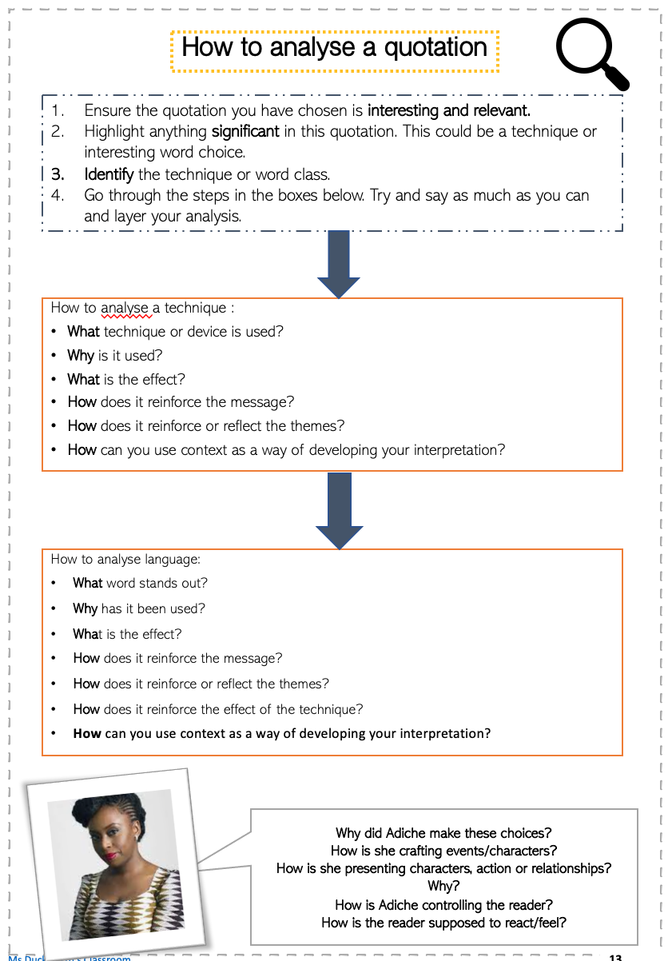
Key quotation analysis
Page 50 in the booklet
Jaya – ‘Fear had darkened Jaya’s eyes to the colour of coal tar, but he looked Papa in the face now.’
Atmosphere – ‘The silence was broken only by the whir of the ceiling fan as it sliced through the still air.’
Kambili – ‘I meant to say I am sorry Papa broke your figurines, but the words that came out were, “I’m sorry your figurines broke Mama.” ‘
Mama – ‘There were never tears on her face…The last time, only two weeks ago, when her swollen eye was still the black-purple color of an overripe avocado, she had arranged them after she polished them.’
Papa – ‘Aunty Ifeoma, said once that Papa was too much of a colonial product.’
Papa – ‘There was a shadow clouding Papa’s eyes, a shadow that had been in Jaya’s eyes. Fear. It had left Jaya’s eyes and entered Papa’s.’
Papa – ‘The shadow grew, enveloping the whites of Papa’s eyes. Jaja was walking out of the dining room with his plate. Papa made to get up and then slumped back on his seat. His cheeks drooped, bulldog-like.’
Kambili – ‘The compound walls would crumble, I was sure, and squash the frangipani trees. The sky would cave in. The Persian rugs on the stretches of gleaming marble floor would shrink. Something would happen. But the only thing that happened was my choking. My body shook from the coughing.’
Kambili – ‘Inside my head, thousands of monsters played a painful game of catch, but instead of a ball, it was a brown leather-bound missal that they threw to each other.’
Kambili - ‘I lay in bed after Mama left and let my mind rake through the past, through the years when Jaja and Mama and I spoke more with our spirits than with our lips.’
Kambili – ‘ “Jaja’s defiance seemed to me now like Aunty Ifeoma’s experimental purple hibiscus: rare, fragrant with the undertones of freedom, a different kind of freedom from the one the crowds waving green leaves chanted at Government Square after the coup. A freedom to be, to do. ‘
Notes:
This in in the booklet.
Go through the next slide before pupils complete the task.

Slide 30
Key quotation analysis
What should you be looking out for?
Interesting word choice
Imagery and figurative language
Structural choices
Sentence types
Contrasts
Shifts
Juxtapositions
Noun placed at the beginning of the sentence highlights the impact this has as well as its presence in their lives
Verb highlights the change in Jaja and the significance of his actions
Jaya – ‘Fear had darkened Jaya’s eyes to the colour of coal tar, but he looked Papa in the face now.’
20 minutes
Notes:
Pupils should do this in pairs.

Slide 31
Final Task
What is the contrast between the Papa we see at Church and the Papa we see at home? Why is he a contradictory character?

Slide 32
Thank you for visiting Ms Duckworth’s Classroom! I hope you enjoy the resource. The full scheme of work can be found here.
You can also follow me on Instagram and find me on Facebook or twitter.
Notes:
https://www.msduckworthsclassroom.com/product-page/purple-hibiscus-full-scheme-of-work-cie-igcse

