Slide 1
Reading for Meaning
Date:
LO: to understand how to read for meaning
Starter:
Name the technique and say whether it is better suited for argue or persuade –
I understand that you think school uniforms are necessary and help us to focus, however I would like to suggest they are outdated.
I would like you to stop and consider just how many defenceless animals will be affected by your heartless decision.
Many would argue that 2/5 is too small a number and that it actually does not suggest that mobile phones are widely available to all teenagers.
It is absolutely imperative that you follow through on the advice that you have previously given.
Notes:
Counter argument
Emotive language
Use of facts
Assertion

Slide 2
Response to reading
Response to a text…
Remember that for Section A: Directed Writing, you are responding to a text or texts.
What does this mean?

Slide 3
Top tips
What do the underlined words mean?
As you read, look for clues that suggest how the writer feels. Can you see evidence of bias? Is there a flaw in their argument?
Look out for a range of ideas, both implicit and explicit
Think about how you are responding to these ideas. Respond to a range of ideas from the text and evaluate them.

Slide 4
Task: in groups of 3, read the extract
You will go through the same steps in the exam!
Make notes on:
What it is about
The main ideas
The point of view/perspective of the writer
How do you know what their purpose/perspective is? What do they say; how do they say it; what is the effect?
Contextual information – what do you learn about the text from the overview given at the beginning?
Any bias the writer may have and why you think this
10 minutes
Notes:
Clarify any terms that pupils may have forgotten. Ensure they fully understand how to approach this text and how to be active readers.

Slide 5
Text – Why Go Vegan?
Feedback
Notes:
Go through with pupils and elicit responses in terms of their notes on the text

Slide 6
End of lesson review
Explain these terms to a partner…
Context
Bias
Point of view
Perspective

Slide 7
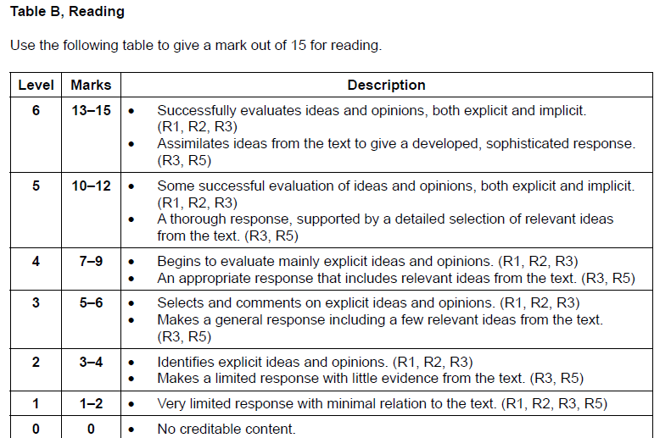
Responding to a text
Date:
LO: to understand how to deconstruct Q1 and write a response
Starter: Organise these exam command words into levels. How are you making your decisions?
Appropriate
Identifies
Selects
Limited
Successfully
General
Assimilates
Sophisticated
Relevant
Level 7
Level 6
Level 5
Level 4
Level 3
Level 2
Level 1
Notes:
This task leads into a nice discussion on what the terms mean and what they they look like in terms of an answer.

Slide 8
PIPS
Use PIPS to help you develop a response
Point from text – rewrite and put it into context
Inference of evidence & evaluation - explore what has been said; consider explicit & implicit meanings along with any bias.
Personal response with reasons – how do you respond to this particular idea? What is your opinion? Why?
Solution – can you offer a solution? Is there another way of looking at or considering this point?

Slide 9
Mini question 1 task– how should you approach this?
Do steps 1 and 2.
STEPS:
Read the question and underline the keywords
FAPP
Read the passage(s)
Plan your ideas
Write up your response
Task:
Write a letter to your Headteacher. In it, you should present your ideas on the introduction of a vegan menu, once a week, to the school canteen.
Identify and evaluate the ideas presented in the passage.
Consider the advantages and disadvantages of this idea.
Begin your letter with, ‘Dear Ms Franklin,’
The bullet points help you to focus on the main ideas and this is where you get your reading marks from.
5 minutes
Notes:
Remind pupils how to deconstruct the question and the bullet points. This will help them to understand what style to write in and what to look for when they read the text again.

Slide 10
In pairs, go back through the text and highlight anything useful to the task.
Always keep the question in mind as you do this
Task:
Write a letter to your Headteacher. In it, you should present your ideas on the introduction of a vegan menu, once a week, to the school canteen.
Identify and evaluate the ideas presented in the passage.
Consider the advantages and disadvantages of this idea.
Begin your letter with, ‘Dear Ms Franklin,’
Notes:
Go through with pupils and elicit responses in terms if their notes on the text

Slide 11
What style will you write in?
What do you know about letters?
Task:
Write a letter to your Headteacher. In it, you should present your ideas on the introduction of a vegan menu, once a week, to the school canteen.
Identify and evaluate the ideas presented in the passage.
Consider the advantages and disadvantages of this idea.
Begin your letter with, ‘Dear Ms Franklin,’
Where will you find information on advantages and disadvantages?
What must you consider when writing to a Headteacher?
What does evaluate mean?
What does identify mean?
Notes:
Pupils can use some persuasive techniques here in order to drive through their ideas. They will also be using argue techniques as they consider both sides. Hopefully pupils will understand that they have explicit and implicit reference to advantages but will have to make their own interpretations about the disadvantages – this must always have a basis in the text however and should be linked to an example.

Slide 12
Group plan
Task:
Write a letter to your Headteacher. In it, you should present your ideas on the introduction of a vegan menu, once a week, to the school canteen.
Identify and evaluate the ideas presented in the passage.
Consider the advantages and disadvantages of this idea.
Begin your letter with, ‘Dear Ms Franklin,’
Join up with another pair and plan your answer.
The writer’s views in the passage How do they convey this view? | Your views with reasons. This is where you develop your RESPONSE.
 | Agree: Disagree:
Include 3 points here
Notes:
Hand out A3 paper so pupils can plan. You may want them to write the task at the top of the paper or print it out for them to glue on.

Slide 13
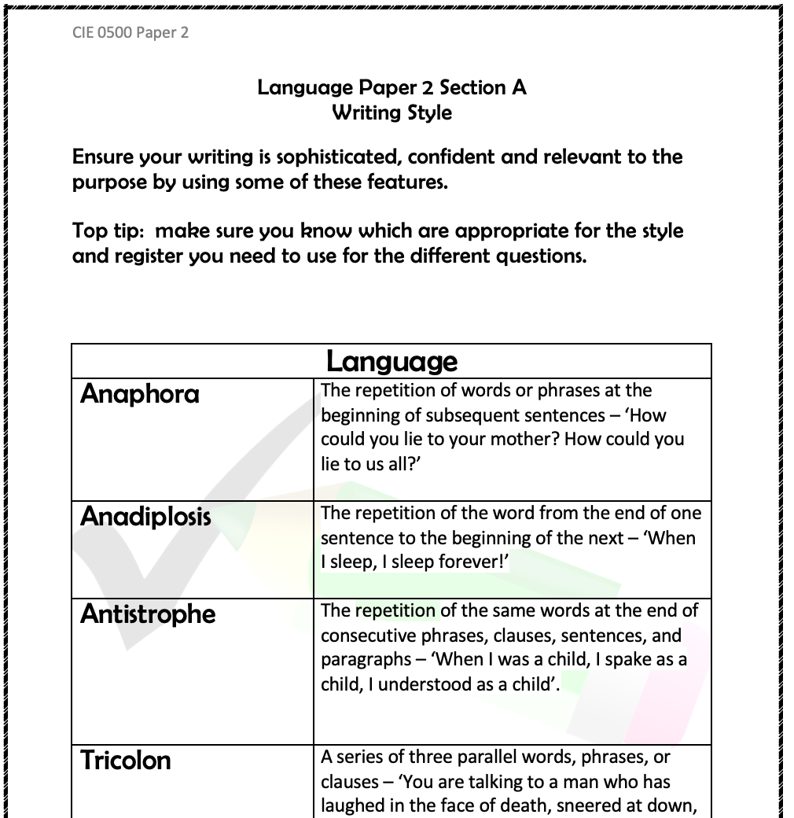
Success Criteria - writing
In your groups of 4, write up a group answer. 20 minutes!
Style
Accuracy
Sophisticated techniques such as anaphora
Repetition
List of 3
Counter argument
Facts
Short sentences for effect
One line paragraphs
Link between paragraphs
Circular structure
Rhetorical question
Vocabulary for effect
Connectives – link ideas
A range of different sentence types
Effective use of punctuation (at least 5)
Paragraphs
Organisation of ideas
Links and transitions between ideas and paragraphs
Fluency
Topic sentences
Peer assess: exchange your answer with another group and write down your feedback. Comments must be linked to the success criteria for both reading and writing.
Use the ‘Writing Style’ sheet to help you.
Notes:
Talk pupils through this to ensure they feel comfortable with all of the different skills/techniques etc
The Writing Style sheet is in the bundle.
It doesn’t matter if the answer is only partial – this is just a practice exercise.

Slide 14
Thank you for downloading this resource; I hope it is useful! You can view the full Language Paper 2 scheme of work here. Or you can find the revision scheme of work here.
You can also follow me on Instagram and find me on Facebook or twitter.

