Slide 1
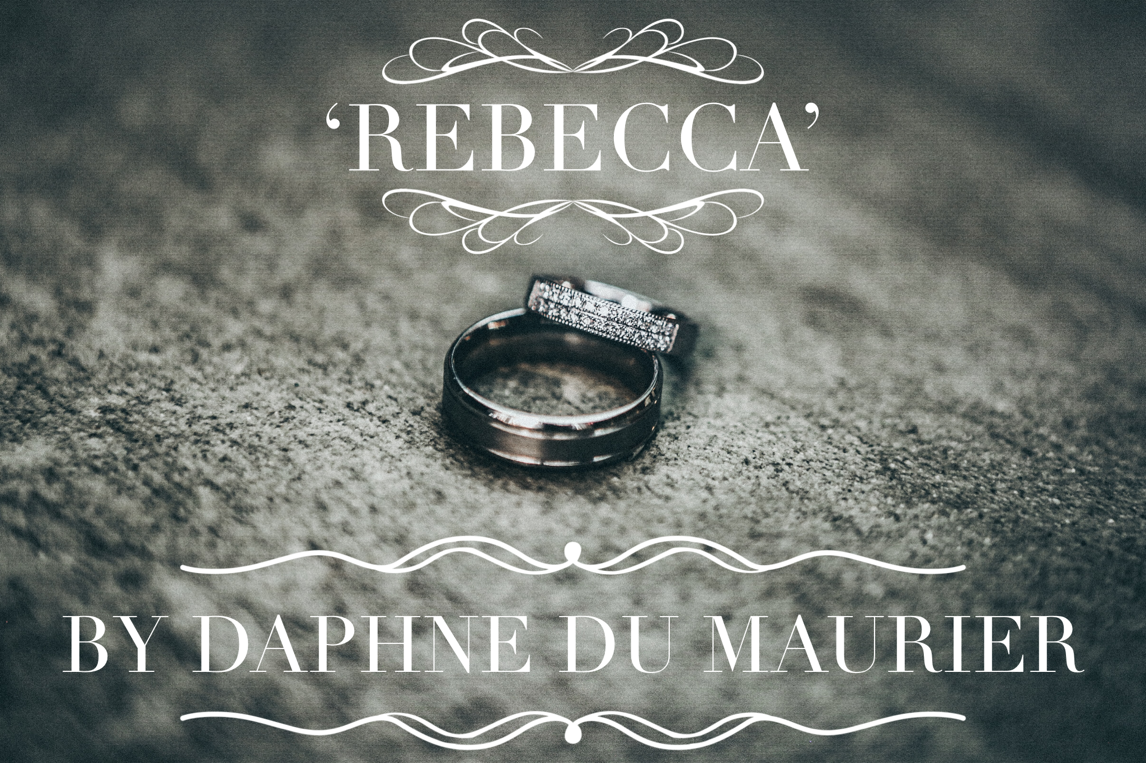
Maxim de Winter
Learning Question: how does Du Maurier characterise Maxim at the beginning of the novel?
Date:
Do now:
True or false…
The novel opens with a description of an estate by the name of Menabilly.
The narrator’s name is Francis.
The narrator works for a woman called Mrs Van Hopper
The narrator meets Maxim de Winter in Mexico.
In Chapter 4, the narrator learns that Maxim’s wife drowned
Notes:
False – Manderley
False – we don’t know her name
True
False – Monte Carlo
True

Slide 2
What does characterisation refer to?
How does a writer create a character?
Discuss in pairs and make notes on your whiteboards.
Speech
Appearance
Actions/behaviour
Setting
Interactions with others
Notes:
Play the slide
Language
Mood
Description of setting / characters / weather
Feelings that are evoked

Slide 3
Today’s focus
What do we learn about Maxim de Winter?
How is he presented?
Why is he presented in this way?

Slide 4
Today we will write up one paragraph about the characterisation of Maxim in Chapters 3 & 4.
Before we do, think about how you will effectively introduce and embed your quotations. This is a very important skill. Watch the tutorial and make notes if you feel you need a recap.
Notes:
https://www.youtube.com/watch?v=sdAau1eI1Mc&list=PLw8WoAh2Xt9WrJz3-QzE3Yc161trHOkPH&index=1

Slide 5
Embedding and introducing quotations
Top tips:
Make it clear who is speaking, who to, why, in what way.
What is happening?
What is being described?
Where is the quotation from?
Do you need all of it or can you paraphrase sections so the rest can be embedded into your own sentence?
Which of these are embedded?
Du Maurier writes ‘We can never go back again…’.
It says in Chapter 2 ‘We can never go back again…’.
In Chapter 2, the narrator reflects upon her past at Manderley and declares that they ‘can never go back again…’.
Notes:
The 3rd one is embedded

Slide 6
Introducing and presenting characters
Authorial method
When we think about authorial choices, we should consider not only characterization but also when characters are introduced and how.
How is Maxim introduced to us?
At what point?
What do we learn about him?
What kind of a person is he?
How does the narrator view him?
How do we feel about him?
Narrative perspective: don’t forget that this is a retrospective account told by an unnamed narrator. Might this affect how this memory is retold?
Maxim isn’t named until the end of Chapter 2.
Why do you think this is?
The significance of names:
Maxim = a short, pithy statement expressing a general truth or rule of conduct.
Maxim = Maxim machine gun, first fully automatic machine gun (q.v.), developed by engineer and inventor Hiram Maxim in about 1884.
de Winter = connotations of death, cold.
Notes:
Name = duality of character. May not be what he seems. Danger. Winter = sterile, cold, lack of life.

Slide 7
Introducing and presenting characters
Authorial method
Maxim isn’t named until the end of Chapter 2.
What tone is created by the way in which he is spoken about in Chapter 2?
How is foreshadowing used?
He is wonderfully patient and never complains, not even when he remembers... which happens, I think, rather more often than he would have me know.
I can tell by the way he will look lost and puzzled suddenly, all expression dying away from his dear face as though swept clean by an unseen hand, and in its place a mask will form, a sculptured thing, formal and cold, beautiful still but lifeless. He will fall to smoking cigarette after cigarette, not bothering to extinguish them, and the glowing stubs will lie around on the ground like petals. He will talk quickly and eagerly about nothing at all, snatching at any subject as a panacea to pain. I believe there is a theory that men and women emerge finer and stronger after suffering, and that to advance in this or any world we must endure ordeal by fire. This we have done in full measure, ironic though it seems. We have both known fear, and. loneliness, and very great distress. I suppose sooner or later in the life of everyone comes a moment of trial. We all of us have our particular devil who rides us and torments us, and we must give battle in the end. We have conquered ours, or so we believe.
What is the effect of the repeated us of plural pronouns?
What clues are we given about the past events?

Slide 8
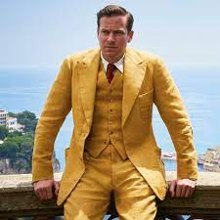
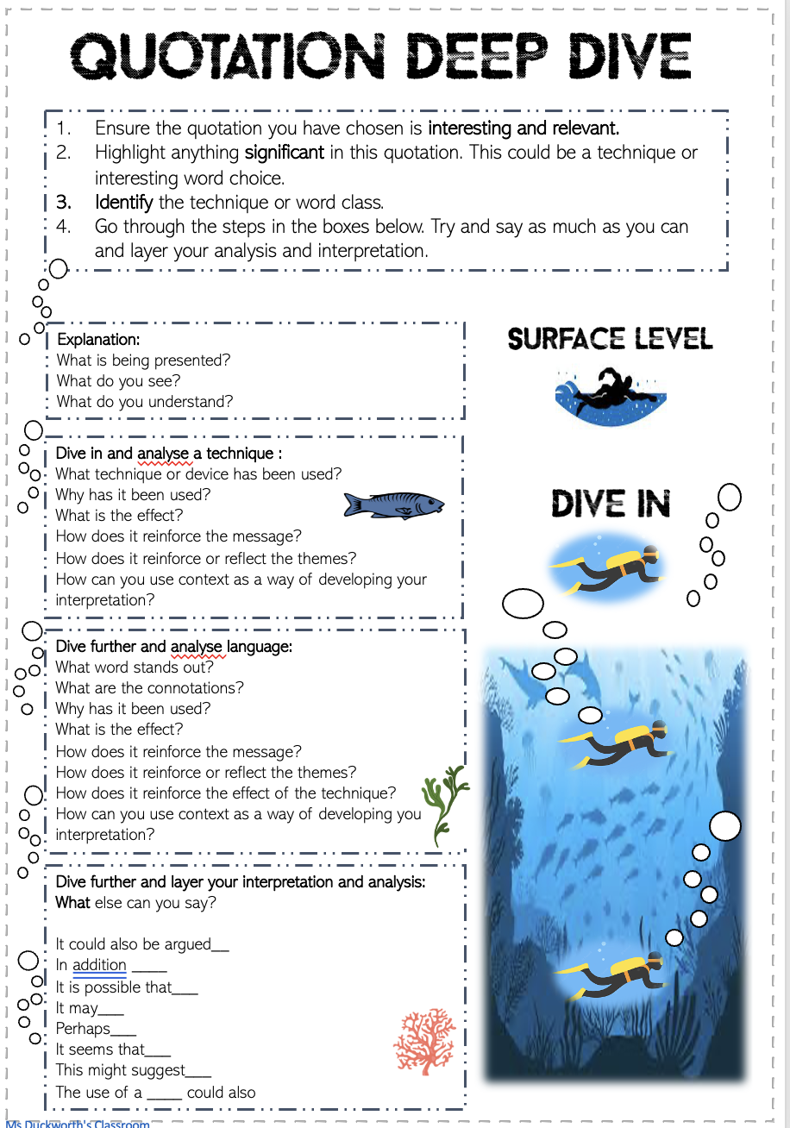
Maxim de Winter
We will do a Deep Dive on Maxim when the narrator first meets him
Wealthy
Charismatic
Powerful
Confident
Masculine
Cultured
Handsome
Wealthy
Polite
Gentleman
Intimidating
Notes:
Talk through the models with pupils

Slide 9
Watch the video. What tips are you given for how to analyse techniques?
Notes:
https://www.youtube.com/watch?v=D98_w9FUt2I

Slide 10
Let’s dive into the text: Chapter 3
Model analysis
We will try to find and analyse 2 quotations and then write an analytical paragraph
‘This time his shaft had found the mark...’
‘He looked down at us, mocking, faintly sardonic, a ghost of a smile on his lips.’
Shows the intentional power behind his words.
Conveys his enjoyment
1. Explanation:
What is being presented?
What do you see?
What do you understand?
Surface meaning
2. Use of metaphor –
Shaft – weapon
Shows his power and potential danger
2. Use of list –
Builds up the description of Maxim’s derisory attitude towards Mrs. Van Hopper
2. Dive in and analyse a technique :
What technique or device has been used?
Why has it been used?
What is the effect?
How does it reinforce the message?
How does it reinforce or reflect the themes?
How can you use context as a way of developing your interpretation?
Layers of meaning
3. Dive further and analyse language:
What word stands out?
What are the connotations?
Why has it been used?
What is the effect?
How does it reinforce the message?
How does it reinforce or reflect the themes?
How does it reinforce the effect of the technique?
How can you use context as a way of developing your interpretation?
3. Use of language –
‘sardonic’ – critical and scornful of Mrs. Van Hopper. Reveals how little he thinks of her / lack of respect
4. In addition, ‘smile’ – juxtaposes his derisory attitude. Suggests he is enjoying her reaction. Perhaps Du Maurier is suggesting there are two sides to Maxim.
3. Use of language –
‘mark’ – connotations of weakness, target, pain, wound.
Reveals his intention to hurt Mrs. Van Hopper with his words.
4. Dive further and layer your interpretation and analysis:
What else can you say?
Notes:
Go through the model analysis
I have chosen 2 quotations that are linked – if this is too difficult delete 1 and then also delete it from the model parapgraph

Slide 11
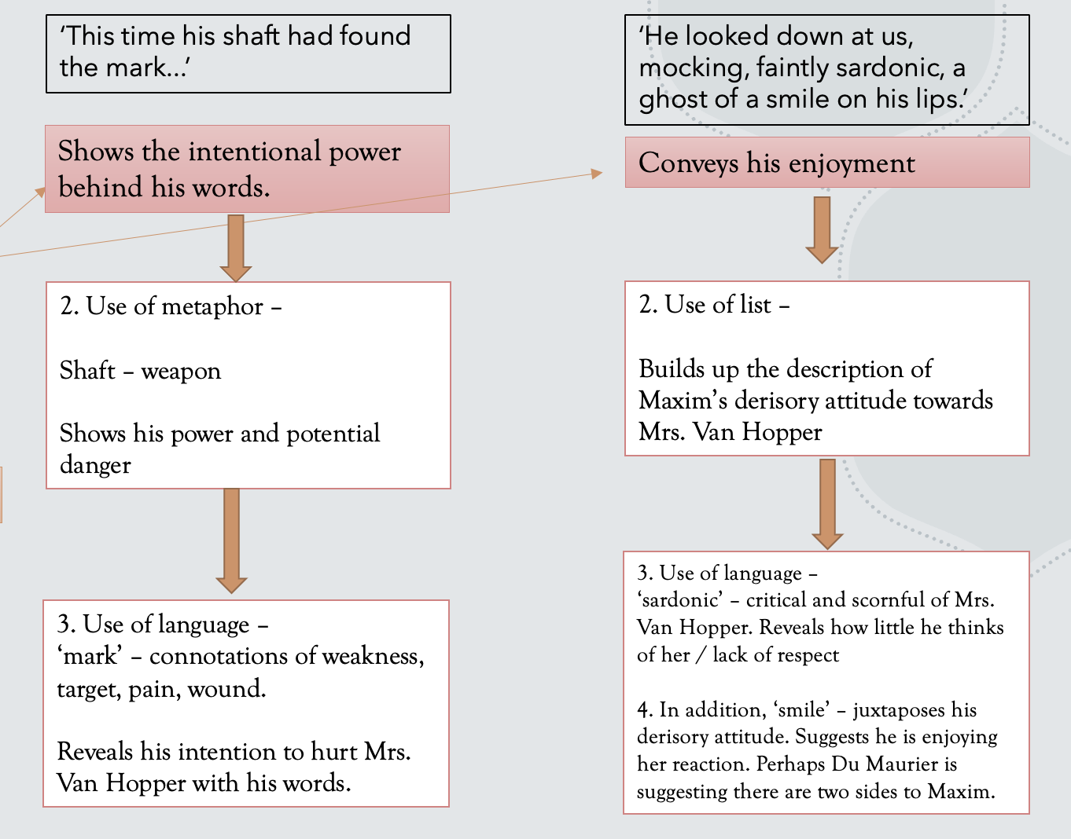
How to turn your deep dive into analytical writing
Maxim is introduced to be both powerful and derisory when in the company of Mrs van Hopper in Chapter 3. In response to Mrs Van Hopper’s over familiarity, Maxim responds in a way meant to both poke fun at her and make her feel uncomfortable. It is clear he has been successful when the narrator remarks that ‘This time his shaft had found the mark…’. This description accurately reveals the intentional power behind his words. Moreover, the use of the metaphor ‘shaft’ links his words to a weapon and magnifies his power over Mrs. Van Hopper at this moment as well as hinting at a potential danger lurking within. In addition, the use of ‘mark’ suggests a weakness on the part of Mrs Van Hopper and emphasises the potential pain caused by his words. Furthermore, as a ‘mark’ is a target, the use of this noun makes it clear that it was Maxim’s intention to hurt Mrs Van Hopper with his response. This idea of wanting to hurt and cause pain is further reinforced when he is described to look down on the narrator and Mrs Van Hopper ‘mocking, faintly sardonic, a ghost of a smile on his lips.’ It is evident from this description that he enjoys the pain and discomfort he has caused. Discomfort caused is enhanced by the use of a list which builds up the description of his derisory attitude towards his listener and almost reflects how overwhelming his attitude is at this moment. Furthermore, the use of ‘sardonic’ reflects how scornful Maxim is and makes it clear he does not respect her. Following on from this idea, the description of a ‘smile on his lips’ juxtaposes his derisory attitude and suggests he is enjoying her uncomfortableness. Perhaps, in this small interaction, De Maurier is providing both the narrator and the reader with clues as to the hidden nature of Maxim du Winter.
Notes:
Explain how the analysis has now been turned into a paragraph

Slide 12
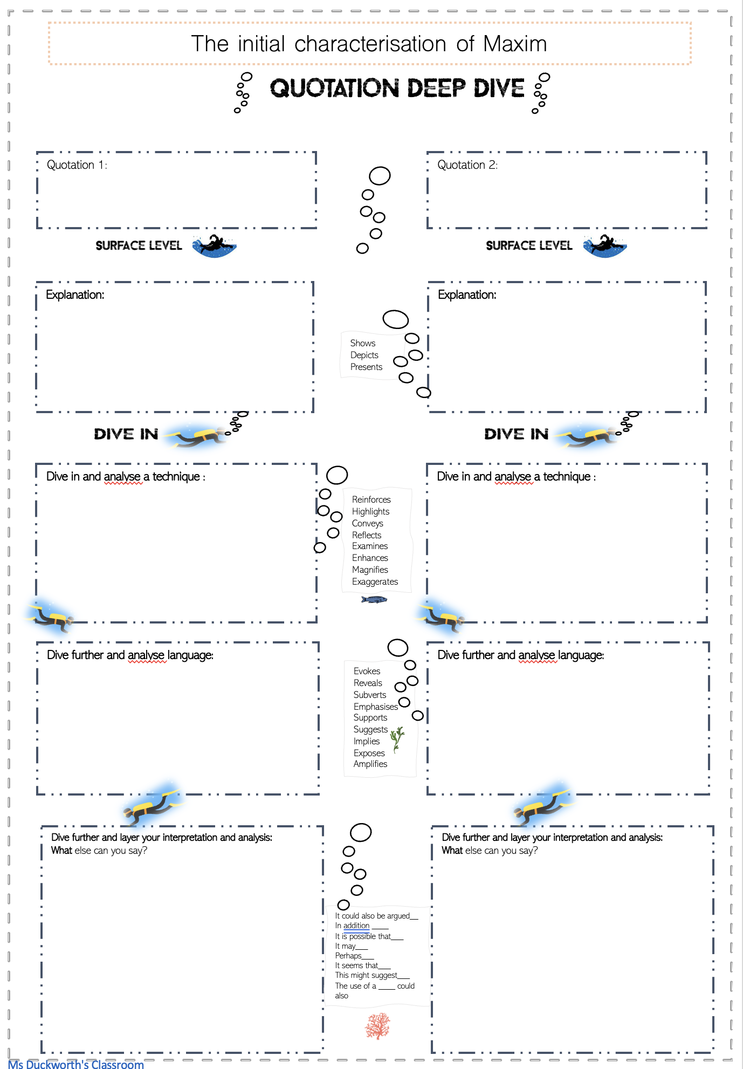
Task
Page 51 in the booklet
Choose two quotations of your own and do a deep dive.
Try and choose quotations that can be linked together.
How is Maxim presented in Chapters 3 & 4?
20 minutes
Notes:
Pupils can choose quotations from anywhere in Chapters 3 & 4

Slide 13
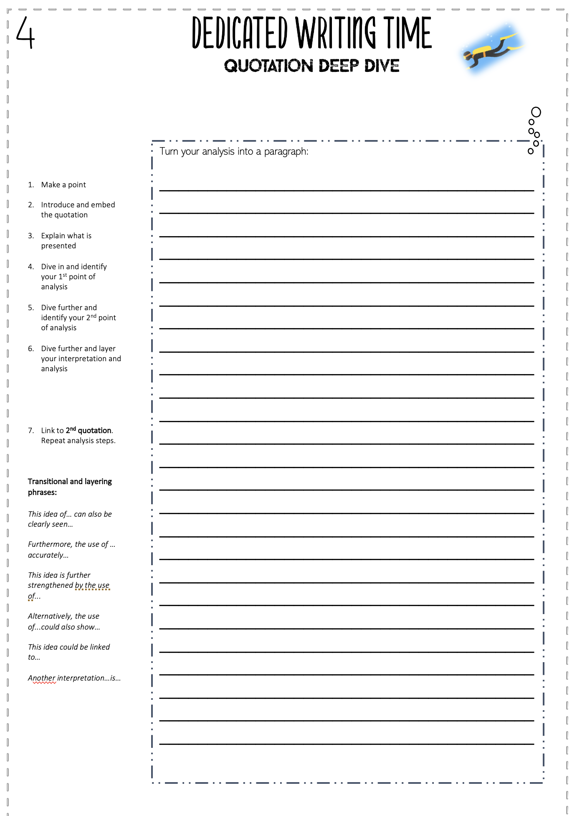
20 minutes
How is Maxim presented in Chapters 3 & 4?
Wealthy
Charismatic
Powerful
Confident
Masculine
Cultured
Handsome
Wealthy
Polite
Gentleman
Intimidating
What is presented?
Turn your deep dive analysis into a paragraph
Analyse a technique OR zoom in on a word. What does it show? Why has it been used?
Why is it presented in this way?

Slide 14
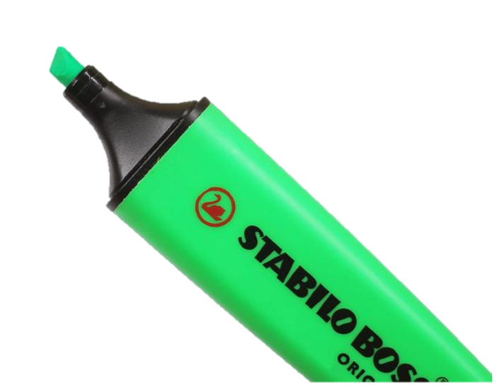
Highlight where you…
Included an embedded quotation
Analysed a word
Analysed a technique
What did you do well?
What do you still need to work on?

Slide 15
Thank you for visiting Ms Duckworth’s Classroom! I hope you enjoy the resource. The full scheme of work can be found here.
You can also follow me on Instagram and find me on Facebook or twitter.
Notes:
https://www.msduckworthsclassroom.com/product-page/rebecca-full-scheme-of-work-cie-igcse?utm_campaign=ccd3d27c-fabb-4db1-b485-1e43c58d43e8&utm_source=so&utm_medium=mail

