Slide 1
Skills for Descriptive Writing (Language Paper 2 Composition Question)
LO: to understand how to describe individual images
Date:
STARTER:
Quick quiz
What is a simile?
What is a metaphor?
What is an adverb?
What is personification?
What are the 5 senses?

Slide 2
Descriptive skills
Metaphors
Similes
Senses
Personification
Adjectives
Adverbs
Hyperbole
Pathetic fallacy
Oxymoron
Juxtaposition
Notes:
Go through each technique and elicit definitions and examples from pupils

Slide 3
One way of differentiating descriptive from narrative writing is by imagining you are looking at photographs. Each paragraph acts as a different photo that only you can see. Then you describe it for your reader.
Show don’t tell.

Slide 4
Mini task
Describe a busy supermarket.
Quickly brainstorm any ideas that come into your head.
Organise these and place similar ideas together. Imagine your photos…
10 minutes

Slide 5
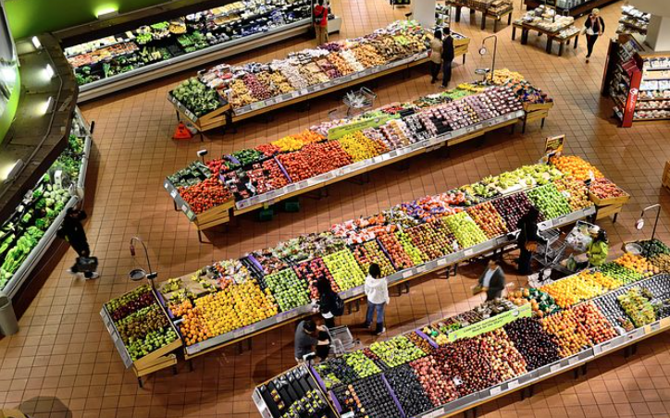
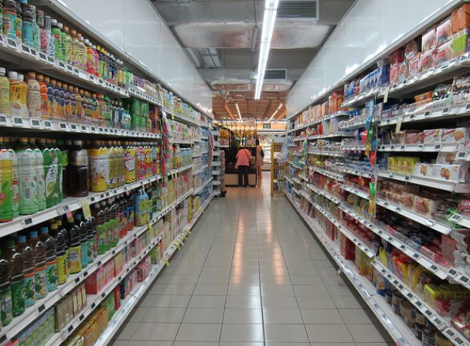
Quickly brainstorm any ideas that come into your head.
Organise these and place similar ideas together. Imagine your photos…
Begin to attach techniques to your different ideas.
Which techniques can you spot in my examples?
The fruit section is a rainbow of exotic produce that calls to me as I walk by.
Customers chatter excitedly as they hunt for items on their list.
The aisle stretches further than I can see. It looks like a magical bowling alley with no end in sight.

Slide 6
Quickly brainstorm any ideas that come into your head.
Organise these and place similar ideas together. Imagine your photos…
Begin to attach techniques to your different ideas.
Now add techniques to your plan.
The fruit section is a rainbow of exotic produce that calls to me as I walk by.
Customers chatter excitedly as they hunt for items on their list.
The aisle stretches further than I can see. It looks like a magical bowling alley with no end in sight.

Slide 7
TASK: Share your plan with a partner. Can you give your partner any tips or ideas? Does it sound descriptive enough? Do they have a range of images to describe?
You have 5 minutes to edit your plan based on the feedback from your partner.

Slide 8
Describe a busy supermarket.
Quickly brainstorm any ideas that come into your head.
Organise these and place similar ideas together. Imagine your photos…
Begin to attach techniques to your different ideas.
Write up your response.
Now write up your response using your plan and the success criteria.
Success Criteria:
Write for the correct purpose
Use a range of descriptive techniques
Clear structure for effect - – ideas and description should progress.
Interesting vocabulary
A range of different sentence types
Different ways of beginning sentences
Use of punctuation to effectively control ideas
Spelling
Appropriate tense
Use of paragraphs to control ideas
A range of different paragraph lengths for effect
Descriptive techniques:
Metaphors
Similes
Senses
Personification
Adjectives
Adverbs
Hyperbole
Pathetic fallacy
Oxymoron
Juxtaposition
Use the guide sheet to help you!

Slide 9
Thank you for downloading this resource; I hope it is useful! You can view the full Language Paper 2 scheme of work here.
You can also follow me on Instagram and find me on Facebook or twitter.

