Slide 1
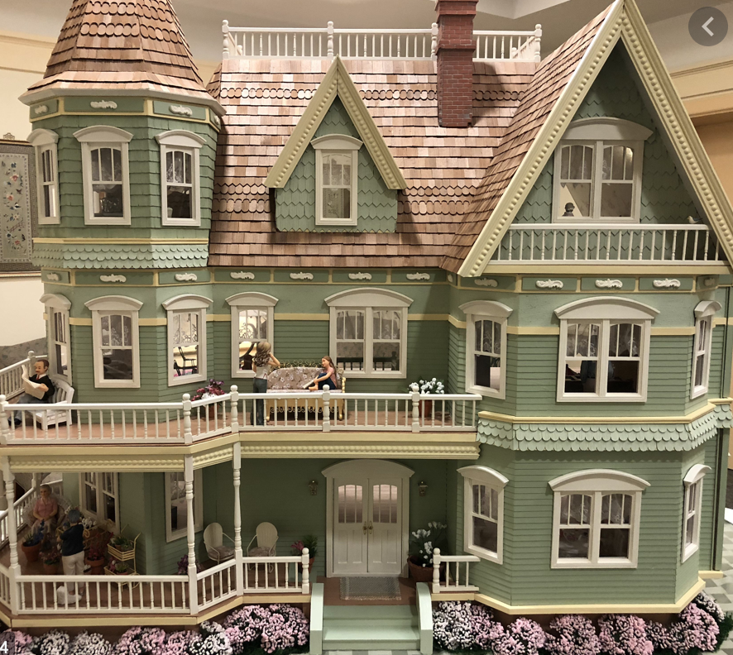
A Doll’s House
Date:
LO: to understand the translation issues relating to the play
To understand the connotations of the title

Slide 2
Why are we studying ‘A Doll’s House’?
Area of exploration—time and space (AOE2)
How important is cultural or historical context to the production and reception of a text?
How do we approach texts from different times and cultures to our own?
To what extent do texts offer insight into another culture?
How does the meaning and impact of a text change over time?
How do texts reflect, represent or form a part of cultural practices?
How does language represent social distinctions and identities?
Area of exploration—readers, writers and texts (AOE1)
Why and how do we study language and literature?
How are we affected by texts in various ways?
In what ways is meaning constructed, negotiated, expressed and interpreted?
How does language use vary amongst text types and amongst literary forms?
How does the structure or style of a text affect meaning?
How do texts offer insights and challenges?
This can be used for:
Paper 2
HL essay
Individual Oral

Slide 3
What do we need to consider when looking at the criterion for paper 2?
This is the same for HL & SL
Notes:
Elicit from pupils what they already know about these or brainstorm what they think they could mean

Slide 4
How is a play different to a novel?
Keep this in mind as we read and analyse the play.
A play is a performance. Therefore it is meant to be watched and enjoyed.
There is an audience as opposed to a reader. Therefore tension and conflict may be felt more clearly by an audience. They may feel involved in the action.
Staging / stage directions
Notes:
Elicit responses from pupils

Slide 5
New terminology
Kinesics: body movements and gestures regarded as a form of non-verbal communication.
Proxemics: the amount of space that people feel it necessary to set between themselves and others.
Paralinguistics: the part of communication outside of the words themselves – the volume, speed, intonation of a voice along with gestures and other non-verbal cues
Stage business: activity performed by an actor for dramatic effect
Can you think of any real world examples of these? Are we using any of them now?

Slide 6
Quick facts
Written whilst Ibsen was in Rome but published in Copenhagen in 1879. Hugely successful but controversial.
Setting: Norway
Language: Dano-Norweigian
Realist / Naturalist play (Realistic Drama)
3 acts
Social problem play: patriarchy, marriage, gender.
5 key characters
Inspired by real events: Laura Kieler (maiden name Peterson)

Slide 7
A text in translation
What does this mean?
What do we have to consider when looking at a text in translation?
In pairs, read the article and summarise the main points.
Notes:
Pupils could consider ideas such as:
Cultural norms of other countries
Performances in England & Germany
Lost meaning in phrases
Cultural understanding of idioms
Censorship
https://www.theguardian.com/stage/2014/oct/29/the-master-linguist-the-problem-with-translating-ibsen

Slide 8
Share your ideas with another group
Can you come up with a shared 10 point list of the main points from the article?
10 minutes

Slide 9
A Text in Translation
Date:
LO: to understand the translation issues relating to the play
True or false:
A Doll’s House was originally published in Italian
Ibsen didn’t like the ending so changed it after the 1st performance.
The play was inspired by real events

Slide 10
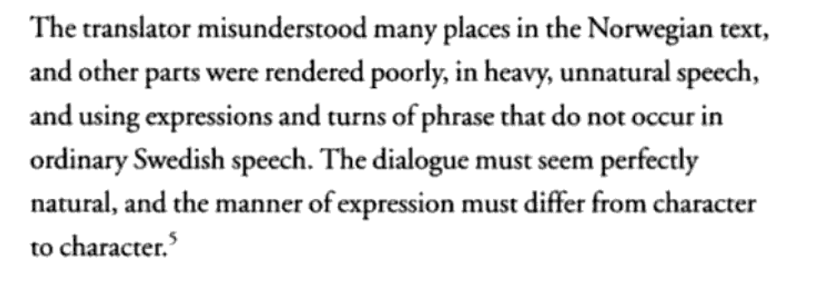
Ibsen’s own views on translation
What does Ibsen mean here? What are his concerns?
Ibsen’s letter to Nationaltidende 1880
7 minute pair discussion
Ibsen discussing An Enemy of the People with August Lindberg

Slide 11
Translation activity
In groups, you will act out the various different versions of some some scenes.
Think about how the different translators have interpreted Ibsen’s original scene and what the impact is.
Which version do you prefer? why?
Let’s see them performed! Show the rest of the class one of the scenes you performed in your group.
20 minutes
Notes:
Resource attached separately

Slide 12
End of lesson reflection…
What have you learned about translation and the impact this can have on a play which is meant to be performed?
7 minutes
Notes:
Pupils to spend 5 minutes writing a personal response

Slide 13
Context
Date:
LO: to understand the connotations of the title
to understand the context of the play
Do now task:
List the 3 main problems linked to translating a text.
List 3 reasons why it is still important for texts to be translated.

Slide 14
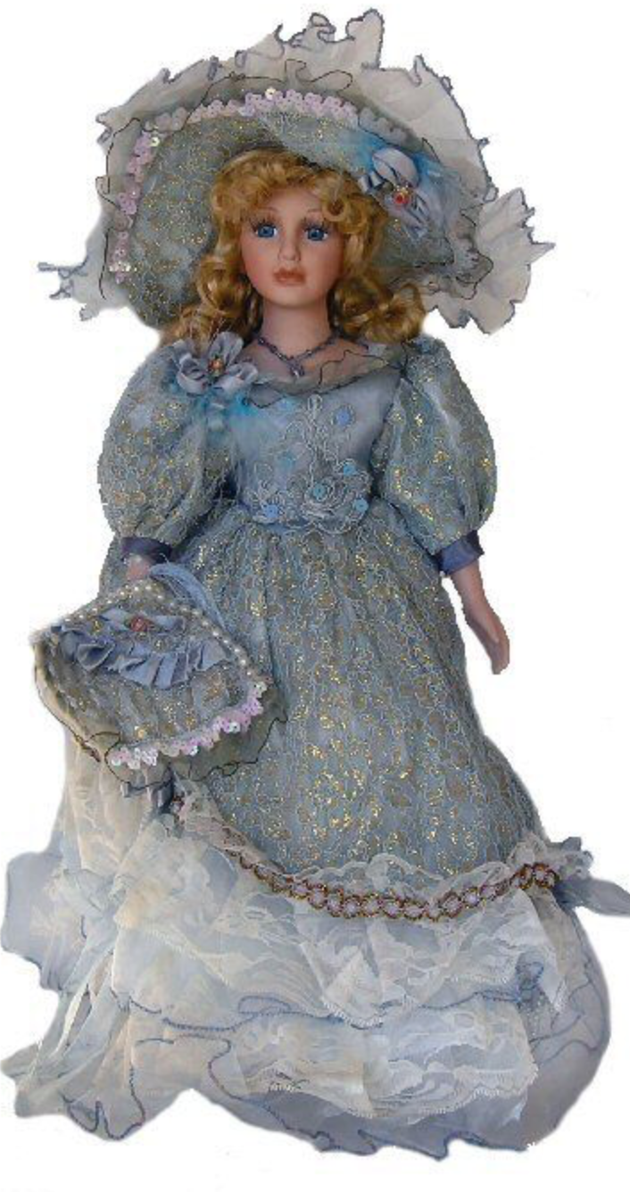
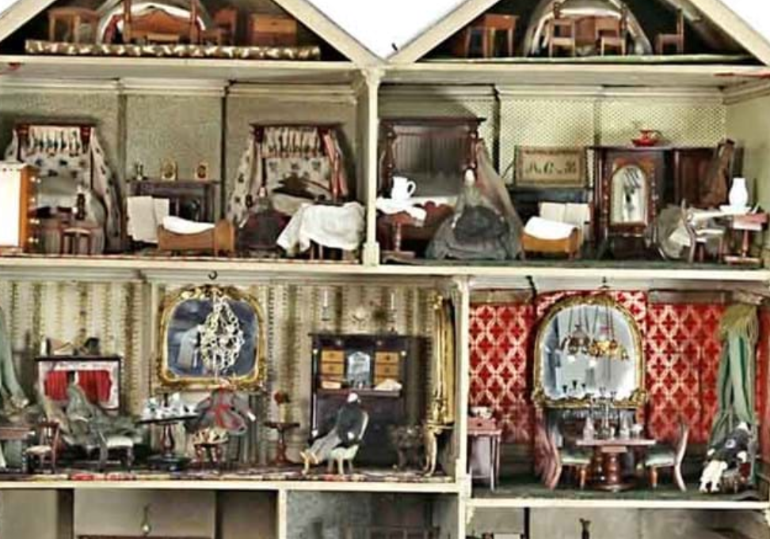
The title…
Why did I choose this title?
What is my intention?
7 minute pair discussion
Questions:
What do we associate with a ‘doll’? How would you describe a doll and its function?
Who do you think the doll is in the play?
How would you describe a doll’s house?
What is its function?
What could the doll’s house in the title be a symbol of?
What is Ibsen’s message?
Original title: Et Dukkehjem

Slide 15
How do these images help you to develop your interpretation of the title?
5 minute pair discussion
Fun fact: the name for a house for dolls in Norwegian is dukkehus or dukkestue.
Et dukkehjem actually refers to a small cosy neat home.

Slide 16
How does the meaning change?
Original title: Et Dukkehjem
A Doll House
American translation by Rolf Jelde
The Doll’s House
Errol Durbach uses this term when referring not to the title but the subject of the play
A Doll’s House
English title
Notes:
Elicit discussion before revealing the additional information about each.

Slide 17
Context Presentations
Research these areas in groups: You will research this and condense into 10 bullet points. Then you will present a summary to the class. Link your research to the play– how does it help us to understand author intention and the message of the play? How does your research help us to understand some of the themes or the social significance?
Essay: The Subjugation of Women by John Mills. Include key quotations that may be useful later on.
Drama vs Tragedy. Modern Drama – what is this? The elements of a tragedy as stated by Aristotle. To what extent can we link this to the play? Use Ibsen’s essay ‘Notes for a Modern Tragedy’ to help with this.
Gender roles and patriarchy in 19th C Norway around the time the play was written/performed. Class divisions and the expectations placed on women of different classes. Expectations of married women. Women and money. Motherhood & family life. Double standards. Feminism & Women’s Rights.
Ibsen and his personal life /marriage. Influences. Norway and political freedom from Denmark – impact on language. Other significant works.
Laura Kieler: Who is she? What was her relationship to Ibsen? What are the details of her story? What happened to her? Why? What do you learn about marriage and gender in the 19th Century from this story?
Notes:
This may take several lessons unless you set it as homework
Divide the class into 5 groups

Slide 18
Your presentations should…
Be informative
Be relevant
Be easy to follow and make notes from
Be interesting
Engage your audience
You can present your topic any way you choose: PPT, Prezi etc

Slide 19
Delivering your presentations…
What do you need to consider?
Notes:
Elicit points from pupils and make a success criteria

Slide 20
As you watch the presentations…
Make notes.
Think of questions to ask that help to clarify or extend ideas.
Be respectful!

Slide 21
Homework
Due:
Read the following articles and add to your notes on context.
Think about the experience for theatregoers at the time.
What do you learn about the history of theatre?
What do you learn about both the experience and who the audience were likely to be?
1. Theatre in the 19th C
2. The History of Theatre

Slide 22
Thank you for downloading this resource; I hope it is useful! You can find the full SoW here.
You can also follow me on Instagram and find me on Facebook or twitter.

