Slide 1
Approaching the novel
Date:
Today we will:
Use our contextual knowledge to interpret the opening of the novel
Begin to analyse character, narrative perspective, setting, tone & themes

Slide 2
Before we begin to read, let’s think about the criteria. What are you assessed on for P2?
Criterion A: | Knowledge, understanding and interpretation How much knowledge and understanding does the candidate demonstrate of the works? To what extent does the candidate make use of knowledge and understanding of the works to draw conclusions about their similarities and differences in relation to the question?
Criterion B: | To what extent does the candidate analyse and evaluate how the choices of language, technique and style, and/or broader authorial choices, shape meaning? How effectively does the candidate use analysis and evaluation skills to compare and contrast both works?
Criterion C: | How well structured, balanced and focused is the presentation of ideas?
Criterion D: | How clear, varied and accurate is the language? How appropriate is the choice of register and style? (“Register” refers, in this context, to the candidate’s use of elements such as vocabulary, tone, sentence structure and terminology appropriate to the essay).
We will begin by focusing on Criterion B
Notes:
This text is one of the texts pupils may choose for paper 2 therefore the focus here is on that mark scheme. Even if you are using this text for a different assessment it is still useful to encourage pupils to think abut skills required here as they are replicated elsewhere.

Slide 3
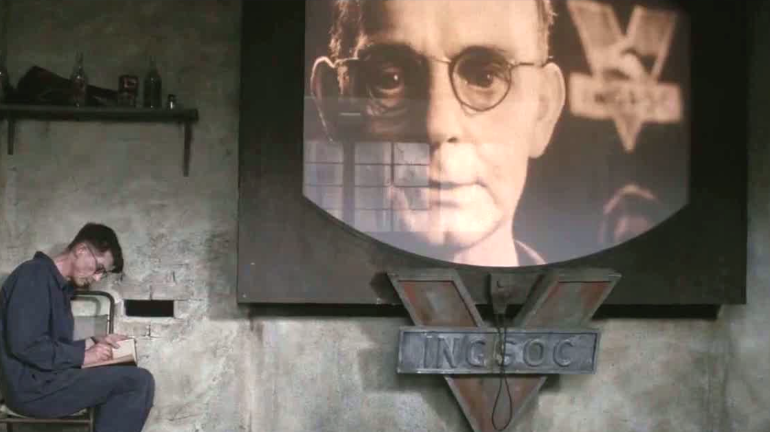
Narrative style
Why do you think Orwell chooses this style?
3rd person limited omniscient narrative:
A third-person point of view can be omniscient, in which the narrator knows all of the thoughts and feelings of all of the characters in the story, or it can be limited. If it's limited, the narrator only relates his or her own thoughts, feelings, and knowledge of various situations and other characters

Slide 4
Close Analysis of Chapter 1
How do we analyse a literary text?
What are we looking out for?
Why is the first chapter of any novel important?
What is the job of an initial chapter?
Quick brainstorm in pairs – 5 minutes.

Slide 5
Chapter 1 Always ask yourself: What does Orwell show you? How does he show you? Why does he show you this?
What happens? Why here? How is it described?
Which characters are introduced? How?
How is flashback used?
Which ideas are expressed?
Use your contextual knowledge to help you with your interpretation.
What are we told about the setting?
Which symbols are introduced?
What can you say about language choices?
Think about context as we read. How can you use this to develop your interpretation?
Notes:
In the previous lesson pupils researched the context, encourage them to use this information as they read Ch1. We read chapter 1 together so I could model what pupils should be looking out for. I encouraged them to stop the reading whenever they thought we had encountered something important. They then explained why they thought it was important and this then prompted a larger discussion linked to authorial method etc. The purpose of this activity is to allow pupils to become more familiar with the analysis they must demonstrate and also helps them to feel more confident when replicating this task independently. I kept this slide on the board whilst we read and they used it to help develop their responses.

Slide 6
Chapter 1 reflection…
Can you use some of the terminology from the tier 2 and 3 vocabulary list?
Spend 10 minutes making independent notes.
What do you learn in Chapter 1?
How do you learn it?
Why does Orwell want you to learn it?

Slide 7
Thank you for downloading this resource; I hope it is useful! You can find the full SoW here.
You can also follow me on Instagram and find me on Facebook or twitter.

