Slide 1
The Jaguar
Learning question:
What ideas are being expressed in this poem? How? Why?
Date:
Do now: what are the definitions of these techniques?
Personification
Asyndeton
Caesura
Enjambment
Alliteration

Slide 2
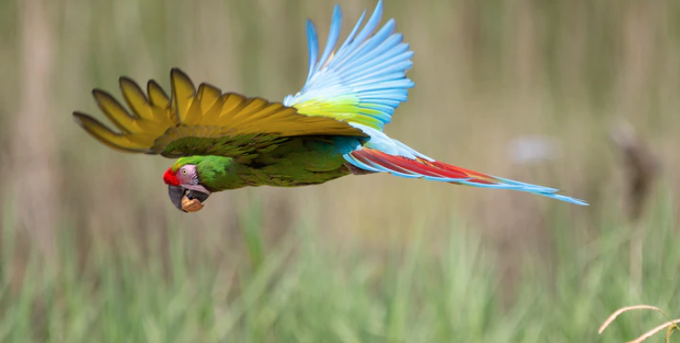
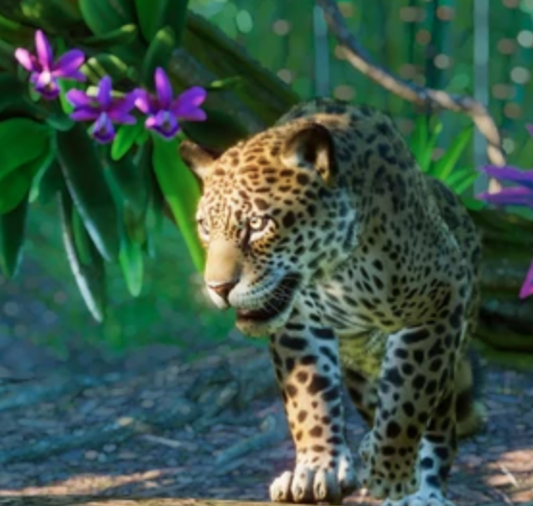
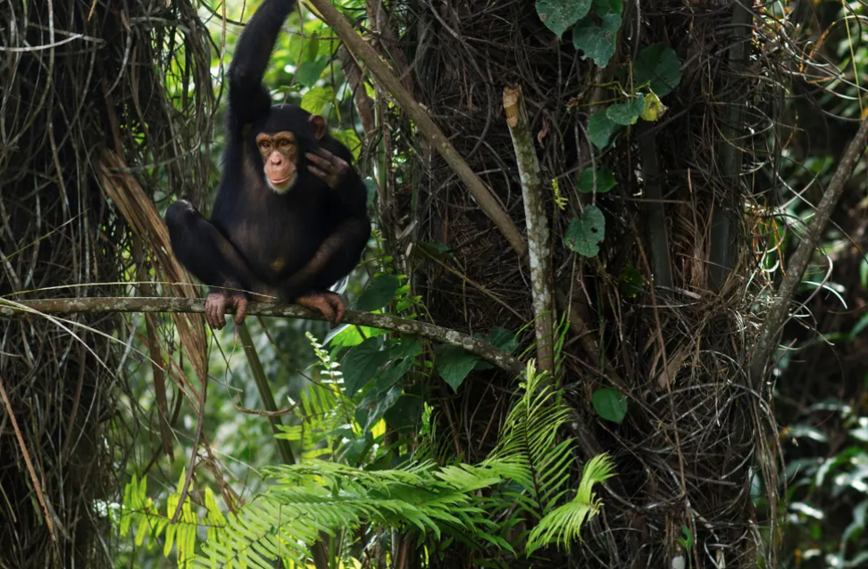
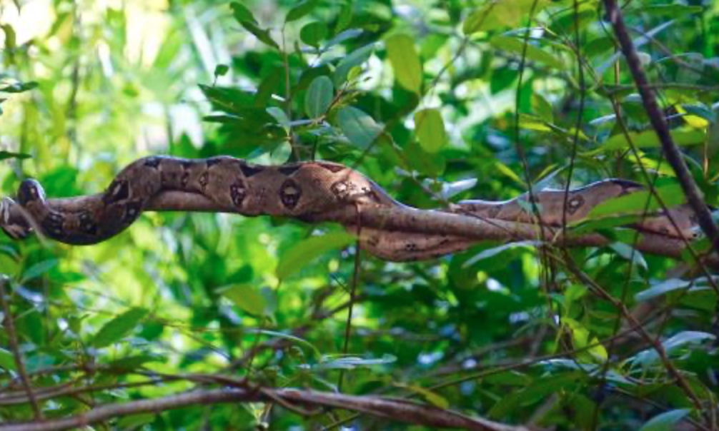
How would you describe each of these animals?

Slide 3
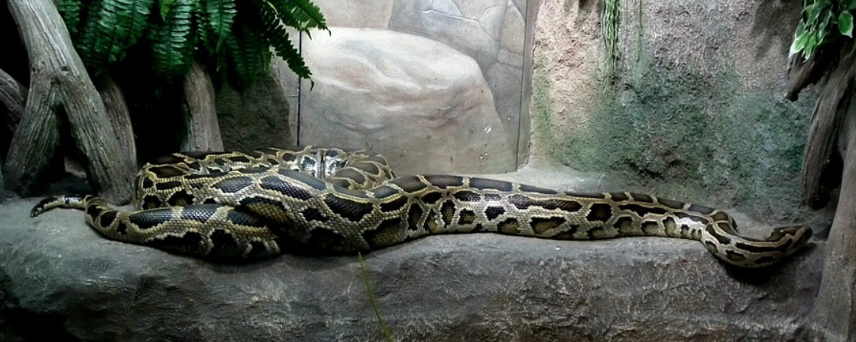
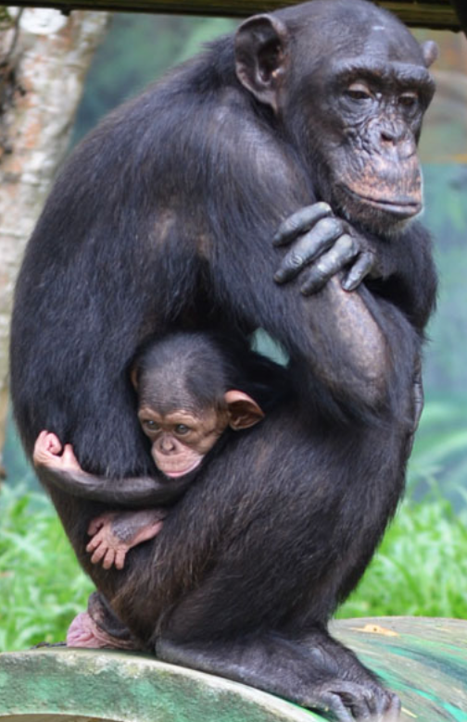
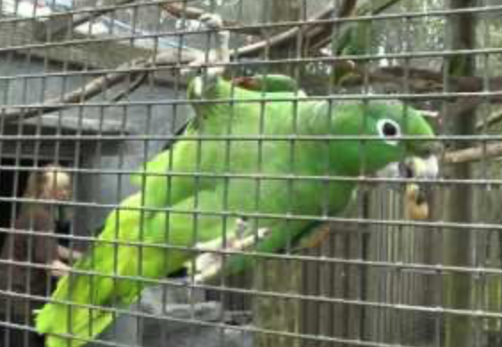
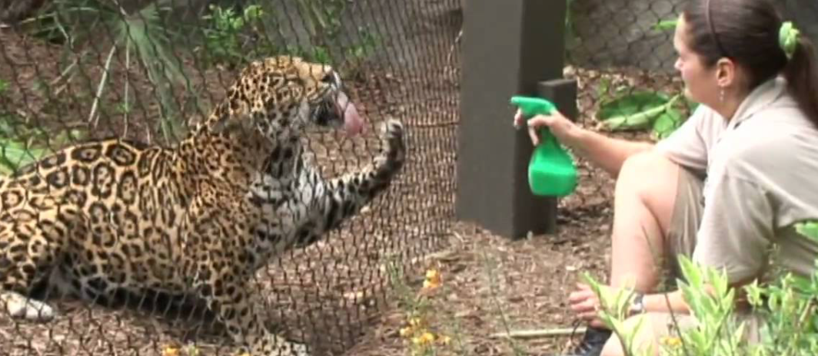
Would you still describe them in the same way?

Slide 4

What are the pros and cons of zoos?
Pros
Cons
Notes:
Give pupils time to discuss then feedback

Slide 5
The apes yawn and adore their fleas in the sun.
The parrots shriek as if they were on fire, or strut
Like cheap tarts to attract the stroller with the nut.
Fatigued with indolence, tiger and lion
Lie still as the sun. The boa-constrictor’s coil
Is a fossil. Cage after cage seems empty, or
Stinks of sleepers from the breathing straw.
It might be painted on a nursery wall.
But who runs like the rest past these arrives
At a cage where the crowd stands, stares, mesmerized,
As a child at a dream, at a jaguar hurrying enraged
Through prison darkness after the drills of his eyes
On a short fierce fuse. Not in boredom –
The eye satisfied to be blind in fire,
By the bang of blood in the brain deaf the ear –
He spins from the bars, but there’s no cage to him
More than to the visionary his cell:
His stride is wildernesses of freedom:
The world rolls under the long thrust of his heel.
Over the cage floor the horizons come.
Let’s read the poem together.
Consider your discussion on zoos – what perspective do you think Hughes is writing from?
Think about what is being presented to you.
How do you feel as you listen to each stanza? Why?
Notes:
Initial reading of the poem – discuss pupils’ 1st reactions

Slide 6
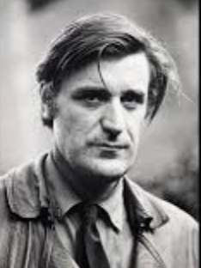
Why did Hughes write this poem? What is he trying to show the reader? What is he trying to achieve as a poet?
“During the autumn of 1954 I’d worked in Regent’s park Zoo, and got to know a particular Jaguar. It lived in a ‘transit’ cage near the kitchen window at which I stood for most of the day washing up.“
-from The Letters of Ted Hughes (edited by Christopher Reid).
This jaguar reminded Hughes of one he had seen as a young child, locked in a small cage at Morecambe zoo. He was enthralled by this jaguar and tried to recreate it in plasticine.
How do you know?
Notes:
How do you know – this is prompting pupils to go back to the poem and support their ideas with evidence.
Prompt pupils to add any useful contextual references to their notes in the booklet
Possible answers: Hughes is now able to recreate the jaguar in a way he could not as a young child; he presents the challenges faced by captivity and the jaguar’s strength in this difficult position; he is able to show he animal respect through his poem; it is a tribute to the animal; through Hughes, we are able to experience the jaguar’s emotions in a way that is not normally possible; we marvel over the jaguar just as the zoo visitors do - Hughes forces us to question our own role in this situation; Hughes presents the cruelty of man.

Slide 7
This poem is from the Hawk in the Rain collection
Hawk in the Rain (1957) | In 1957, The Hawk in the Rain was awarded first prize in the New York City Poetry Center’s First Publication Award by judges W H Auden, Stephen Spender and Marianne Moore. It was published in the US by Harper & Brothers. Hughes dedicated the collection to Sylvia Plath, his first wife, who had typed out the poems and submitted the manuscript to the contest. This remains one of Ted Hughes’s most important, and most accomplished, collections. His most famous poems from this collection present a primeval world of strength and struggle. Hughes believed that through art, man could reinvigorate his primal instincts. Hughes believed that poetry was powerful but that modern poetry had been disconnected from its ancient, mystical, druidic roots, and that as a consequence, it had lost its revelatory power. Hughes sought to re-establish the connection between poetry and revelation in The Hawk in the Rain. Hughes returns readers to an England that is dark and inhospitable. Although nature is a central focus in this collection, themes of violence, competition, war, and struggle dominate. The presence of Hughes’s native Yorkshire – its landscape and language – is felt throughout. Hughes seeks to try and articulate the dark and divine laws of nature .
Look at the description of this collection. Does the context help you to develop your interpretation of the poem further?
Notes:
In the full SoW, this is in the pupil booklets

Slide 8


Big Ideas
Big ideas can be social, political, philosophical, religious or pose questions about life and our existence.
Literal meaning
Symbolic or metaphorical meaning
In groups of 4, discuss the different ‘ideas’ being presented by Hughes. Try and think about both the literal and symbolic meanings.
Notes:
Feedback and make notes on the whiteboard so pupils can use these later.
The poem is about the effects on the animals and the way in which their spirit has been broken. They are merely there for our amusement – only the jaguar shows signs of its true nature.
Encourage pupils to think about what the poem may symbolise – resistance; captivity; spirit. The way in which we as human beings lived mechanical, meaningless lives that are far removed from our true nature.

Slide 9


Read the poem by yourself and consider the following questions.
What is each animal doing?
How is each animal described?
At what point does the tone of the poem shift? How do you know?
How does the poem begin and end? Why? What is the effect?
How does Hughes present the visitors in the zoo? Why?
How is the jaguar contrasted with the other animals? Why?
How does the poem begin and end? What is the effect?
The form and structure of the poem is quite regular: 5 stanzas separated into quatrains. Why do you think Hughes does this?
Don’t forget to link back to the ‘big ideas’ we just discussed.
15 minutes
Notes:
Pupils can either make notes on the copy of the poem or in their English book

Slide 10
Join up with a partner
Share your notes. Don’t forget the discussion you had on the ‘big ideas’ earlier.
What is the poem about?
What is the message?
What are the themes?
What is the tone?
10 minutes

Slide 11
End of lesson review
What are the similarities and differences in the way in which Hughes presents animals in both ‘Hawk Roosting’ and ‘The Jaguar’.
Extension: how far have you progressed in terms of today’s learning question?
Learning question:
What ideas are being expressed in this poem? How? Why?

Slide 12
The Jaguar
Learning question:
What methods does Hughes employ when presenting his ideas about the jaguar in the poem?
Date:
Do now: If this is the answer, what is the question?
‘The Jaguar’ – to show that the jaguar has not been defeated an d broken like the other animals.
‘The Jaguar’ – the parrots try to seek out the visitors that have brought food.
Notes:
Why are the other animals contrasted with the jaguar?
How do we know the animals’ behaviour is not the same as in the wild?
The questions could be anything – there is no correct response.
Hear the different ‘questions’ once pupils have had time to complete the task and ask them to explain why they phrased the question in the way that they did.

Slide 13
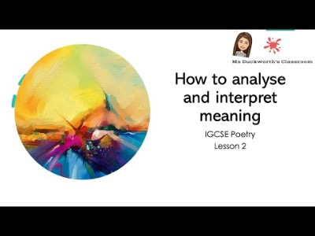
Watch the tutorial and think about how you can use this as model for your own analysis.
Notes:
You may feel that your class do not need this reminder here – delete if not needed.
The tutorial uses a Carol Ann Duffy poem as a way of modelling how to analyse techniques within a poem.
https://www.youtube.com/watch?v=UeM55b60Dps&list=PLw8WoAh2Xt9VYn6u_3J19mZwvT9pw4Rii&index=2

Slide 14
In groups of 4....
You will each be given a stanza and will work through the questions in order to fully analyse language, structure and form.
As you discuss in groups, make notes on the poem in your booklet.
You will then feedback to the rest of the class so they can make notes on your stanza.
15 minutes
Notes:
Assign stanzas to the different groups. It is ok if some groups are looking at the same stanza. Stanza 3 has the most questions so perhaps give this to 2 different groups.
The questions are on the next slides – you could print them out or email them to pupils depending on their access to a device.

Slide 15
Don’t forget to double up and layer your analysis:
Discuss more than one aspect of each line e.g. 2 techniques or 1 technique and 1 language analysis
The apes yawn and adore their fleas in the sun.
The parrots shriek as if they were on fire, or strut
Like cheap tarts to attract the stroller with the nut.
Fatigued with indolence, tiger and lion
Lie still as the sun. The boa-constrictor’s coil
Is a fossil. Cage after cage seems empty, or
Stinks of sleepers from the breathing straw.
It might be painted on a nursery wall.
But who runs like the rest past these arrives
At a cage where the crowd stands, stares, mesmerized,
As a child at a dream, at a jaguar hurrying enraged
Through prison darkness after the drills of his eyes
On a short fierce fuse. Not in boredom –
The eye satisfied to be blind in fire,
By the bang of blood in the brain deaf the ear –
He spins from the bars, but there’s no cage to him
More than to the visionary his cell:
His stride is wildernesses of freedom:
The world rolls under the long thrust of his heel.
Over the cage floor the horizons come.
Stanza 1:
Which word seems odd here? Why has it been included? What is the effect?
Which words rhyme? Why? What is the connection between these two words? What is the effect of the rhyme in terms of the flow of the lines?
What is the effect of the simile used?
Why has Hughes included a stanza break through enjambment? What does it reveal about the tiger and the lion?
What is the effect of the consonance used in line 3?
Extension: what is the effect of using monosyllabic words here?
Notes:
Encourage pupils to take their analysis further by using the devices list to find techniques that are not listed here.

Slide 16
Don’t forget to double up and layer your analysis:
Discuss more than one aspect of each line e.g. 2 techniques or 1 technique and 1 language analysis
Stanza 2:
What is the effect of the repeated use of caesura?
Why does this stanza end with an end stopped line?
How has personification been used here to create an atmosphere?
What is the effect of the simile used?
Why has Hughes included a stanza break through enjambment? What does it reveal about the tiger and the lion?
What is the effect of the consonance used throughout this stanza?
What is the effect of the sibilance used throughout this stanza?
Extension: what is the effect of juxtaposing the cage with the image of a nursery?
The apes yawn and adore their fleas in the sun.
The parrots shriek as if they were on fire, or strut
Like cheap tarts to attract the stroller with the nut.
Fatigued with indolence, tiger and lion
Lie still as the sun. The boa-constrictor’s coil
Is a fossil. Cage after cage seems empty, or
Stinks of sleepers from the breathing straw.
It might be painted on a nursery wall.
But who runs like the rest past these arrives
At a cage where the crowd stands, stares, mesmerized,
As a child at a dream, at a jaguar hurrying enraged
Through prison darkness after the drills of his eyes
On a short fierce fuse. Not in boredom –
The eye satisfied to be blind in fire,
By the bang of blood in the brain deaf the ear –
He spins from the bars, but there’s no cage to him
More than to the visionary his cell:
His stride is wildernesses of freedom:
The world rolls under the long thrust of his heel.
Over the cage floor the horizons come.
Notes:
Encourage pupils to take their analysis further by using the devices list to find techniques that are not listed here.

Slide 17
Don’t forget to double up and layer your analysis:
Discuss more than one aspect of each line e.g. 2 techniques or 1 technique and 1 language analysis
Stanza 3:
Why does this stanza begin with a conjunction?
What is the effect of the repeated use of caesura in lines 2 and 3?
There is only one end stopped line in this stanza and this is a comma instead of the full stops used in stanzas 1 and 2. Why? What is the effect?
What is the effect of the consonance created through the ‘c’ sound?
What is the effect of the sibilance used throughout this stanza?
Why has Hughes included a stanza break through enjambment? What does it reveal about the jaguar?
How has Hughes contrasted the child and the jaguar? Why?
What is the effect of the negative imagery used throughout this stanza? What does it reflect?
What does the rhyme in lines 1 and 2 show about the visitors to the zoo?
Extension: can you compare the different effects of enjambment in stanza 1 and 3?
The apes yawn and adore their fleas in the sun.
The parrots shriek as if they were on fire, or strut
Like cheap tarts to attract the stroller with the nut.
Fatigued with indolence, tiger and lion
Lie still as the sun. The boa-constrictor’s coil
Is a fossil. Cage after cage seems empty, or
Stinks of sleepers from the breathing straw.
It might be painted on a nursery wall.
But who runs like the rest past these arrives
At a cage where the crowd stands, stares, mesmerized,
As a child at a dream, at a jaguar hurrying enraged
Through prison darkness after the drills of his eyes
On a short fierce fuse. Not in boredom –
The eye satisfied to be blind in fire,
By the bang of blood in the brain deaf the ear –
He spins from the bars, but there’s no cage to him
More than to the visionary his cell:
His stride is wildernesses of freedom:
The world rolls under the long thrust of his heel.
Over the cage floor the horizons come.
Notes:
Encourage pupils to take their analysis further by using the devices list to find techniques that are not listed here.

Slide 18
Don’t forget to double up and layer your analysis:
Discuss more than one aspect of each line e.g. 2 techniques or 1 technique and 1 language analysis
Stanza 4:
What is the effect of the use of caesura in lines 1 and 4?
What is the effect of the alliteration of the ‘b’ sound?
What is the effect of the sibilance used throughout this stanza?
Why has Hughes included a stanza break through enjambment? What does it reveal about the jaguar?
What is the effect of the negative imagery used throughout this stanza? What does it reflect?
How is the wildness of the jaguar highlighted in this stanza?
What does the metaphor in line 2 show about the temperament of the jaguar?
Extension: how is the alliteration enhanced by the use of monosyllabic words in line 3?
The apes yawn and adore their fleas in the sun.
The parrots shriek as if they were on fire, or strut
Like cheap tarts to attract the stroller with the nut.
Fatigued with indolence, tiger and lion
Lie still as the sun. The boa-constrictor’s coil
Is a fossil. Cage after cage seems empty, or
Stinks of sleepers from the breathing straw.
It might be painted on a nursery wall.
But who runs like the rest past these arrives
At a cage where the crowd stands, stares, mesmerized,
As a child at a dream, at a jaguar hurrying enraged
Through prison darkness after the drills of his eyes
On a short fierce fuse. Not in boredom –
The eye satisfied to be blind in fire,
By the bang of blood in the brain deaf the ear –
He spins from the bars, but there’s no cage to him
More than to the visionary his cell:
His stride is wildernesses of freedom:
The world rolls under the long thrust of his heel.
Over the cage floor the horizons come.
Notes:
Encourage pupils to take their analysis further by using the devices list to find techniques that are not listed here.

Slide 19
Don’t forget to double up and layer your analysis:
Discuss more than one aspect of each line e.g. 2 techniques or 1 technique and 1 language analysis
The apes yawn and adore their fleas in the sun.
The parrots shriek as if they were on fire, or strut
Like cheap tarts to attract the stroller with the nut.
Fatigued with indolence, tiger and lion
Lie still as the sun. The boa-constrictor’s coil
Is a fossil. Cage after cage seems empty, or
Stinks of sleepers from the breathing straw.
It might be painted on a nursery wall.
But who runs like the rest past these arrives
At a cage where the crowd stands, stares, mesmerized,
As a child at a dream, at a jaguar hurrying enraged
Through prison darkness after the drills of his eyes
On a short fierce fuse. Not in boredom –
The eye satisfied to be blind in fire,
By the bang of blood in the brain deaf the ear –
He spins from the bars, but there’s no cage to him
More than to the visionary his cell:
His stride is wildernesses of freedom:
The world rolls under the long thrust of his heel.
Over the cage floor the horizons come.
Stanza 5:
Why is the jaguar described as a ‘visionary’?
Why is each line end stopped? Why include this feature in the final stanza?
What is the effect of the different metaphors used here? Why has Hughes used so many metaphors to describe the jaguar?
How is the jaguar’s power suggested in this stanza?
What is the effect of the monosyllabic phrase ‘long thrust of his heel’?
What is the effect of the juxtaposition in lines 1 and 2?
Extension: how does this stanza compare to stanza 1? Why does Hughes begin and end he poem in this way?
Notes:
Encourage pupils to take their analysis further by using the devices list to find techniques that are not listed here.

Slide 20
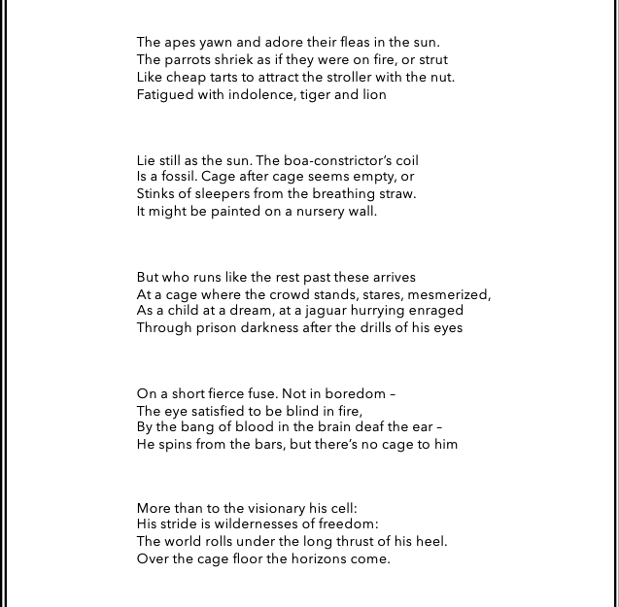
Each group will now feedback. As they do, make notes on the poem.
You may also ask questions to each group – see if you can help them to develop their analysis further.
Notes:
Assist pupils with this if they need you to extend any ideas or clarify a response.
This is in the student booklet in the full SoW

Slide 21

Thank you for visiting Ms Duckworth’s Classroom! I hope you enjoy the resource. You can find the full scheme of work here.
Please feel free to let me know how you used them and if they were helpful.
You can also follow me on Instagram and find me on Facebook, Youtube or twitter.
Don’t forget to subscribe so you don’t miss out on any sales, free resources and new uploads.

