Slide 1
‘The Planners’
Date:
Learning question: what are the big ideas that are presented in the poem?
Do now: recap
What is a simile?
What does free verse mean?
How is a caesura different to enjambment?
What is alliteration?
What is personification?

Slide 2
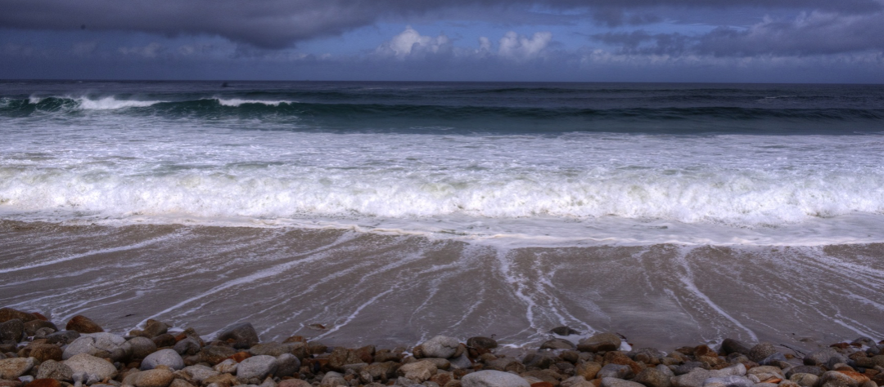
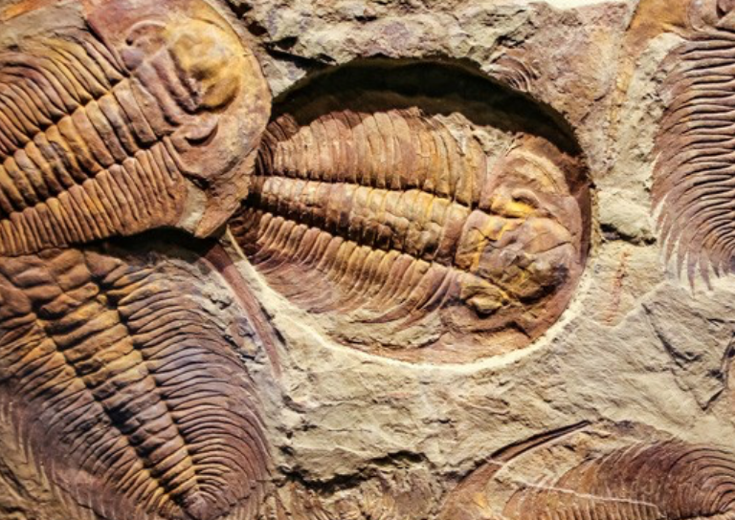
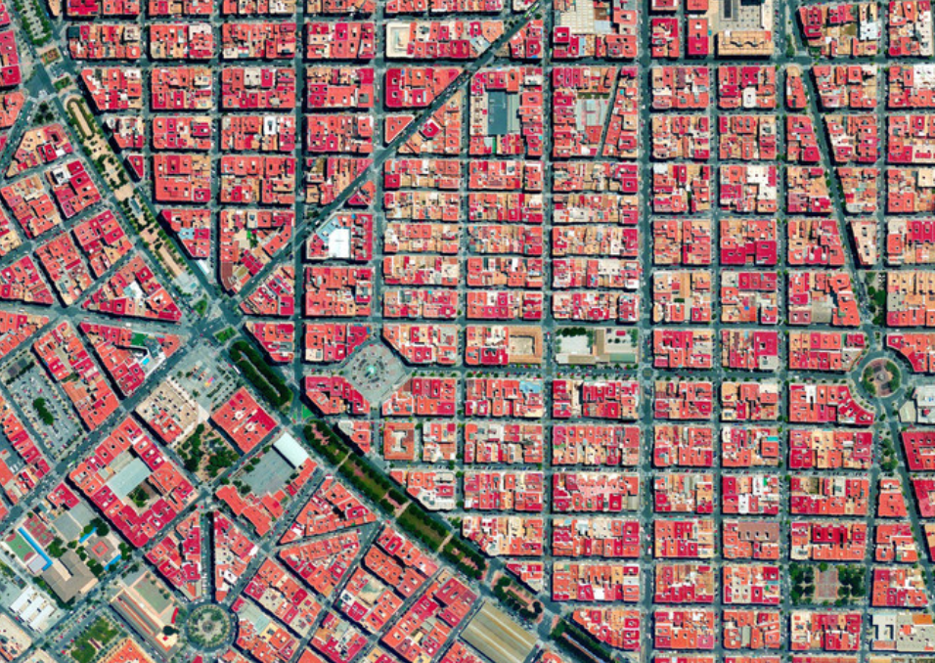
Put the images in order of how you think they appear in the poem.
How are you making your choices?
5 minute pair task

Slide 3
Put the images in order of how you think they appear in the poem.
1.
3.
5.
Task: read through the poem and highlight where you see this imagery.
Is this how you imagined the image?
How does the imagery help you to understand the poem?
4.
2.

Slide 4
Recap: What are ‘big ideas’?
These are the bigger issues that are being presented in the poem. These can be social, political, environmental, moral, existential or religious. These are often ideas that go beyond what is merely written on the page e.g. a poem about a cat and mouse may actually be about family relationships. Try and think about what is being suggested in the poem and see if you can spot any wider issues that the poet may be alluding to.
Now you have read the poem once, discuss the big ideas with a partner. What do you think they are?
How do you know?
10 minutes
Notes:
Share ideas during feedback and write them on the board. Ask pupils to explain how they know – they should be referring to evidence from the poem.
Once you have a list of big ideas, pupils can transfer these to the MASST page of their booklet.

Slide 5
Which statement do you agree with the most? Why?
BIG IDEAS
The poem is about what is gained and lost due to urban planning.
The poet offers a vision of our modern world.
The poem explores the extent to which we become desensitised to this type of progress.
The poet is concerned with the problems of displacement upon the individual.
In the poem, we see the past and present merge to form a new Singapore.
The poet is commenting on the relentless race for perfection and progress.
The poem is about the disillusionment of the artist with soulless progress and a lack of creativity.
The poem reflects the idea that history works in cycles – everything will be replaced.

Slide 6
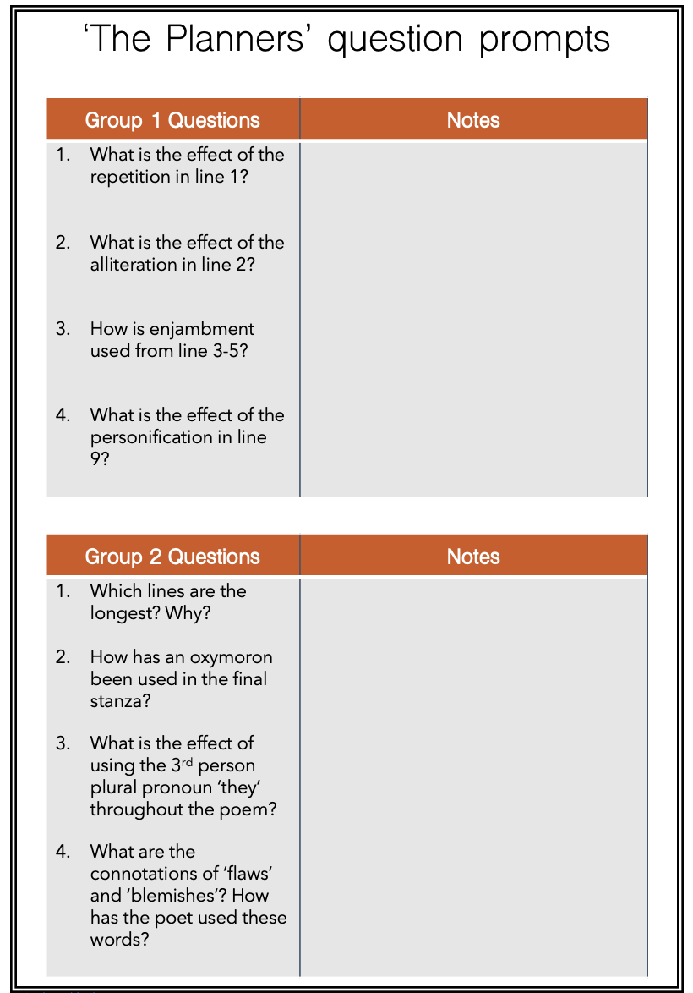
Task: in groups of 3, read back through the poem and answer the questions on the sheet.
Each group will be given several questions. Work through your questions and then we will feedback and make notes.
15 minutes
Notes:
Assign each group a number e.g. group 1, group 2
If you have a large class, it’s ok for 2 groups to be working on the same questions.

Slide 7
Each group will now explain their answers.
Make notes in the boxes as each group feeds back.

Slide 8
End of lesson review
Which poem resonates with you more: ‘The City Planners’ or ‘The Planners’?
Extension: how far have you progressed in terms of today’s learning question?
Learning question: what are the big ideas expressed in the poem?

Slide 9
Analysing ‘The Planners’
Date:
Learning question: What methods does Boey Kim Cheng employ when presenting his ideas in the poem?
Do now: which poems are the following quotations from?
‘gradual as glaciers’
‘houses in pedantic rows’
‘the skies surrender’
‘a bland madness of snows’
‘Anaesthesia, amnesia, hypnosis’
Notes:
This ‘do now’ is based on pupils already having covered City Planners.
The City Planners
The City Planners
The Planners
The City Planners
The Planners

Slide 10
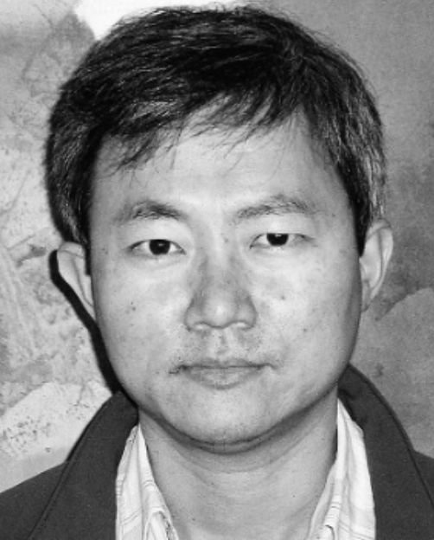
Why did Boey Kim Cheng write this poem? What is he trying to show the reader? What is he trying to achieve as a poet?
“I've always been a poet of experience, and writing is a way of making sense of what happened. The autobiographical impulse is there, but as with any form of self-writing, autobiographical poetry involves stepping back, splitting the self between subjective and objective positions, between lyric and narrative modes. You don't think much about it until you see yourself as a character, and the poem as a story or artifact printed on the screen or page.”
“But for most poets it's much more mundane. It's about making your own life matter, about making sense of what happened, and paying attention to the everyday.”
“I have mostly written in response to the pressure/promptings of experiences, whether recent or distant in time. It’s the need to understand, to sift through the events/memories, discover some kind of pattern and order, and achieve through that some semblance of meaning.”
How do you know?

Slide 11
Watch the tutorial and think about how you can use this as model for your own analysis.
Notes:
You may feel that your class do not need this reminder here – delete if not needed.
The tutorial uses a Carol Ann Duffy poem as a way of modelling how to analyse techniques within a poem but it is still relevant. .
https://www.youtube.com/watch?v=UeM55b60Dps&list=PLw8WoAh2Xt9VYn6u_3J19mZwvT9pw4Rii&index=2

Slide 12
In groups of 4....
Using the notes from last lesson, go through the poem and analyse the methods used by the poem.
Step 1: highlight anything interesting
Step 2: name the technique if you can
Step 3: analyse the effect by linking to the message and the big ideas
Now split into 2 pairs, join up with another pair to share analysis.
Can you help each other develop the analysis you have already made?
3rd person collective pronoun ‘they’
Oxymoron
Repetition
Alliteration
Extended metaphor
List of 3
Cliché
Personification
Free verse
Caesura
3rd person
Change to 1st person in the final stanza.
Irregular stanza lengths
Enjambment
Irregular line length
20 minutes
Notes:
Name it: what technique is it? If there isn’t a technique then encourage pupils to analyse language and the connotations.

Slide 13
End of lesson review
How have you developed your skills of analysis in today’s lesson?
Extension: how far have you progressed in terms of today’s learning question?
Learning question: What methods does Boey Kim Cheng employ when presenting his ideas in the poem?

Slide 14
Thank you for visiting Ms Duckworth’s Classroom! You can find the full scheme of work here.
You can also follow me on Instagram and find me on Facebook, Youtube or twitter.
Don’t forget to subscribe so you don’t miss out on any sales, free resources and new uploads.

