Slide 1
Relationships in ‘Thank you ma’am’
LO: To understand how to identify and comment on language and structure
Date:
STARTER: What kind of relationship have we seen so far? How do you think it develops?
Extension: can you use the context you have already learned to develop your ideas about their relationship?

Slide 2
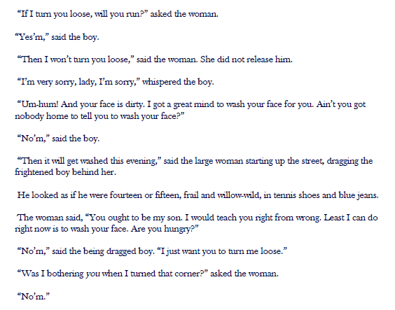
Commenting on language and structure
Language:
Word choice to describe the characters or their actions
Adjectives that sound like verbs
Interesting verbs
Alliteration
Structure:
Repetition
Sentence types
Use of punctuation
Questions – how many? Who asks them?
Task: Find and label as many as you can.
Extension: what is the effect? What do they reveal/show about the characters, their actions and their relationship?

Slide 3
Reading on…
Thinking questions:
How does their relationship change? Why?
What happens at the end? What is your reaction?
What do you think the story is supposed to teach us? Is there a moral?
?
?
?

Slide 4
Pair work
Now switch! Join up with a different partner and repeat the same activity. How did they portray their character? Was it the same as your first partner?
Once you have finished, go back to you seats and make a note of what you have learned about the characters from this activity.
Imagine one of you is Mrs Hughes and one of you is the boy.
Tell the other how you felt about what happened.
Create realistic characters
Use information from the story
Develop by discussing thoughts and feelings

Slide 5
Thank you for visiting Ms Duckworth’s Classroom! I hope you enjoy the free resource. Please feel free to let me know how you used them and if they were helpful. Also, you can find the full SoW in my website store.
You can also follow me on Instagram and find me on Facebook or twitter.

