Slide 1
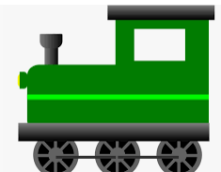
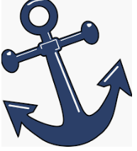
Imagery and connotations
Such plenty was too dear in our expanse of drought
where dams leaked dry and windmills stalled.
Like mommy’s smile. Her lips stretched back
and anchored down, in anger at some fault—
of mine, I thought—not knowing then
it was a clasp to keep us all from chaos.
She saw it always, snapping locks and straps,
the spilling: sums and worries, shopping lists
Extension: how do the 2 metaphors link together to create or reinforce meaning?
Imagery Train
Imagery technique
Which word gives meaning to the technique?
What is it?
What are the connotations?
Inference. What does it mean in the poem?
Metaphor: ‘anchored down’
anchor
Used to hold something down or in place; stop something from moving away. Boats and ships. Keeps the boat safe.
Heavy
Solid
Immovable
Safety
Home - port
A lot is weighing her down. Lost her buoyancy. Heavy burdens. She is their anchor – keeps them safe and secure.
Now do the same for the 2nd example

