Slide 1
Introduction to imagery at GCSE
LO: To understand how to find good examples of imagery
To understand how to talk about the effects of imagery
Date:
STARTER:
Pick one quote that shows a celebratory atmosphere
Pick one quote that shows a relaxed atmosphere
Pick one quote that shows an excited atmosphere
Extension 1: underline the words/phrases that show this atmosphere
Extension 2: what do the words you have underlined make you think of?
The room buzzed with energy and everything appeared to be moving slightly as if to echo the frenetic hum of cheerful voices. Balloons gently swayed in the breeze, bunting swished above the heads as couples danced or chatted with animation. Even the edges of the brightly patterned table cloths lifted as dresses swept by.
Thinking question: What skills are you using? How will this help you in the exam?

Slide 2
What is imagery?
How will you make sure you pick the interesting examples?
Imagery is:
Anything unusual or that stands out within the context
Extra description
Writing that appeals to your senses
Sometimes techniques are used, such as similes, but not always so you don’t need to ‘technique spot’.
In your exam you must choose the BEST examples from the text. We will practice how to do this.

Slide 3
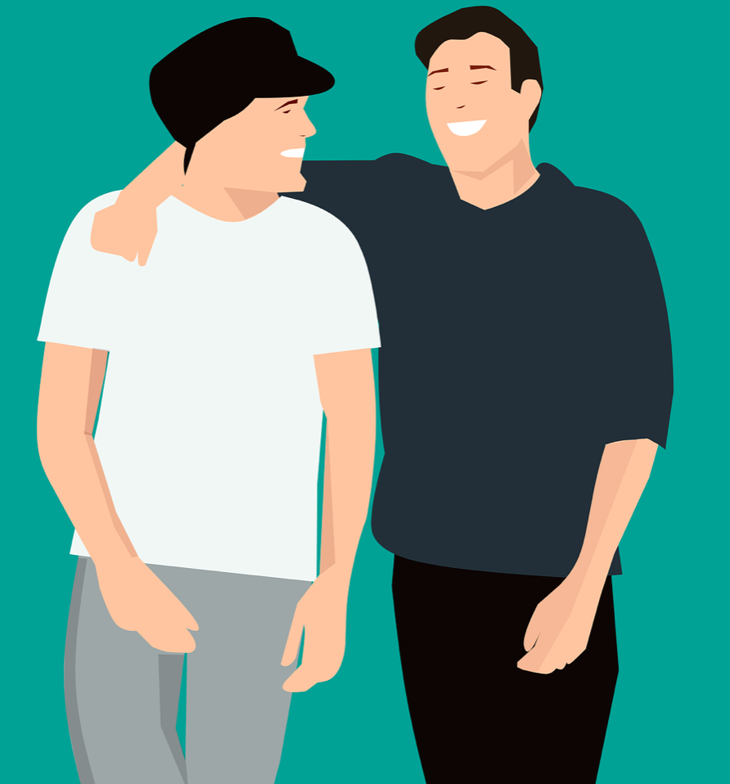
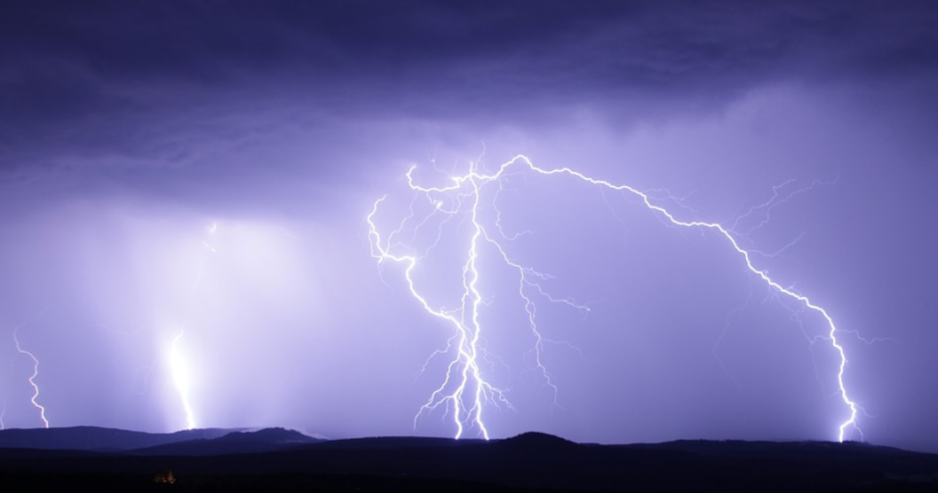
Can you identify the imagery in this extract? Is there any imagery in your starter answer?
The room buzzed with energy and everything appeared to be moving slightly as if to echo the furious hum of cheerful voices. Balloons gently swayed in the breeze, bunting swished above the heads as couples danced or chatted with animation. Even the edges of the brightly patterned table cloths lifted as dresses swept by.

Slide 4
Explaining the effect of imagery
Now you know you can find imagery!
Next, you need
to be able to talk about it.
Why has it been used?
What is the effect?

Slide 5
Explaining the effect of imagery
The room buzzed with energy and everything appeared to be moving slightly as if to echo the frenetic hum of cheerful voices. Balloons gently swayed in the breeze, bunting swished above the heads as couples danced or chatted with animation. Even the edges of the brightly patterned table cloths lifted as dresses swept by.
INDIVIDUAL TASK: Choose two more examples and explain them. Think of everything we have discussed so far.
The word ‘buzzed’ means/is…
It makes it seem as if the room…
It makes me think of…
It reinforces the…atmosphere because
TASK: In pairs, finish the sentences. Be as detailed as you can.

Slide 6
Plenary task
You must:
Write a minimum of one paragraph
Use punctuation accurately
Write for 2 of the senses
Use 3 examples of imagery
You should:
Write for 3 of the senses
Use 4 examples of imagery
Group similar ideas together and develop into 2 paragraphs
You could:
Use interesting and unusual vocabulary
Challenge yourself to think of interesting ways to describe a person, an object, an action or the scenery
Use punctuation to reinforce the mood or atmosphere
Describe one of the scenarios below:
A boat ride along a river
A wedding
A football game
What do you want your reader to visualize?
What kind atmosphere are you trying to create?
How do you want the reader to feel?

Slide 7
Imagery Question: Exam
LO: To understand how to writers achieve effects
Date:
STARTER:
Make a personal checklist to remind yourself of how to identify imagery and how to write about it.
Extension: share your list with a partner.

Slide 8
Question 2d (imagery): what questions do you have?
How many marks are awarded?
What will my answer look like?
What will the question look like?
Which skills are tested?
What kind of extract will we be given?
How do I approach the question?
Notes:
Extract taken from: I Survived the Blizzard of ’79
Essay - Beth Ann Fennelly

Slide 9
Question 2d example
As we progress through the lesson, think of how your questions are being answered. How confident do you feel at each different stage?
Task: write down any queries or concerns you have as we go, we will answer these together at the end of the lesson.
Re-read paragraphs 5 and 6.
Paragraph 5 begins ‘And then the world began shutting down...’ and is about the effects of the blizzard.
Paragraph 6 begins ‘Then it was Sunday, so Dad said get ready for mass ...’ and is about their own experience in the snow.
Explain how the writer uses language to convey meaning and to create effect in these paragraphs.
Choose three examples of words or phrases from each paragraph to support your answer. Your choices should include the use of imagery.
Write about 200 to 300 words.
Up to 15 marks are available for the content of your answer.

Slide 10
Question 2 steps
Remember!
At this stage in the exam you will already have read the text and answered comprehension questions on it. Therefore you will have a good understanding of what it is about.
Important things to focus on:
What it is about
What happens
Who is involved
Tone/atmosphere
Read Q2d (language question)
Underline the paragraphs that you will focus on, then circle them on the text.
Do step 1&2 NOW
Top tip – you will be given clues about what the focus is in the question. This will help you to make your choices as well as explain them.
What is the focus? What will you be looking for?
Re-read paragraphs 5 and 6.
Paragraph 5 begins ‘And then the world began shutting down...’ and is about the effects of the blizzard.
Paragraph 6 begins ‘Then it was Sunday, so Dad said get ready for mass ...’ and is about their own experience in the snow.
Explain how the writer uses language to convey meaning and to create effect in these paragraphs.
Choose three examples of words or phrases from each paragraph to support your answer. Your choices should include the use of imagery.
Write about 200 to 300 words.
Up to 15 marks are available for the content of your answer.

Slide 11
Question 2 steps
Read Q2d (language question)
Underline the paragraphs that you will focus on, then circle them on the text.
Go through each paragraph and underline interesting words and phrases
Go back and tick the best 3 in each paragraph
Write your answer
Do this for (a) – paragraph 5
Choose quotes that:
You understand
Are interesting
Include imagery
You can say a lot about
Remind yourself what this is?
Re-read paragraphs 5 and 6.
Paragraph 5 begins ‘And then the world began shutting down...’ and is about the effects of the blizzard.

Slide 12
Move around the room and talk to as many people as you can! Share your choices and try and narrow them down to the best 3. You have 6 minutes!
And then the world began shutting down. The airports, which was bad because Mom was in Toronto, visiting her sister. The schools, which was great for the first day, and good for the second, and then less good and less good yet. Because the roads were impossible; the fridge, emptying. Does this smell OK to you? Couldn’t watch Little House because Channel 5 covered the blizzard all day. A motorist, dead of exposure in a stranded car. A man, dead of a heart attack while shoveling snow; ambulance couldn’t reach him. Coat drive, shelters for the homeless. Check in on your elderly neighbors, folks. If you can get out, that is. Amtrak trains abandoned. Hundreds of cars lining the highway, buried by snow, white lumps pierced by antennas. Family of five, killed when their roof collapsed. We were a family of four, but with Mom far away, we were only three. I got out of the bathtub to answer her crackling long-distance call.
Questions to ask each other:
Is it relevant to the question?
Is it imagery?
Why is it imagery?
What does it show?
Is it the best example?
Why did you choose it?

Slide 13
Plenary
Next lesson we will start to discuss the effect of the imagery and also look at the mark scheme.
How do you feel at the end of this lesson?
Which questions have been answered?
Which questions still need answering? Let’s see if we can find answers together !

Slide 14
Thank you for visiting Ms Duckworth’s Classroom! I hope you enjoy the free resource. Please feel free to let me know how you used them and if they were helpful.
Also, you can find the full SoW in my website store.
You can also follow me on Instagram and find me on Facebook or twitter.

