Slide 1
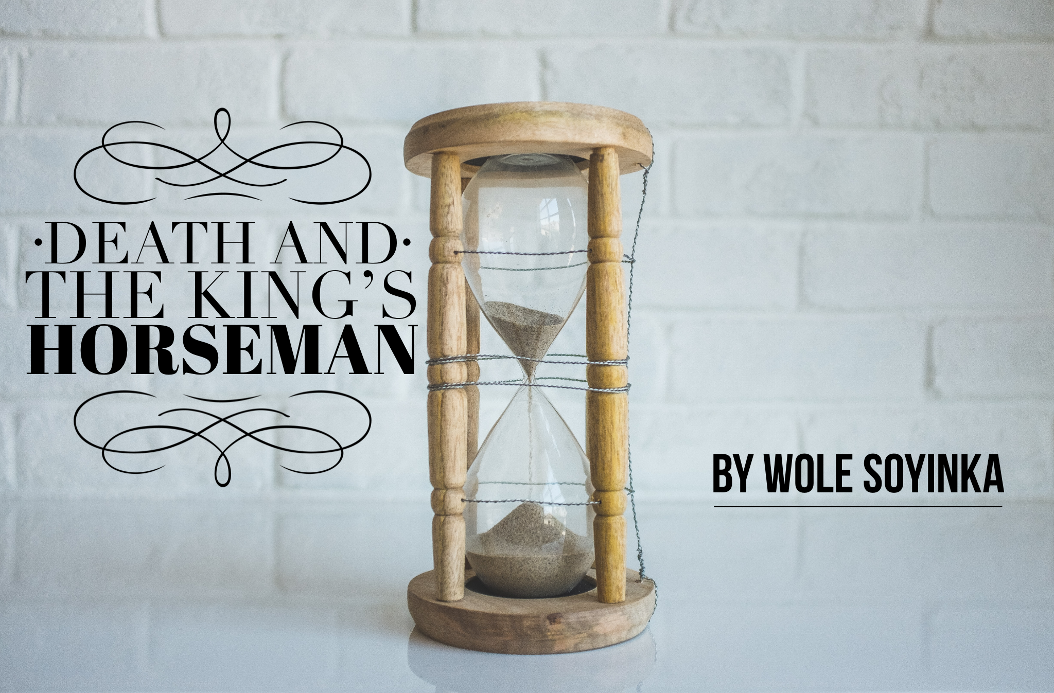
Act 1: characters and setting
Date:
Learning question: How does Soyinka introduce the characters and setting?
Do now: Act 1 opens in a market. List words that you would associate with a market.

Slide 2
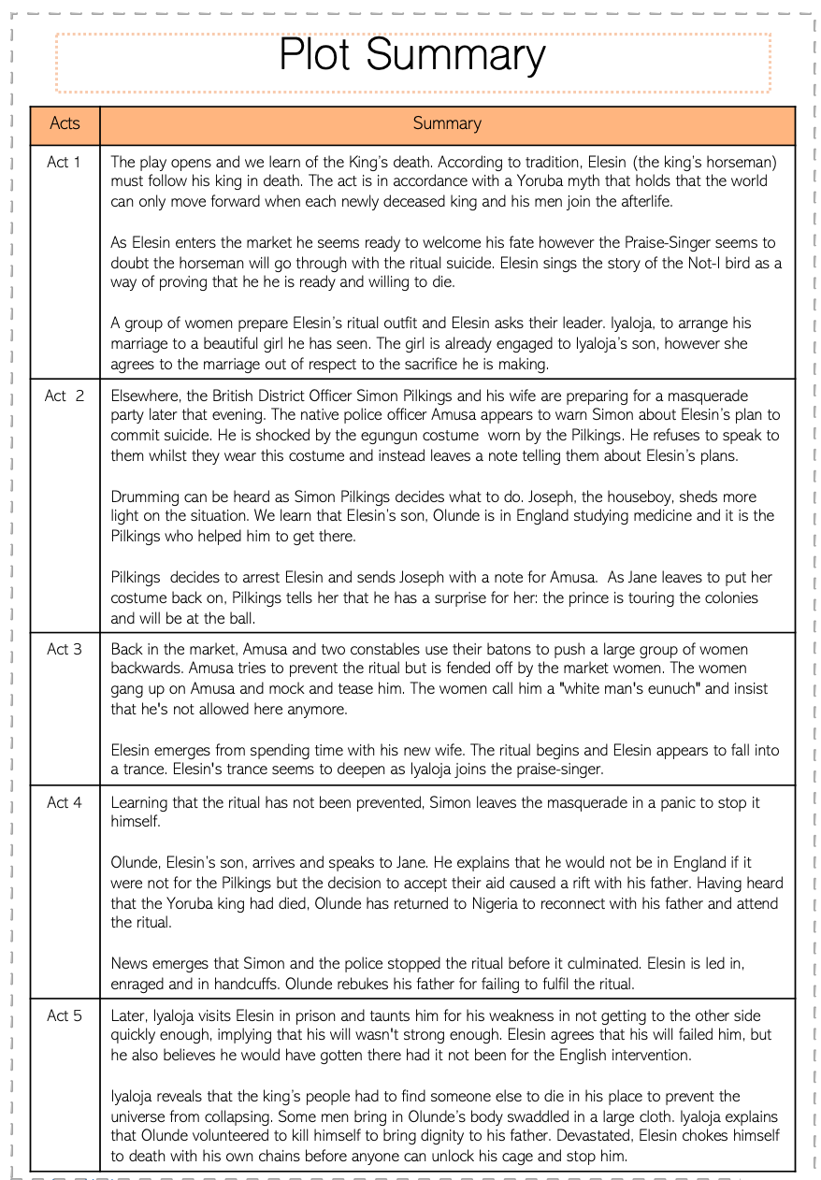

In pairs, read through the plot summary and condense this into 10 bullet points.
Challenge: what do you think the themes of the play are?
10 minutes
Notes:
Feedback – share ideas and discuss the plot details. This will help pupils to understand significant details as they read.

Slide 3
What should we know before we read?
This play is a Drama / Tragedy.
It was published in 1975
Set during World War 2 - 1944
Set in colonial Nigeria
The play is based on a real incident that took place in Nigeria during the colonial era
It is set in Oyo, Nigeria

Slide 4
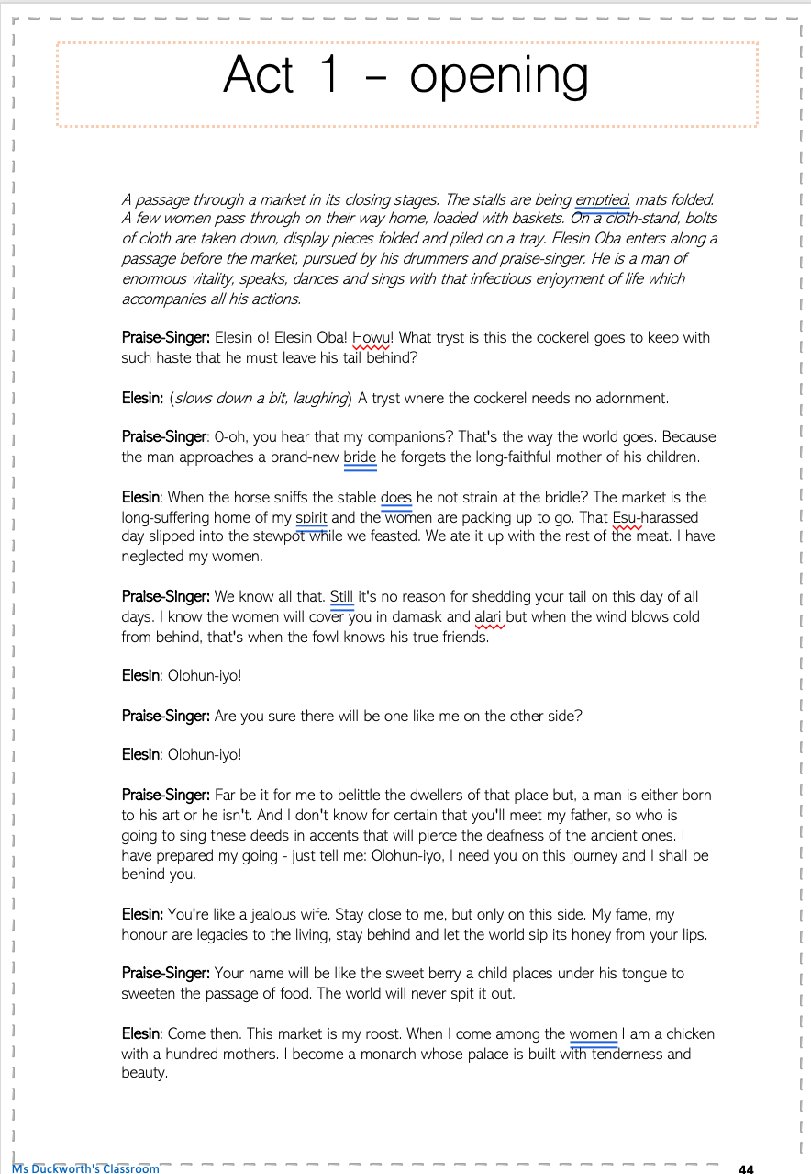

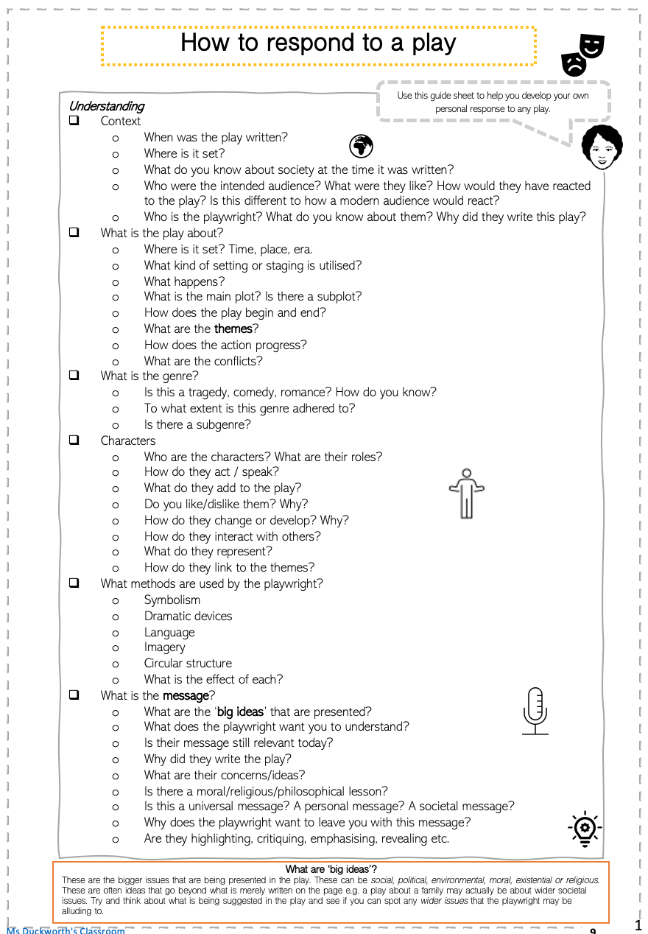
Act 1 - opening
Make notes as we read and discuss
Glossary:
Olohun-iyo – Praise singer
Oba – chief
Howu – ‘how’ or ‘why’
Esu – the Yoruba gid of mischief and uncertainty
Damask – a reversible fabric, usually of silk or linen, with a pattern woven into it.
Alari – a rich, woven cloth which is brightly coloured.
Use the guide to help you
Notes:
Go to next slide – this slide is for information purposes

Slide 5
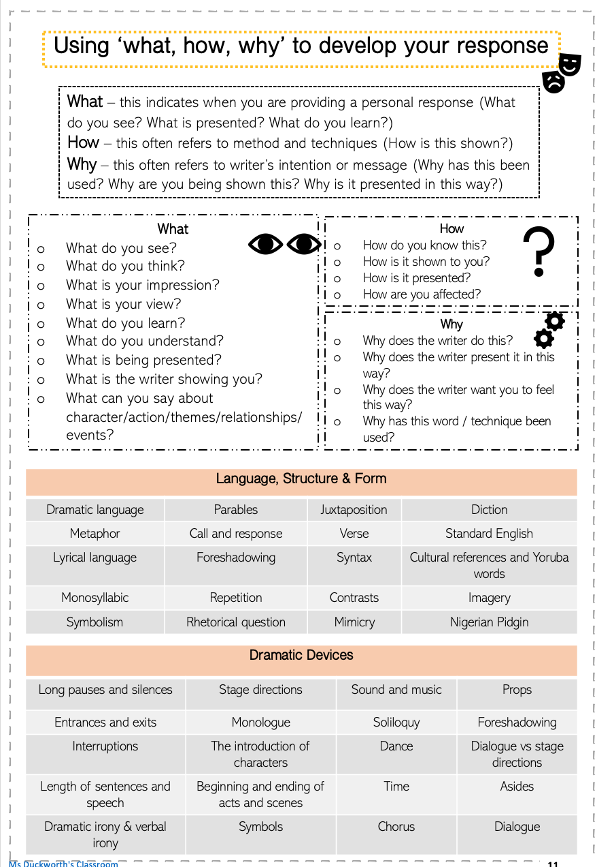
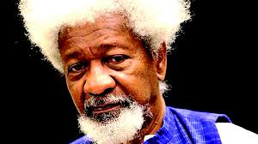
When analysing, we are looking at the choices made by the writer: AO3
I am the writer…why did I make the authorial choices I did?

Slide 6
Act 1 – stage directions
How significant are these stage directions?
How important are markets? Use your contextual knowledge.
Why does the play begin here?
A passage through a market in its closing stages. The stalls are being emptied, mats folded. A few women pass through on their way home, loaded with baskets. On a cloth-stand, bolts of cloth are taken down, display pieces folded and piled on a tray. Elesin Oba enters along a passage before the market, pursued by his drummers and praise-singer. He is a man of enormous vitality, speaks, dances and sings with that infectious enjoyment of life which accompanies all his actions.
What does this signify?
Why are we given this information? Think about what Elesin is preparing to do.
Notes:
Use these guiding questions to prompt discussion – pupils to make notes in their booklet.
Markets are very important, bustling lively places. Mostly run by women. Symbol of community – sets up the idea of collective responsibility and community. the market is a metaphor for the center of the world. Elesin wants to be around life – and women, the creators of life.

Slide 7
Let’s read through the extract together . As we read, think about…
Our impression of Elesin
His relationship with the Praise-Singer
What we learn about his fate
The use of Standard English and Nigerian Pidgin – what effect does this have on us?
The descriptive and metaphorical language used.
The use of parables.
What
How
Why
Notes:
Read and discuss as you go. Pupils should make notes. These prompts should help to focus the reading and guide pupils to areas of interest.

Slide 8
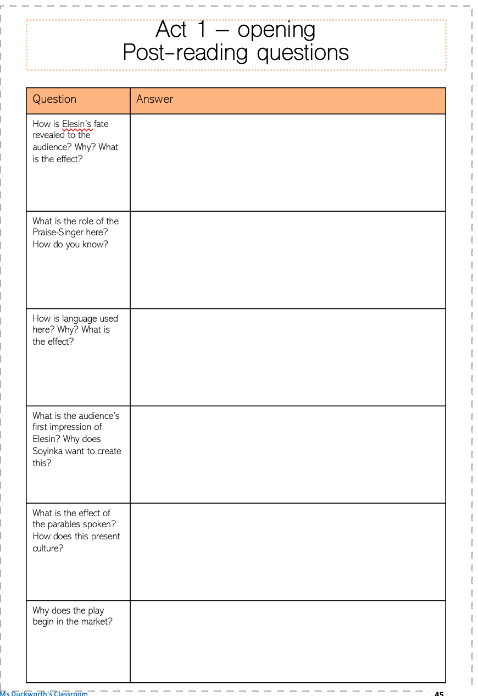
Post-reading questions
How is Elesin’s fate revealed to the audience? Why? What is the effect?
What is the role of the Praise-Singer here?
How is language used here? Why? What is the effect?
What is the audience’s first impression of Elesin? Why does Soyinka want to create this?
What is the effect of the parables spoken? How does this present culture?
Why does the play begin in the market?
Work through these questions in pairs.
10 minutes

Slide 9
End of lesson review
  Write down 3 words to describe your 1st impressions of Elesin.
  Be ready to explain your choices.
How far have you progressed towards the learning question?
Learning question: How does Soyinka introduce the characters and setting?

Slide 10
Act 1: character development
Date:
Learning question: How is the character of Elesin developed?
Do now: True or false?
The play opens in a supermarket.
The protagonist’s name is Elesin.
Elesin means praise-singer.
Elesin says that the market is his ‘cattle shed’.
The mood at the start of the play is joyous.
Notes:
False – market
True
False
False
True

Slide 11
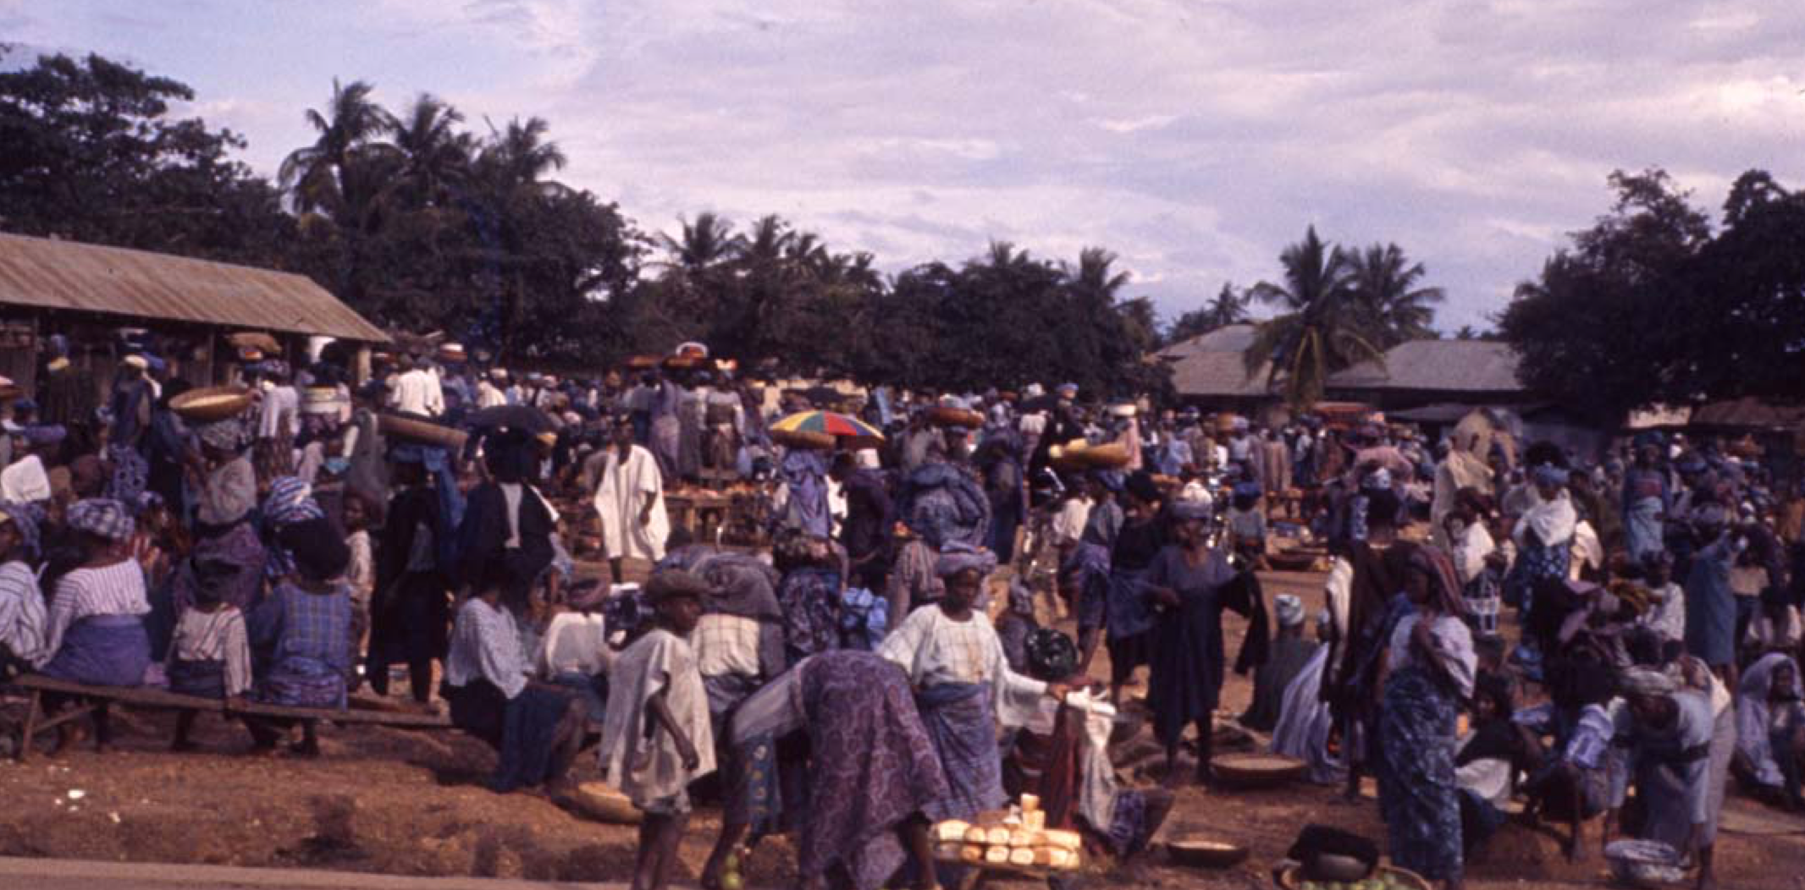
Why do you think the play begins in the market? Use these phrases to discuss this with a partner.
Tradition
Social function
Cultural identity
Multi-cultural
Female domain
Representation of the living world

Slide 12
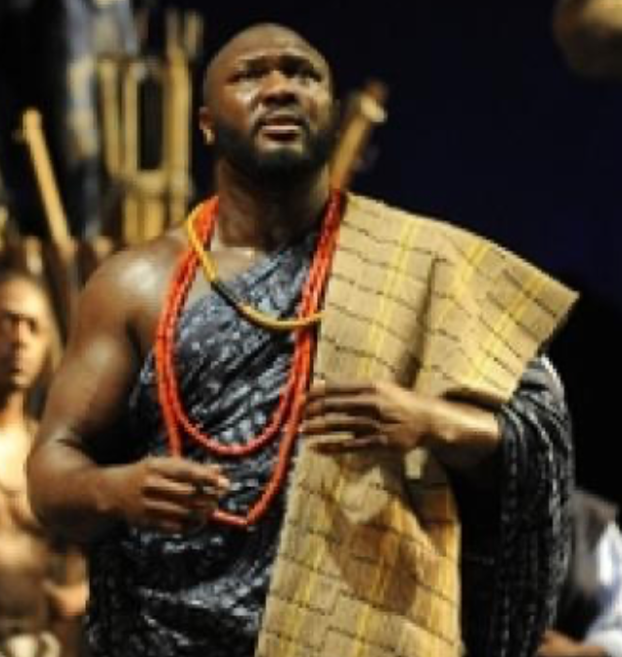
What do we know about Elesin and what he will do? How?
Elesin: … My fame, my honour are legacies to the living, stay behind and let the world sip its honey from your lips
Praise-Singer: We know all that. Still it's no reason for shedding your tail on this day of all days.
Elesin: …This market is my roost. When I come among the women I am a chicken with a hundred mothers. I become a monarch whose palace is built with tenderness and beauty.
What are you expecting as we continue to read? Why?
Notes:
Group discussion based on what both Elesin and the Praise-Singer say. Direct pupils towards the underlined sections if they need prompting.

Slide 13
How does this interpretation help us to understand the significance of the setting?
‘Death and The King's Horseman opens with a grand panorama of the Yoruba market place. Here, Soyinka deploys all his artistic power to paint a picture of grandeur and vitality. According to an old Yoruba saying, "The world is a market place; heaven is home." Apart from its obvious economic importance, the market occupies a signal cultural, political, and spiritual position in the Yoruba cosmos. First, it is a site of political and cultural ferment. Second, it doubles as that numinous zone in which the distinction between the world of the dead and that of the living is abolished. The ancient Yoruba saying captures this crucial contiguity. In most Yoruba towns, the evening market is regarded as the most important, and before the advent of electricity, it was a most eerie sight indeed. Moreover, the market serves as a barometer for the spiritual and psychic health of the community. The most important communal rites are carried out there. It was therefore a stroke of genius to focus on the market place at the beginning of the play .’
Adebayo Williams
Notes:
Source: Ritual and the Political Unconscious: The Case of "Death and the King's Horseman"

Slide 14
Let’s read on from ‘Praise- Singer: They love to spoil you…’ to ‘Women: You will not delay’
What do we learn about:
  How Elesin feels about the women in the market
  History / Gods / Tradition
  Elesin’s role/destiny and how it is viewed both by him and others
Think about how Elesin is being developed by Soyinka. How do you view him?
Notes:
You may wish to assign roles so pupils can act out this section

Slide 15
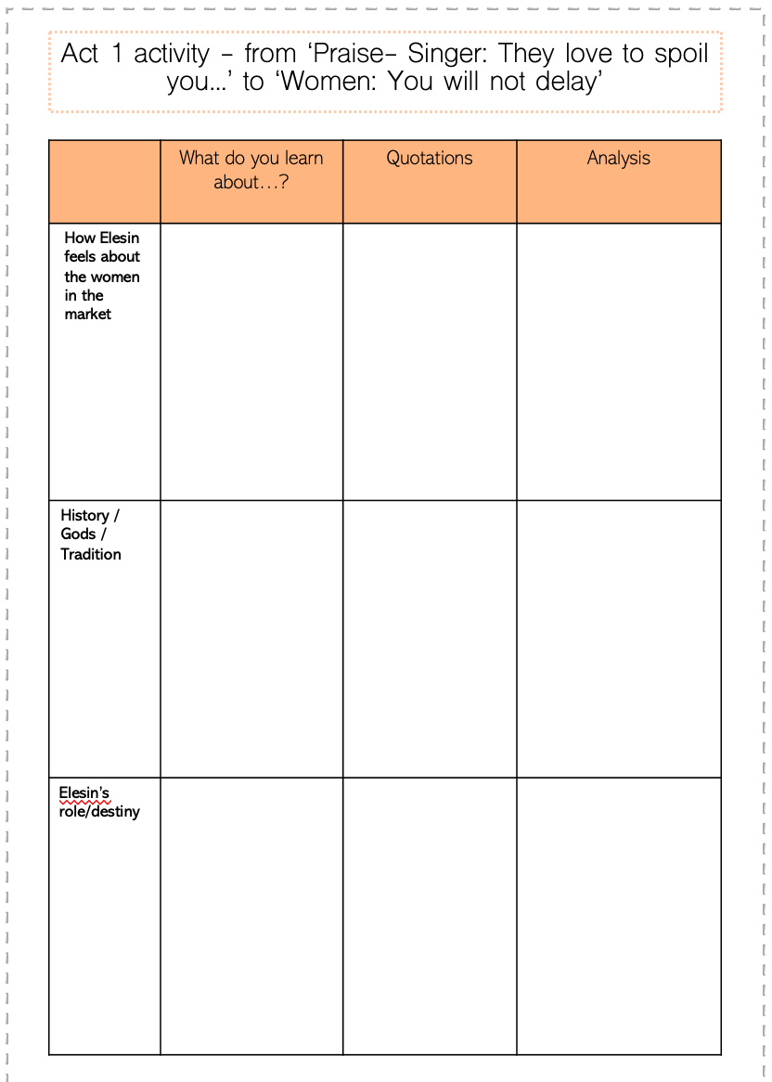
Pair task
Post reading
Fill in your booklet on the section we have just read.
What do we learn about:
  How Elesin feels about the women in the market
  History / Gods / Tradition
  Elesin’s role/destiny and how it is viewed both by him and others
Analyse here:
What is suggested?
What are the connotations of words?
What is the effect on the audience?
Make a point here
Add a quotation
15 minutes

Slide 16
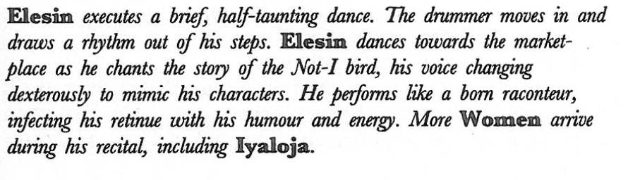
The significance of the ‘Not I Bird’ story…
Post reading
Dramatic device: stage directions
What do we learn in the stage directions?
What kind of words are used to describe his actions?
What sound is introduced? Why? What is the effect?
How does Elesin act? Why?
Who arrives? What is the significance of this?

Slide 17
The significance of the ‘Not I Bird’ story…
Post reading
How is the story introduced?
Praise-Singer: There is only one home to the life of a river-mussel; there is only one home to the life of a tortoise; there is only one shell to the soul of man; there is only one world to the spirit of our race. If that world leaves its course and smashes on boulders of the great void, whose world will give us shelter?
Elesin: It did not in the time of my forebears, it shall not in mine.
Praise-Singer: The cockerel must not be seen without his feathers.
Elesin: Nor will the Not-I bird be much longer without his nest.
Praise-Singer: (stopped in his lyric stride) The Not-I bird, Elesin?
Elesin: I said, the Not-I bird.
Praise-Singer All respect to our elders but, is there really such a bird?
Elesin: What! Could it be that he failed to knock on your door?
Praise-Singer (smiling): Elesin's riddles are not merely the nut in the kernel that breaks human teeth; he also buries the kernel in hot embers and dares a man's fingers to draw it out.
Elesin: I am sure he called on you, Olohun-iyo. Did you hide in the loft and push out ·the servant to tell him you were out?
What do the proverbs reveal?
What do you think the Parise-Singer may be worried about? How does the Not-I bird story allay these fears?
Notes:
Discuss as a class

Slide 18
End of lesson review
  What do we learn about Elesin in this stage direction?
  ‘He performs like a born raconteur, infecting his retinue with humour and energy.’
How far have you progressed towards the learning question?
Learning question: How is the character of Elesin developed?

Slide 19

Thank you for visiting Ms Duckworth’s Classroom! I hope you enjoy the resource. The full scheme of work can be found here.
You can also follow me on Instagram and find me on Facebook or twitter.

