Slide 1
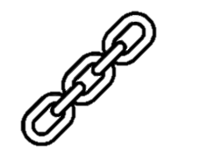
Analysis Chain
Quotation | Technique | Which word gives meaning to the technique | What is it? What does it mean? | What are the connotations? | Inference. What does it mean in the text? Layer your interpretation. Link back to what the poem is about. What is the message/meaning?

