Slide 1
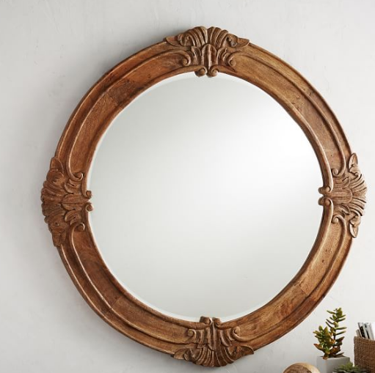
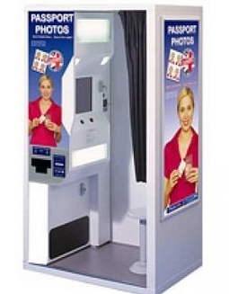
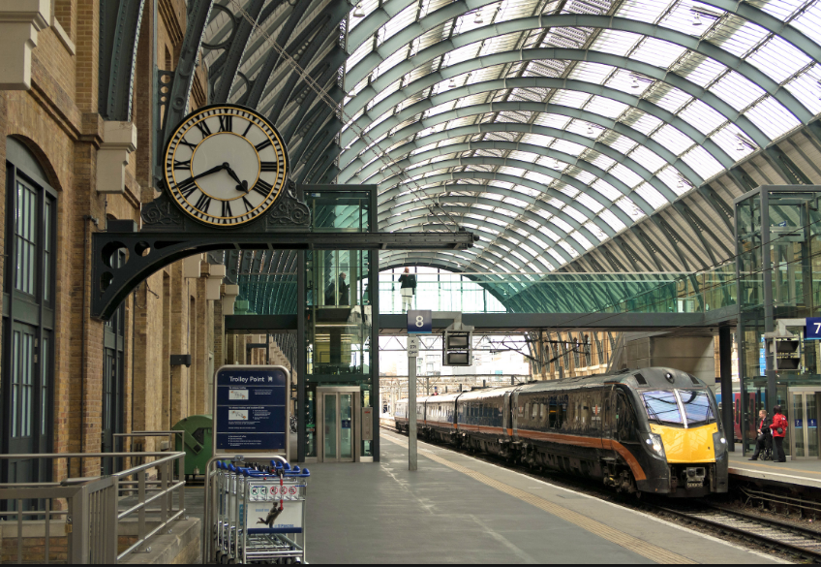
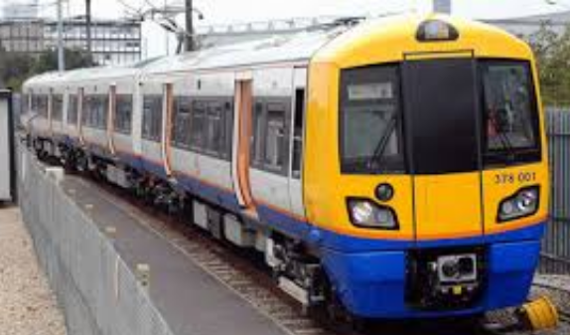
‘The Man with the Yellow Face’ by Anthony Horowitz
Date:
LO: To understand how to make inferences based on the opening of the story
This is the title of the story. Write down any questions you have.
?
These images are linked to the story. Do they give you more questions or do they help with some answers?

Slide 2
I want to tell you how it happened. But it’s not easy. It’s all a long time ago now and even though I think about it often, there are still things I don’t understand. Maybe I never did.
These are the first lines of the story. What are you expecting?
Make predictions under the following headings (use the images from the last slide to help you):
Setting
Character
Main events
Tone
Genre

Slide 3
I want to tell you how it happened. But it’s not easy. It’s all a long time ago now and even though I think about it often, there are still things I don’t understand. Maybe I never did.
Draw two images:
One that shows how you interpret the narrator at this point.
One that shows how you feel as a reader.
Don’t say which is which! Your partner will have to gues…

Slide 4
The beginning of the novel
LO: To understand how to read for meaning and identify and comment on the different features of a short story
Date:
I want to tell you how it happened. But it’s not easy. It’s all a long time ago now and even though I think about it often, there are still things I don’t understand. Maybe I never did.
STARTER: What are your first impressions of the narrator?
Are you looking forward to reading the story? Why/why not?
Extension: How has the writer, Horowitz, tried to engage the reader?

Slide 5
Let’s read the first section
I want to tell you how it happened. But it’s not easy. It’s all a long time ago now and even though I think about it often, there are still things I don’t understand. Maybe I never did.
Why did I even go into the machine? What I’m talking about is one of those instant photograph booths. It was on Platform One at York station – four shots for £2.50. It’s probably still there now if you want to go and look at it. I’ve never been back so I can’t be sure. Anyway, there I was with my uncle and aunt, waiting for the train to London and we were twenty minutes early and I had about three pounds on me, which was all that was left of my pocket money. I could have gone back to the kiosk and bought a comic, another bar of chocolate, a puzzle book. I could have gone into the café and bought Cokes all round. I could have just hung on to it. But maybe you know the feeling when you’ve been on holiday and your mum has given you a certain amount to spend. You’ve just got to spend it. It’s almost a challenge. It doesn’t matter what you spend it on. You’ve just got to be sure it’s all gone by the time you get home. Why the photographs? I was thirteen years old then and I suppose I was what you’d call good-looking. Girls said so, anyway. Fair hair, blue eyes, not fat, not thin. It was important to me how I looked – the right jeans, the right trainers, that sort of thing. But it wasn’t crucial to me. What I’m trying to say is, I didn’t take the photographs to pin on the wall or to prove to anyone what a movie star I was.
I just took them.
I don’t know why.
What do we learn about:
Setting
Character
Tone
Atmosphere
Events
Language
Structure
Is there any mystery?
Are there any clues?

Slide 6
How does Horowitz make the beginning of the story engaging?
Use a quote if you can!
Horowitz engages the reader by….
How does he engage you?
What is he trying to show us?
How does it make us feel?

Slide 7
Thank you for visiting Ms Duckworth’s Classroom! I hope you enjoy the free resource. Please feel free to let me know how you used them and if they were helpful. Also, you can find the full SoW in my website store.
You can also follow me on Instagram and find me on Facebook or twitter.

