Slide 1
Analysing Structure: Q3
Date:
LO: To understand the requirements for question 3
To understand how to analyse the beginning of a text
STARTER:
What do you know about beginnings and endings of stories? Brainstorm features you may find in each.
Think about the purpose of these different parts of a story: what us their function?

Slide 2
Where are we?
Timing: 1 hour 5 minutes for Section A
Step 1 - Read the extract, take note of the overview you are given; this will help with context.
Step 2 – as you read, make notes on: setting, character, action, mood, tone etc. You can do this in brief at the top of the extract. This will help you later on.
Step 3 – read question 1 and answer.
Step 4 – read question 2, plan and answer
Step 5 – read question 3, plan and answer
Step 6 – read question 4, plan and answer

Slide 3
Step 5
A02
Explain, comment on and analyse how writers use language and structure to achieve effects and influence readers, using relevant subject terminology to support their views
Timing: 1 hour for Section A
Step 1 - Read the extract, take note of the overview you are given; this will help with context.
Step 2 – as you read, make notes on: setting, character, action, mood, tone etc. You can do this in brief at the top of the extract. This will help you later on.
Step 3 – read question 1 and answer.
Step 4 – read question 2, plan and answer
Step 5 – read question 3, plan and answer
Step 6 – read question 4, plan and answer
This question is about analysing structure: what happens, when and why.
Your focus is on the whole text
You need to select clear examples, name the technique and analyse them. You do not necessarily have to use quotations if it is not possible.
This question is not about just naming techniques – you must comment on the effect of them. Don’t forget the context that they are used in.
Hello friend!

Slide 4
Before we look at the question, let’s practice talking about structure.
Lemon Orchard Extract
You will work in groups of and will have to label the extract with the structural features.
But first, let’s take a look at how the extract begins.
Notes:
This activity is aimed at enabling pupils to feel confident finding and talking about structural techniques. This is the practice insert (lemon orchard) which is in the bundle. Explain why you will be starting with how the extract begins – this is what the question is advising them to do.
Go to the next slide for the 1st activity.

Slide 5
Techniques
Structure
This is all about where something happens and why.
Changes: character; tone; perspective; setting etc
Developments
Contrasts
Chronology
Transitions
Sequencing
Signposts and movement through the text: connectives and discourse markers
Cohesion
Shifts in topic, focus, time, place
How storytelling changes i.e. does it change from dialogue to description?
Repetition or recurring images/motifs
Flashbacks
Foreshadowing
Links back to something stated previously
Introductions
Internal thoughts
External action or dialogue
Remind yourself of some of the structural techniques you can comment on…
How & Why are your best friends!
How is something presented/shown?
Why is it presented/shown in this way?

Slide 6
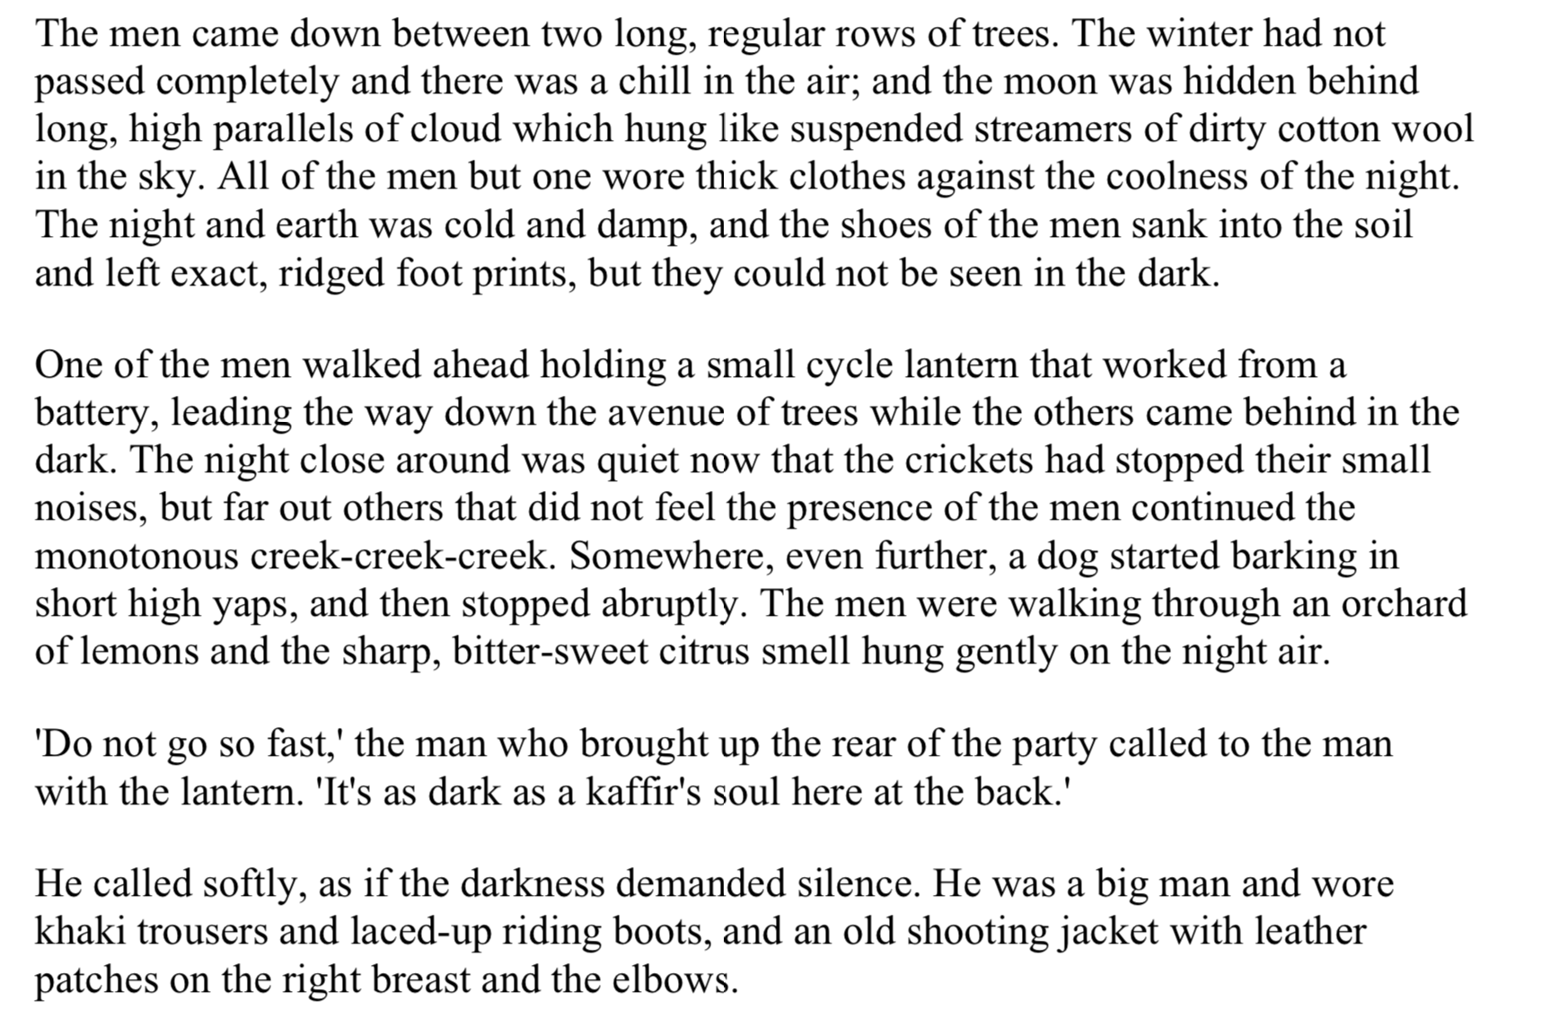
What is established in paragraph 1? If you are going to look at how the rest of the extract is structured, you must start by analysing the beginning.
Do this in your groups – 7 minutes.
Activity 1
What is the mood/tone?
Who is introduced? How are they described?
What kind of atmosphere is created?
How is the setting described?

Slide 7
Feedback and share ideas – move around the room and discuss your notes.
Do this in your groups – 7 minutes.
Activity 2
What is the mood/tone?
Who is introduced? How are they described?
What kind of atmosphere is created?
How is the setting described?

Slide 8
Analysing Structure: Q3
Date:
LO: To understand the requirements for question 3
To understand how to discuss structural techniques in detail
STARTER:
In your own words and without looking back at the extract, write down how the extract we looked at yesterday began. Try and include as much information as you can!
Notes:
Pupils can exchange books and check to see if their partner missed anything out. This could be a verbal activity.

Slide 9
Now we will look at how the text develops.
Do this in your groups – 10 minutes.
Activity 2
As you move on from paragraph 1, think about the changes and developments. In your groups, label the extract with the structural features.
Try and find as many as you can! Some may appear more than once.
Once you think you have found them all, join up with another group and share your ideas.
Extension: are there any other structural techniques that you can find? Think back to the list we created at the beginning of the unit.
Notes:
This activity is aimed at enabling pupils to feel confident finding and talking about structure. This is the practice insert (lemon orchard) which is in the bundle. The extract used for this activity is on the next slide, you can find the worksheet in the bundle.

Slide 10
Change in mood
Contrasts
Change in tone
Repetition
Links back to something stated previously
Notes:
You could blow this section up onto A3 so pupils can annotate around it.

Slide 11
Change in tone
Change in mood
Repetition
Now you have found the techniques, you must analyse the effect.
Questions to prompt analysis:
What causes the change in….?
Why does the writer do this?
How does it make the reader feel?
How do we view the character/action/setting?
What is repeated?
Why is it repeated?
When is it repeated? At which points?
What is the effect?
How is this created?
You can created your own questions for any technique! Just use ‘what’, ‘how’ & ‘why’.
Links back to something stated previously
Notes:
You could blow this section up onto A3 so pupils can annotate around it.

Slide 12
Thank you for downloading this resource; I hope it is useful! You can find the full SoW on my website.

