Slide 1
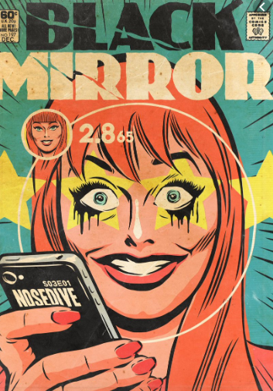
‘Black Mirror’ analysis sheet: Nosedive
Character/s | Themes | Conflict | Plot | Significant scenes- analysis | Links to 1984

